Slide 1
English
Tuesday 10th November

Slide 5
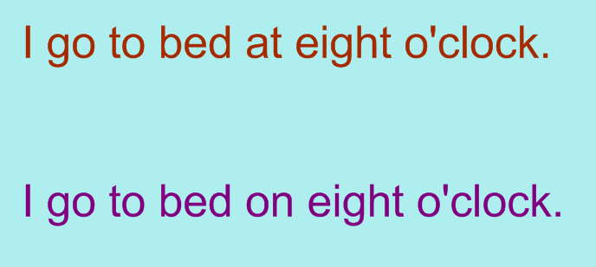

Slide 6
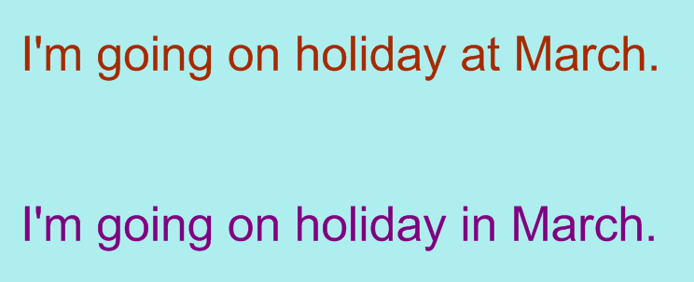

Slide 8
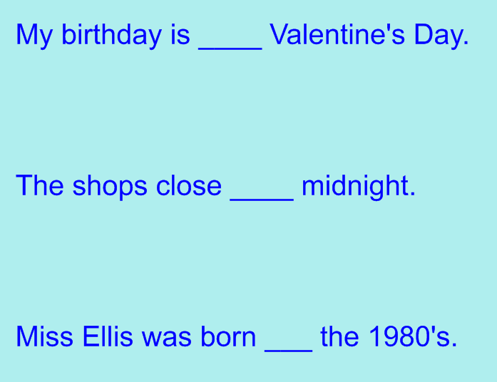

Slide 9
on
at
in

Slide 10
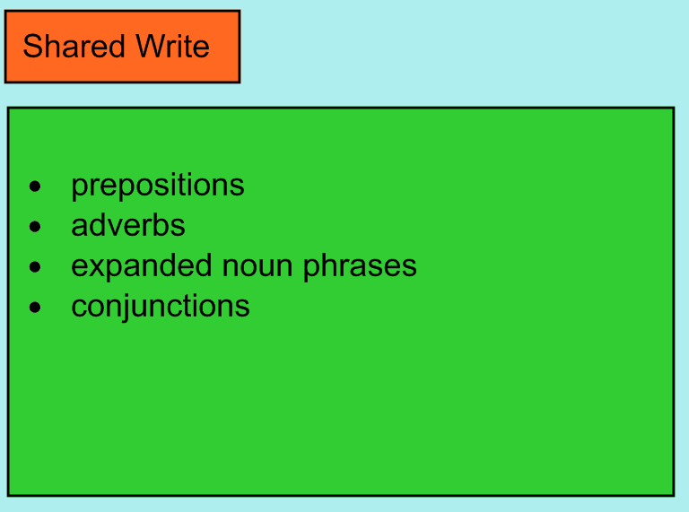

Slide 11
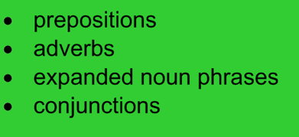
A creepy mummy escapes from a pyramid in Egypt.
Everyone must leave the city of Cairo by nightfall or be destroyed!
One dark stormy night the was a tremendous crash as a noisy, raging mummy escaped from the pyramids of egypt. It immediately made its way to the city of Cairo. the mumy wailed deafeningly at everyone in the streets and ordered them to leave the city. It added evilly that anybody left in the city by nightfall wood be destroyed.

