Slide 1
First turn the volume on!
2.
1.

Slide 2
To start the PowerPoint follow these steps…
1.
2.

Slide 3
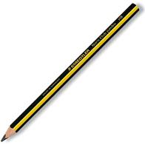
Are you organised?

Slide 4
Starter

Slide 8
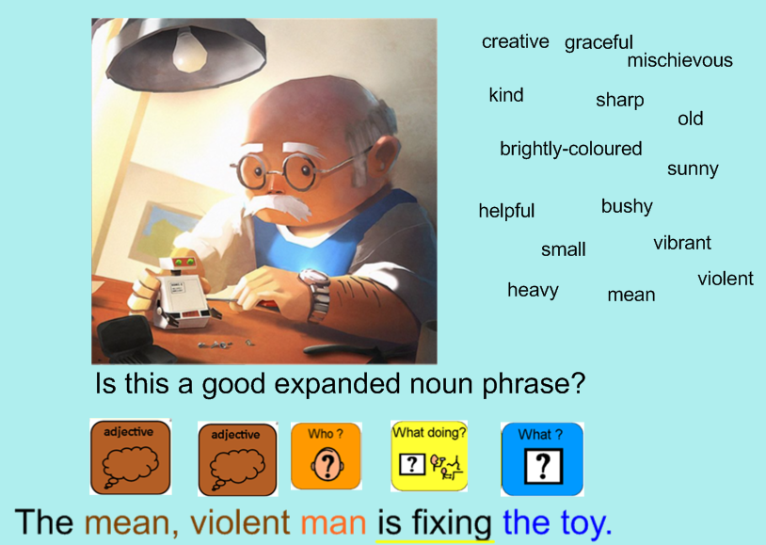

Slide 9
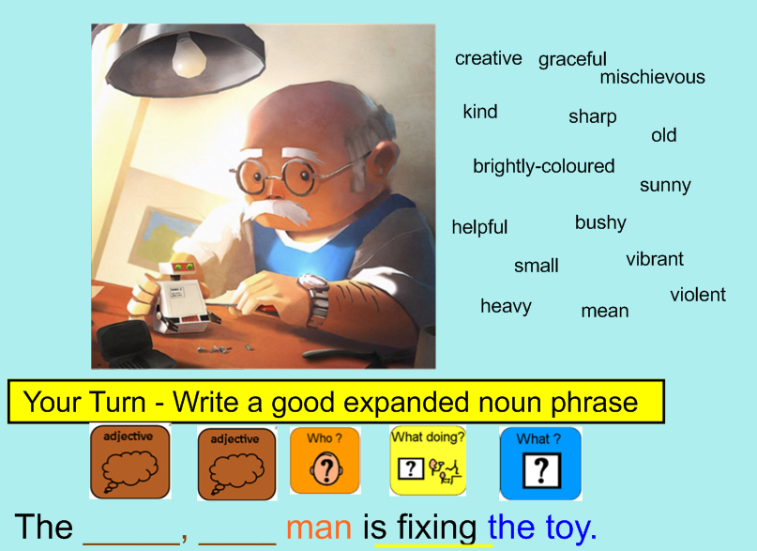

Slide 10
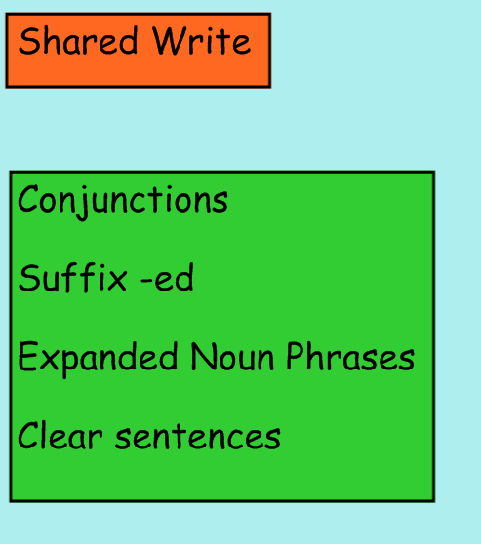

Slide 11
Friday 2nd October 2020
Shared Write

Slide 12
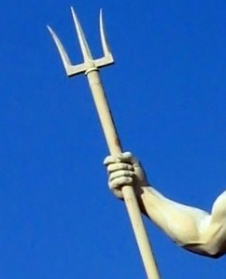
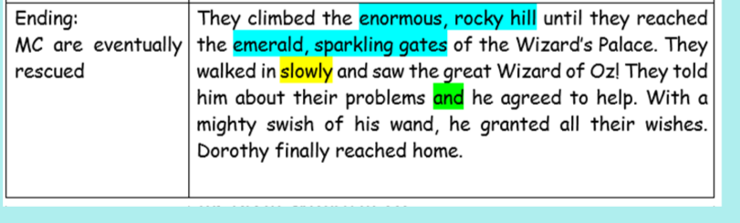
Paragraph 5
Underwater Palace
Magical object: trident

Slide 13
Friday 2nd October 2020
Shared Write
They swam towards the enormous, green palace until they reached the sparkling gates. The opened the gates and swam in slowly. They saw the mysterious, strong mermaid sitting on her throne. They told her about their problems and she agreed to help. With a mighty swish of her trident, she granted all their wishes. Safah finally reached home.

Slide 15
sbibi@peelpark.bradford.sch.uk

