Slide 1
English
Thursday 12th November

Slide 2
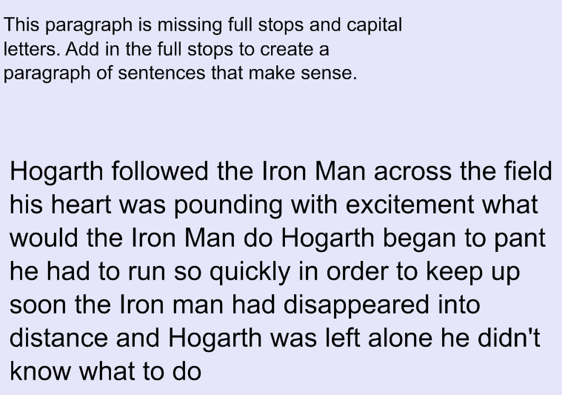

Slide 3
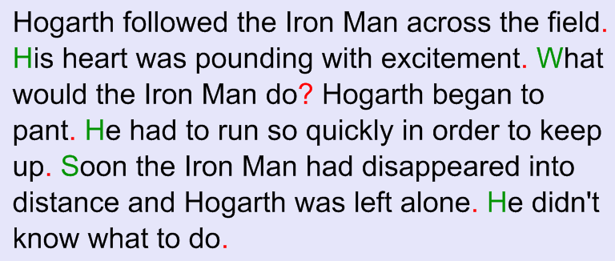

Slide 5
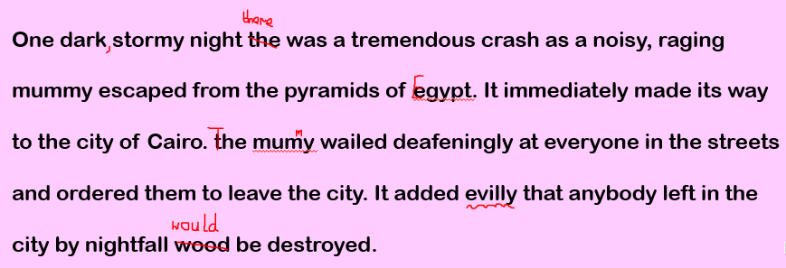
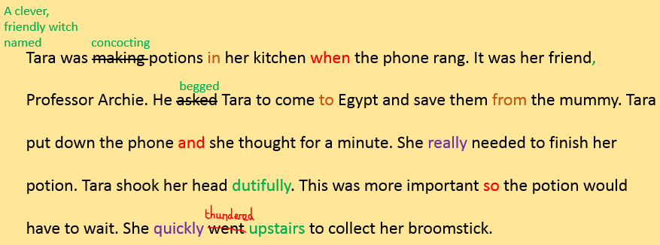

Slide 6
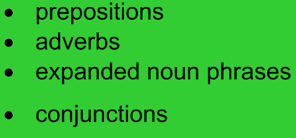
Tara flies to Egypt on her broomstick.
She finds the mummy at a shopping centre and asks him to go home.
He roars and starts to charge.
Tara set off to Cairo in search of the monstrous mummy. She urged her broomstick to fly faster as she didn’t have much time left. The city was deserted when she arrived. All of a sudden, she heard a tremendous clatter coming from the shopping centre behind her. The witch bravely marched inside to confront the mummy.
“It’s time to go home,” declared Tara.
The mummy spun around to face the witch and growled in rage. It began to charge towards the young witch.

