Slide 1
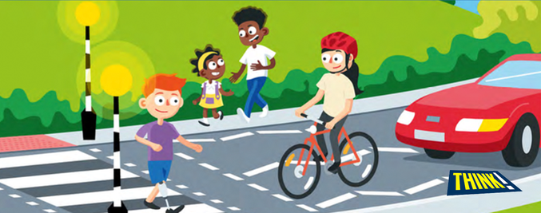
Road Safety

Slide 2
Pedestrian
Who is a pedestrian?
Is this pedestrian safe?

Slide 3
Around 200 children are hurt on the roads in Bradford every year!
The three main ways are:
As a pedestrian – hit by a car
As a car passenger
As a cyclist
Notes:
200 children – give the children an idea of how many this is – more that 6 classes of children.
Can they think of the different ways people can be hurt on the road?
Highest number is often as pedestrians, followed by in cars.
This session concentrates on keeping safe as pedestrians.

Slide 4
Let’s watch this video:
https://vimeo.com/261362528
There are questions to answer throughout the film, when the symbol appears please pause the film and discuss the possible answers with your class.
Notes:
Password: Training

Slide 5
Q1. What are the rules that help us cross the road safely?
Q2. Can you name any safe places to cross the road?
Q3. When the green man shows at a Puffin crossing, what should you do?
Q4. What do you need to do before stepping in to the road when crossing between parked cars?
Q5. Where do you need to look when crossing the road at a T junction?
Q6. Can you think of anything else that might stop you from being able to see the road clearly?
Notes:
Answer on the sheet attached

Slide 6
What is the set of rules called that we use to cross the road?
The Green Cross Code

Slide 7
The Green Cross Code
Find a safer place
Stop on the pavement behind the kerb
Look all around for traffic
Listen for traffic. Sometimes you can
hear traffic before you see it
Think is it safe to cross the road?
Arrive Alive
Keep Looking, Listening and Thinking while you cross – do not run!

Slide 8
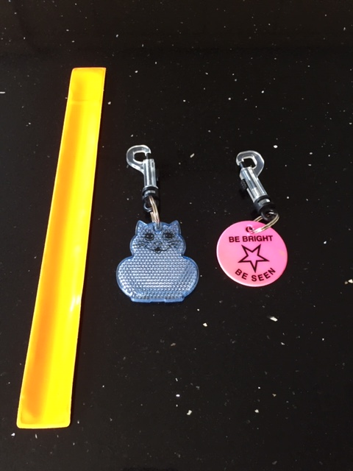
What do we call materials which help you to be seen by traffic at night?
Reflective
Be Bright Be Seen!
Notes:
Fluorescent – for daytime
Reflective – for the dark

Slide 9
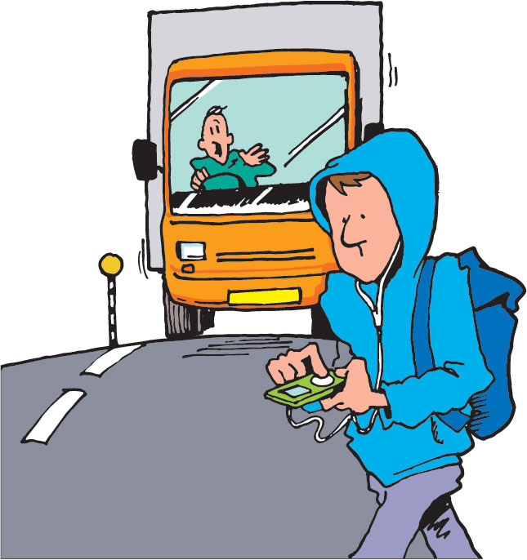
Is this the correct way to cross the road?

Slide 10
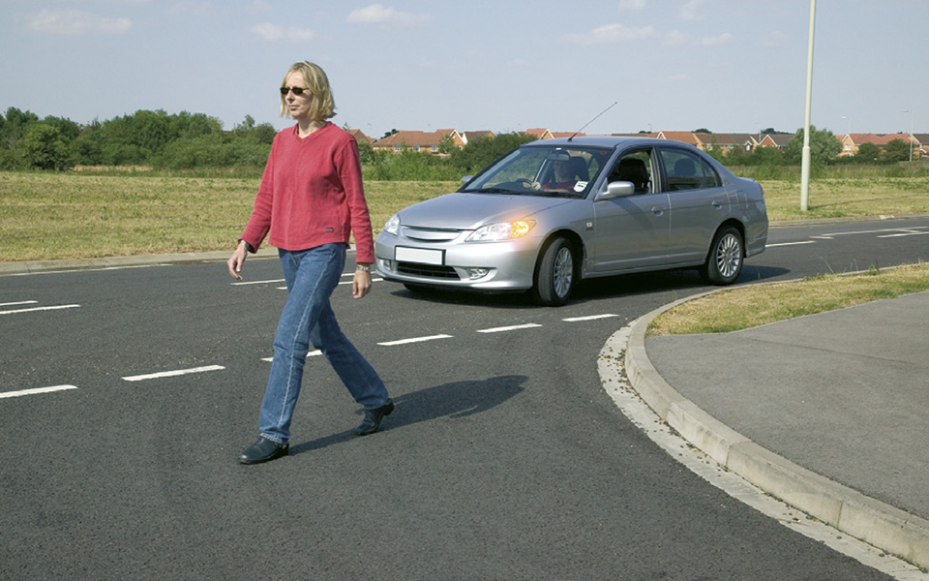
Is this the correct way to cross the road?

Slide 11
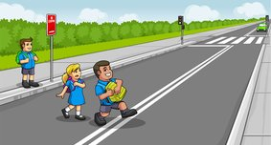
Is this the correct way to cross the road?

Slide 12
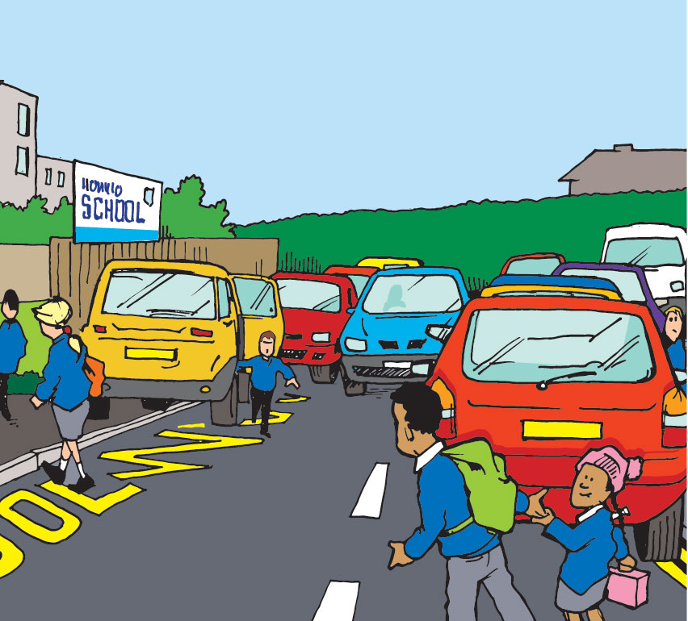
Is this the correct way to cross the road?

Slide 13
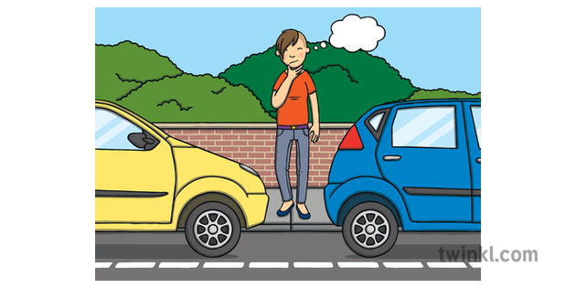
Is this the correct way to cross the road?

Slide 14
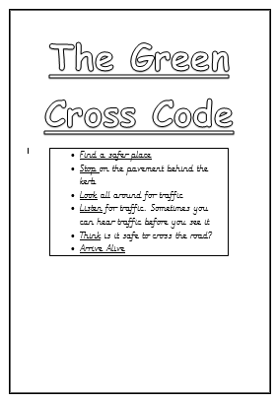
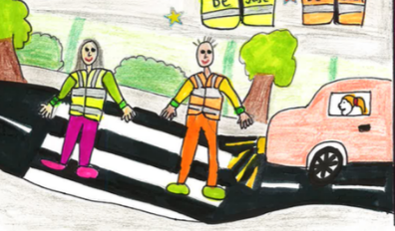
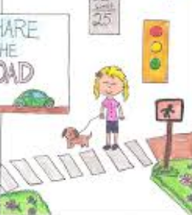
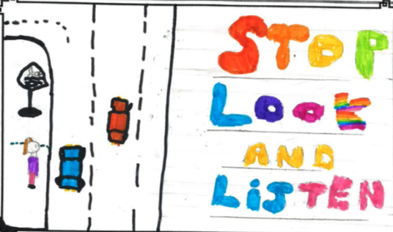
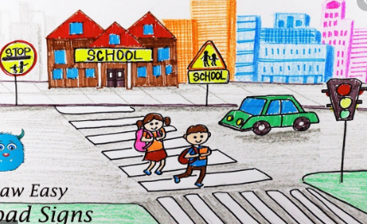
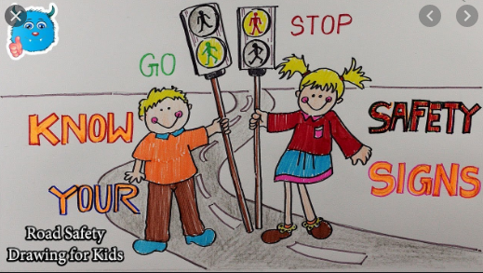
Poster
Draw images of scenes that show the correct way of crossing the road

