Slide 1
Guided Reading
Friday 6th November

Slide 2
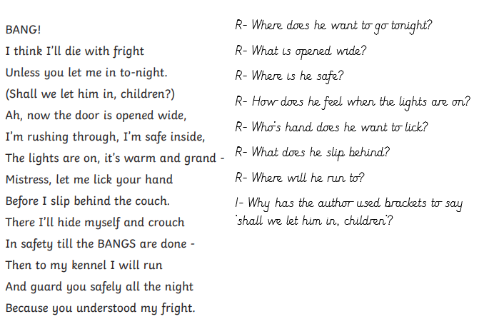
Read the rest of the poem that we started yesterday.
Then answer the questions in your red book.

