Slide 1
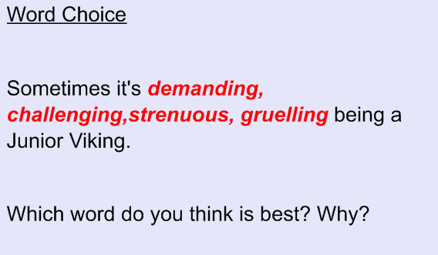
Starter

Slide 2
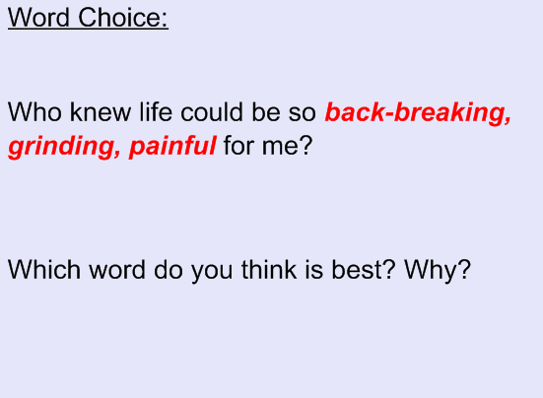

Slide 4
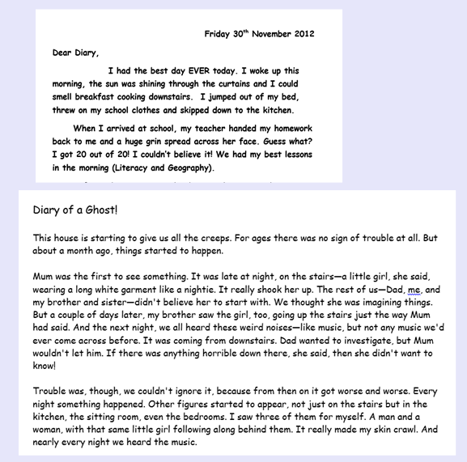
Which diary is better and why?

Slide 6
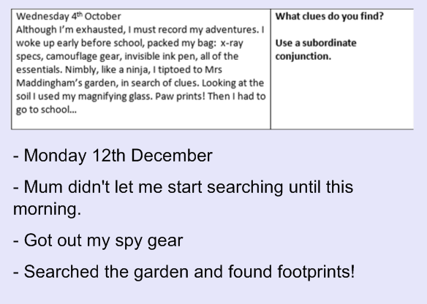
Write paragraph three using your planning sheet.

Slide 7
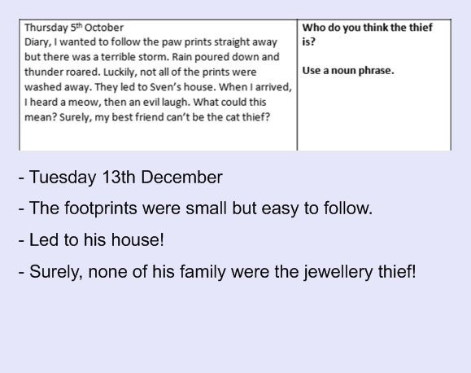
Write paragraph four using your planning sheet.

Slide 8
Don’t forget to edit your two paragraphs. Remember to refer to the Writer’s Toolkit.

