Slide 1
Thursday Maths Lesson

Slide 2
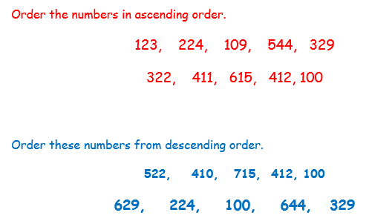
Maths Drill
Circle the biggest number:
124
396
742 724

Slide 3
Number of the Day
427
Count on in tens
Ten less
One more
Is this number even or odd?
Partition number
Hundred more
Hundred less
Count in ones

Slide 4
Subtraction with exchanging
Make the number
Subtract the ones
Subtract the tens
Subtract the hundreds
Exchange if necessary

Slide 5
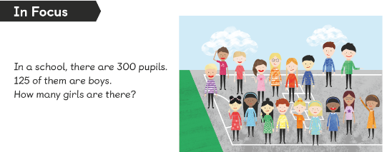
In focus
Let’s recap. How did you work this out yesterday? What steps did you follow?

Slide 6
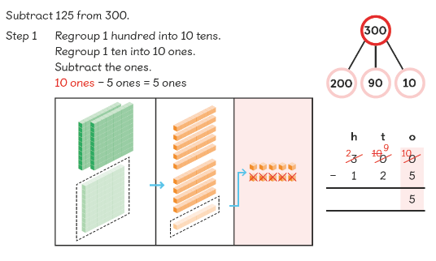
Step 1: subtract the ones. If you can’t, exchange from the tens column. If you don’t have any tens, exchange 1 hundred for ten tens. Then subtract the ones
Let’s Learn

Slide 7
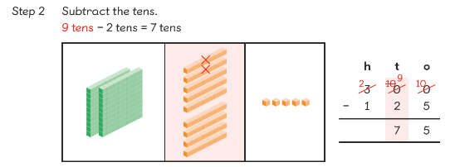
Step 2: Subtract the tens.
Let’s Learn

Slide 8
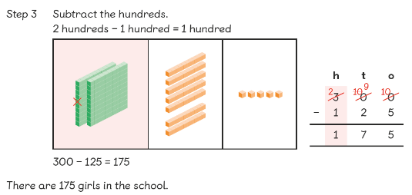
Step 3: Subtract the hundreds.
Let’s Learn

Slide 9
Guided Practice
H T O
1 0 0
7 2
H T O
3 0 0
4 9
H T O
5 0 0
1 7 2
H T O
8 0 0
5 6 9
-
-
-
-
Work this out using column method

Slide 10
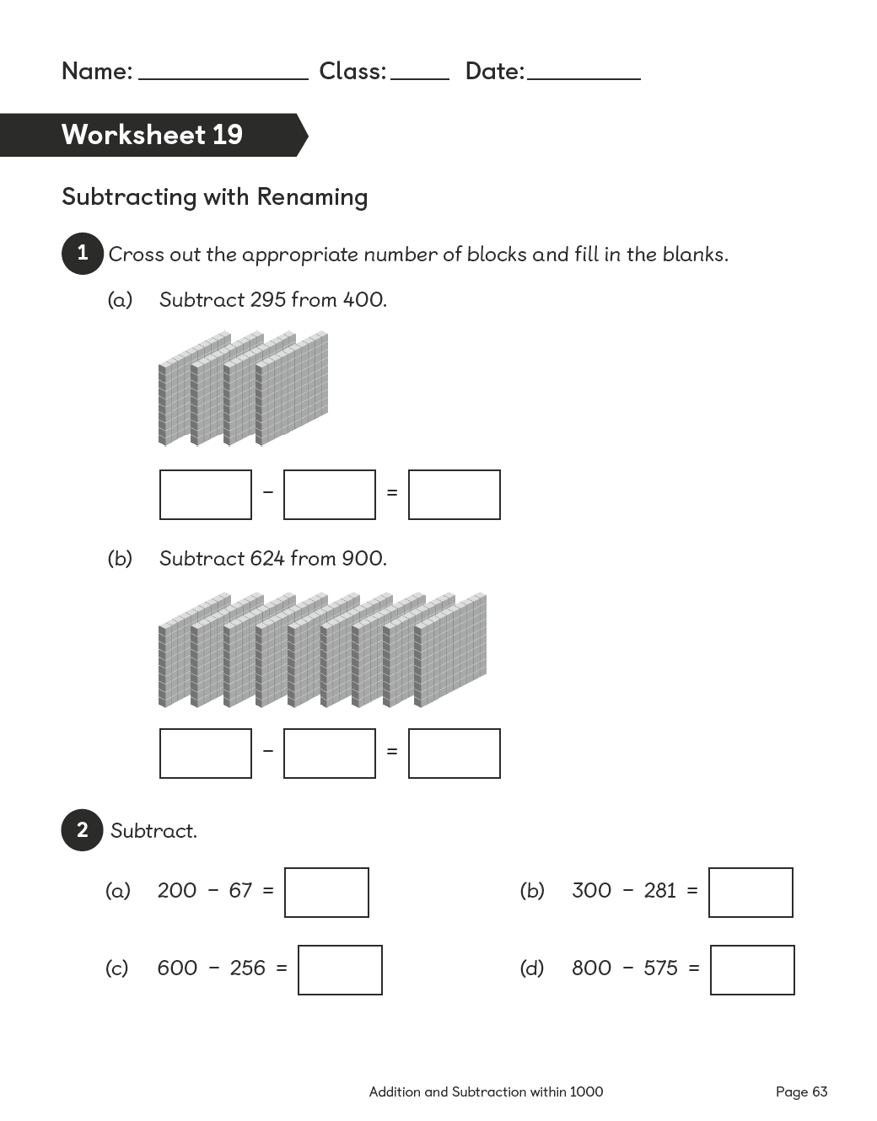
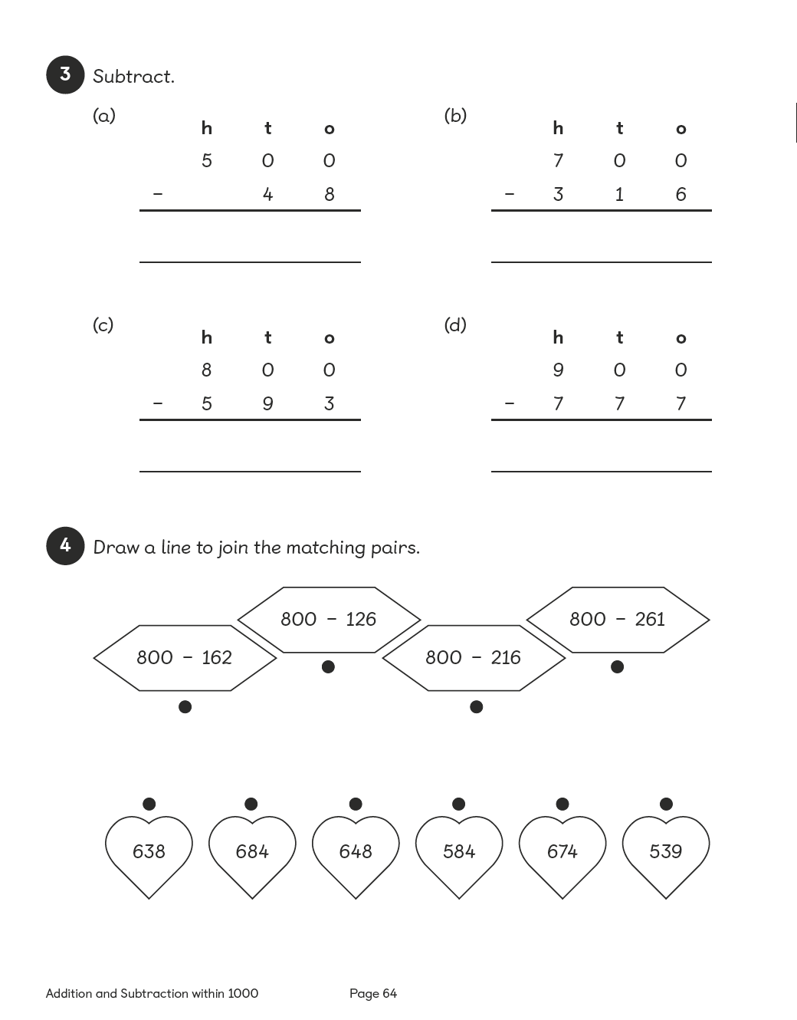

Slide 11
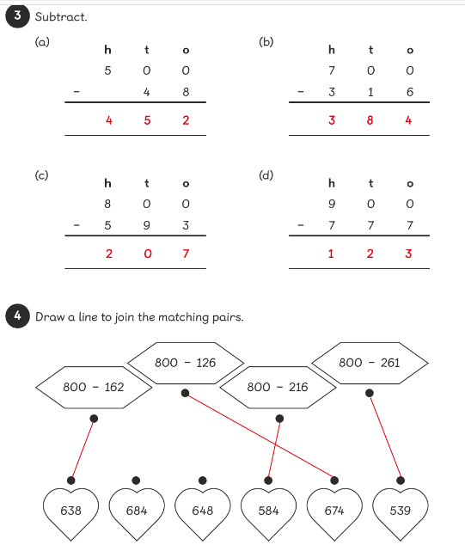
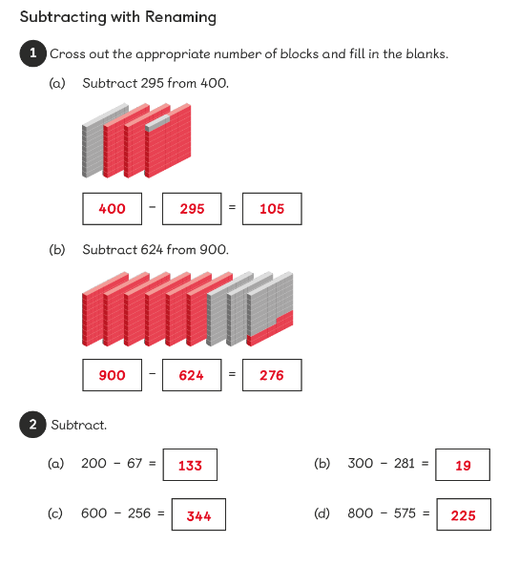
Answer

Slide 12
Extension
H T O
1 0 0
7 2
H T O
3 0 0
4 9
H T O
5 0 0
1 7 2
H T O
8 0 0
5 6 9
-
-
-
-
My friend says it is easier to work this out using this method. She says subtraction means ‘difference’ so if you take away one from the top number and the bottom number and the answer will be the same.
H T O
9 9
7 1
H T O
2 9 9
4 8
H T O
4 9 9
1 7 1
H T O
7 9 9
5 6 8
-
-
-
-

Slide 13
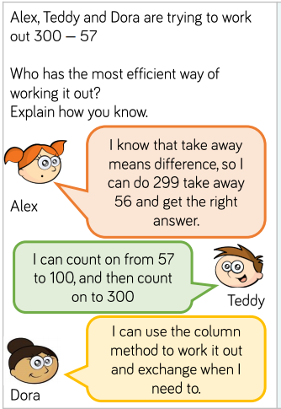
Extension

