Slide 1
Thursday 26th November

Slide 3
2279230
22792300
22792.3

Slide 4
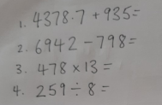

Slide 5
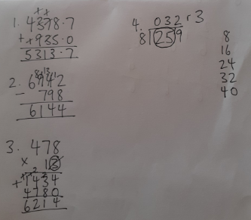

Slide 7
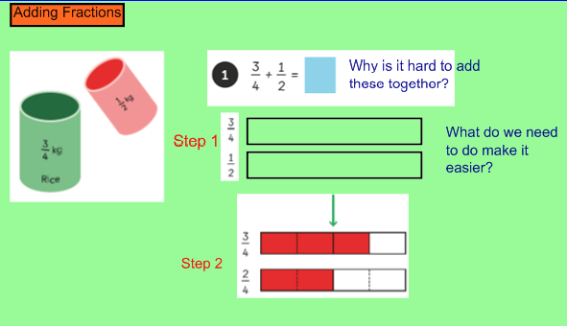

Slide 9
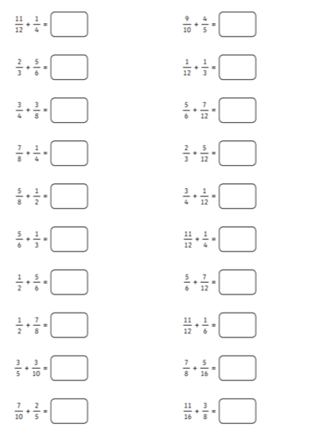

Slide 10
