Slide 2
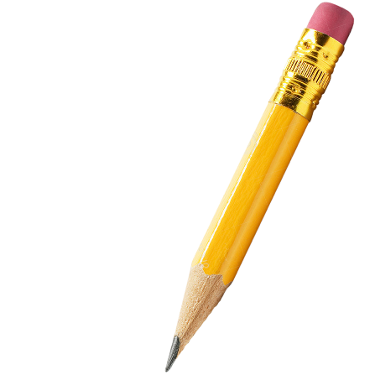
Maths Drill
3x3=
4x4=
5x3=
221+321=
50+72=
100-25=
Challenge:
40 children need 4 pencils.
There are 10 pencils in one box.
Write down the correct number of boxes of pencils that would be needed.
4 10 2 5

Slide 3
Number of the Day
Is the number odd or even? Explain why.
Add 10
553
Partition the number
Add 8
Add 100
Subtract 20

Slide 4
Multiplying by 4
To be able to understand and learn the 4 times table
Make equal groups of 4
Count up in 4s
Use drawings and representations to aid learning

Slide 5
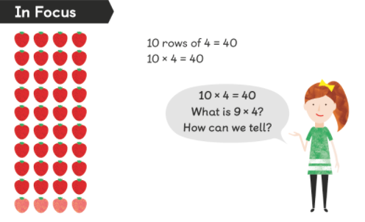
In focus
What is the first step you think we should take?
Discuss with your learning partner what you will do.

Slide 6
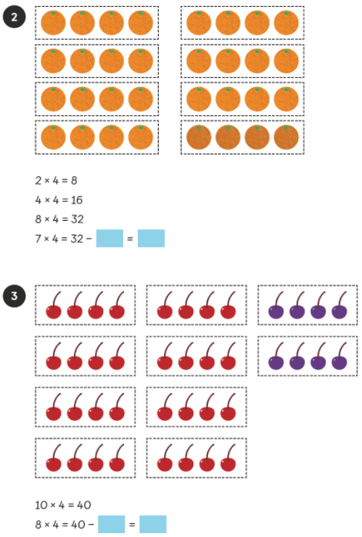
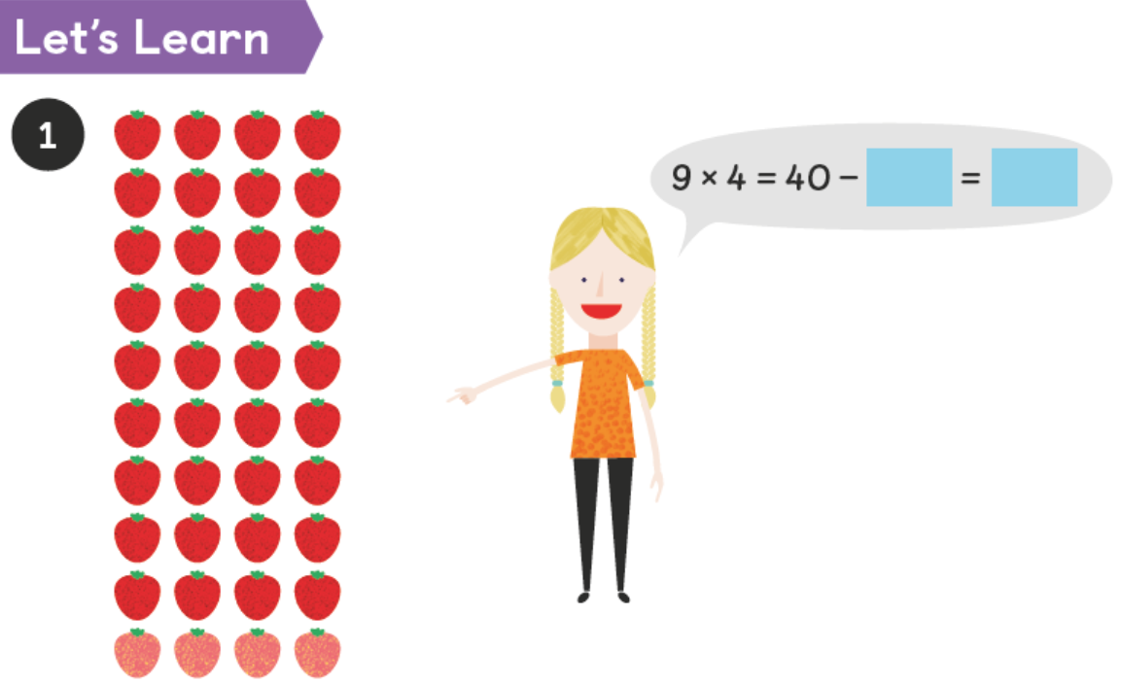
Let’s Learn
What methods could we use to find the answers?
Discuss with your talk partners.

Slide 7
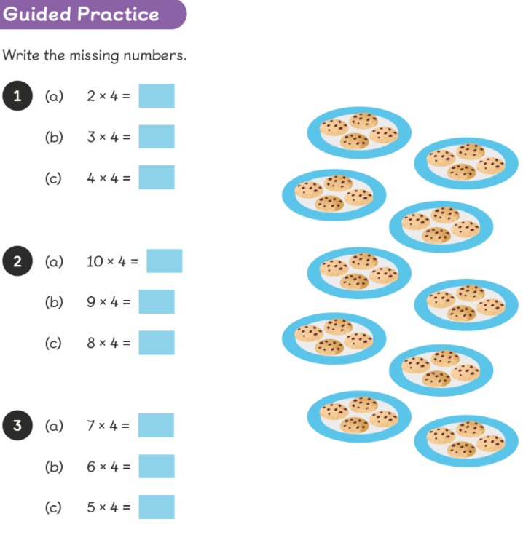
Guided Practice

Slide 8
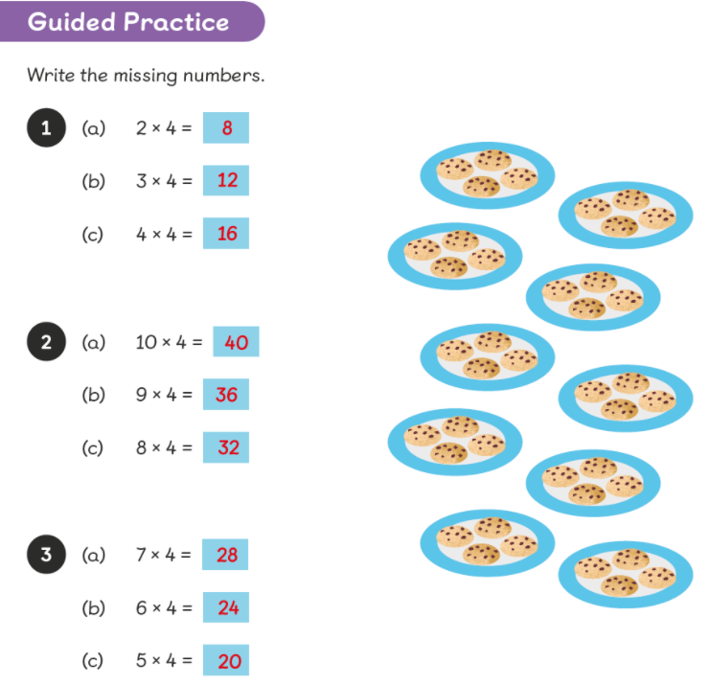
Guided Practice Answers:

Slide 9
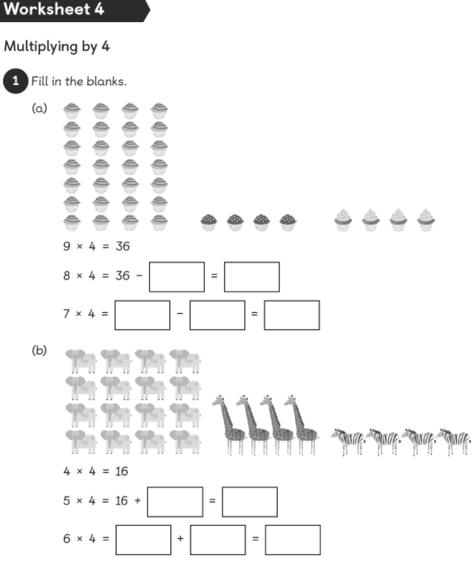
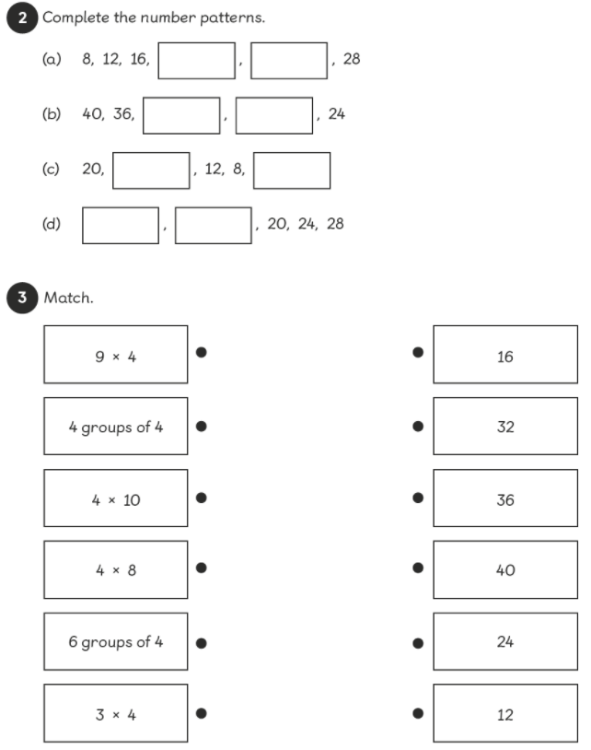
Page 87-88
Complete the pages in your Maths No Problem books.

Slide 10
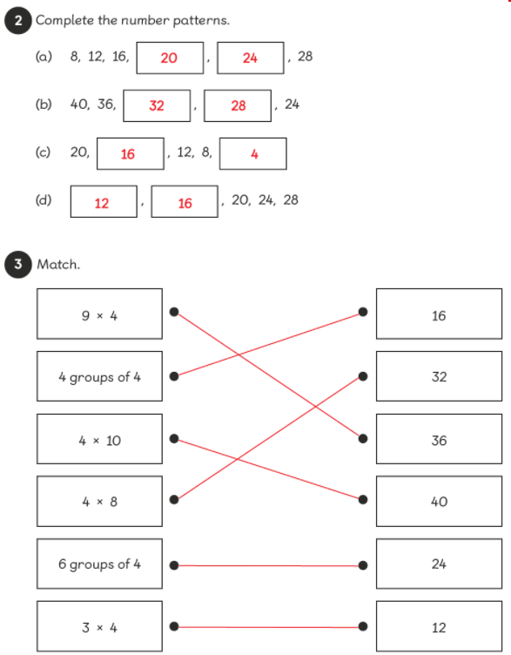
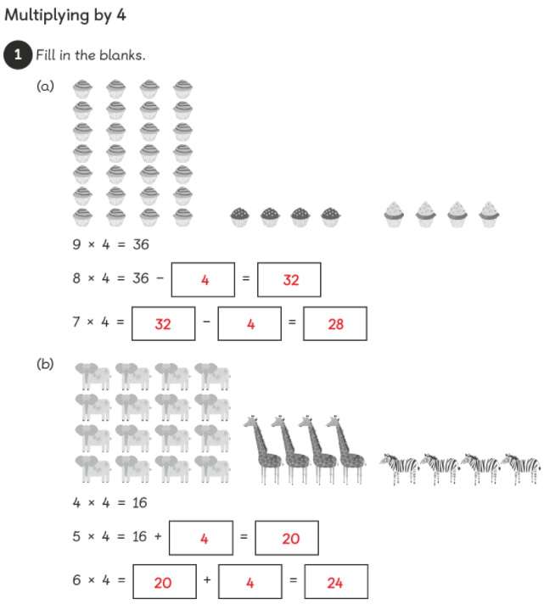
Answers

Slide 11
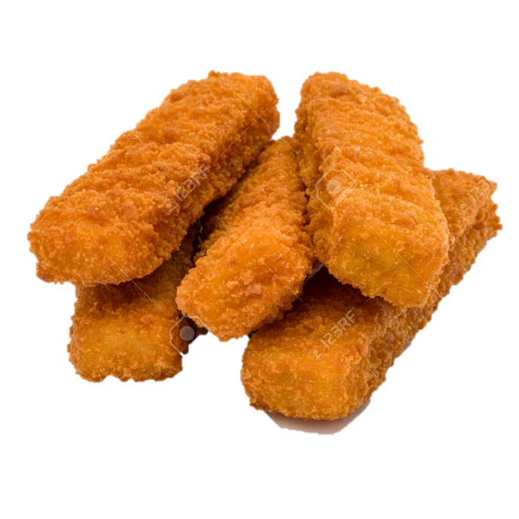
Extension
1. Ben wants to buy 4 lollies for each of his twelve friends.
How many lollies will he need to buy? ____________
2. Tom has 4 friends over for tea. They have 3 fish fingers each.
How many fish fingers does Tom’s mum have to buy for his friends? ___________

Slide 12
Extension
1. Ben wants to buy 4 lollies for each of his twelve friends.
How many lollies will he need to buy? 48
2. Tom has 4 friends over for tea. They have 3 fish fingers each.
How many fish fingers does Tom’s mum have to buy for his friends? 12

