Slide 1
Guided Reading Tuesday
Lesson 2

Slide 2
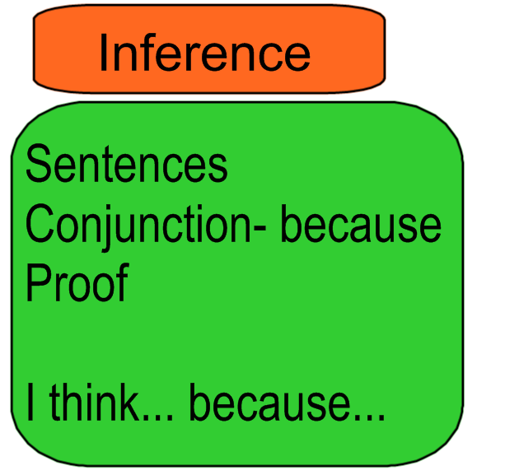

Slide 4
