Slide 1
Wednesday 30th September 2020

Slide 2
Predict

Slide 3
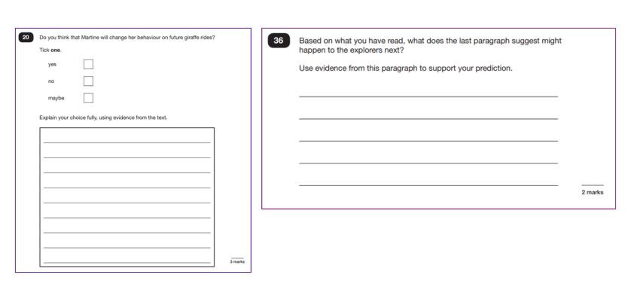
Predicting involves making a logical and reasonable guess about what might happen next.
Examples of SATs prediction questions:
Your answer needs to be supported with evidence from the text.
I think....because it says..

Slide 4
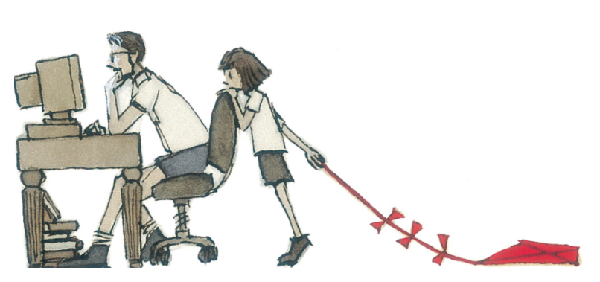
What can you see?
What can you infer?
What do you predict will happen?

Slide 5
man, computer, girl, kite, books, table, chair.
What can you see?
What can you infer?
What do you predict will happen?
Justify with evidence. For example, I think the man is well-read because he has a pile of books under his desk.
Justify your answer. For example, I predict that the girl will ask the man if he will play with her because she is dragging the kite behind her and looking at him longingly.

Slide 6
Based on this front cover, can you predict what the text will be about?

Slide 7
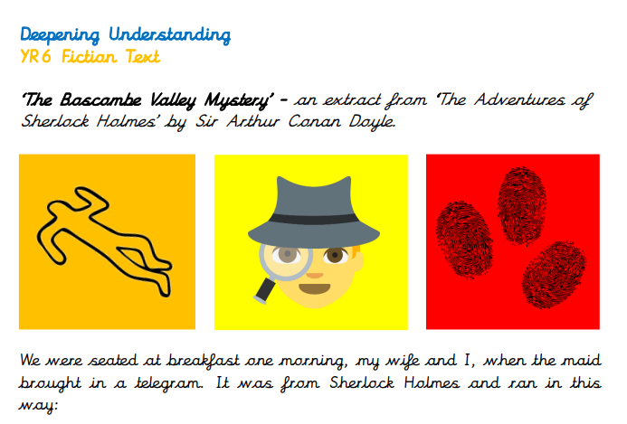
Answer the questions that accompany the text “The Bascambe Valley Mystery.”
Check the next slides and correct your answers as required.

Slide 8
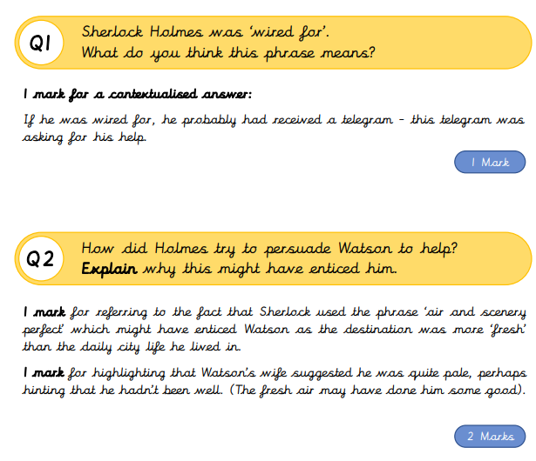

Slide 9
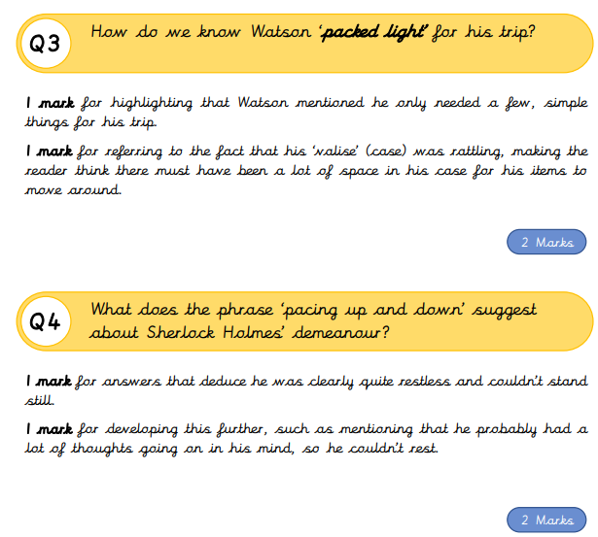

Slide 10
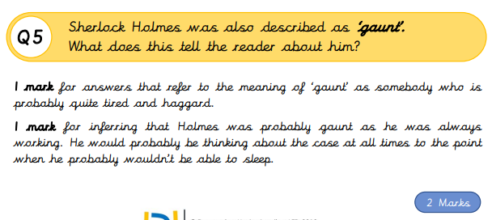
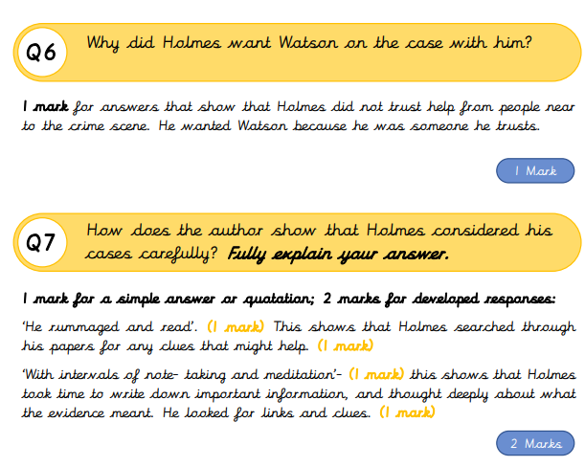

Slide 11
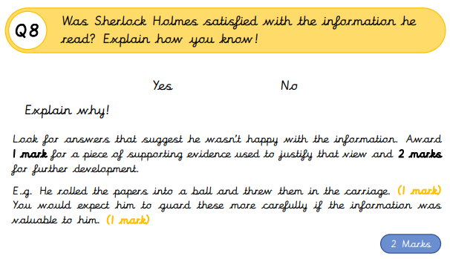
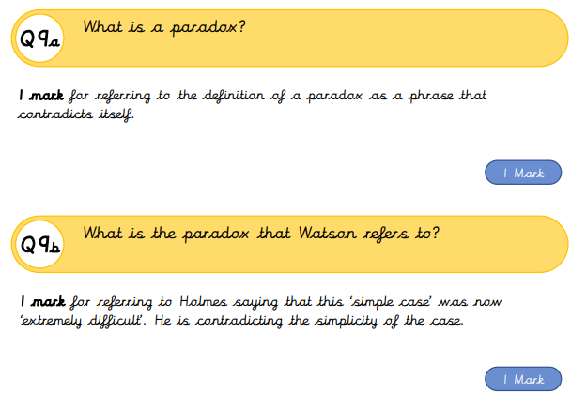

Slide 12
