Slide 1
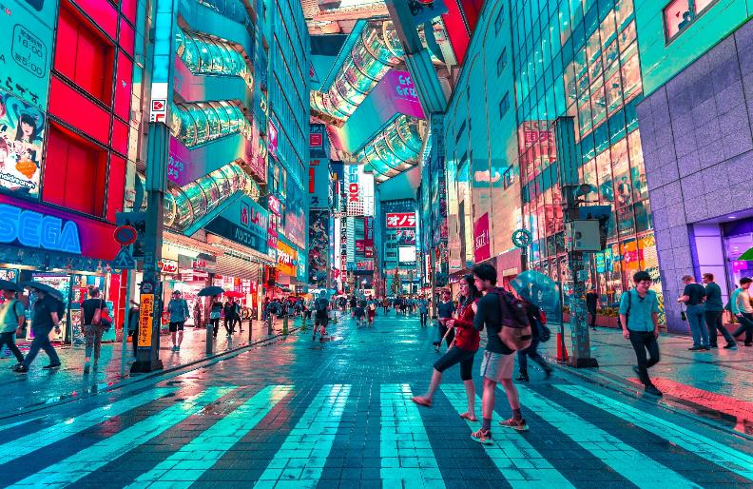
VILLAGES, TOWNS & CITIES
YEAR THREE
AUTUMN 2

Slide 2
LESSON ONE WHERE ARE ALL OF THE WORLD’S PEOPLE?

Slide 3
https://www.worldometers.info/world-population/

Slide 4
8,000,000,000 Eight Billion

Slide 5
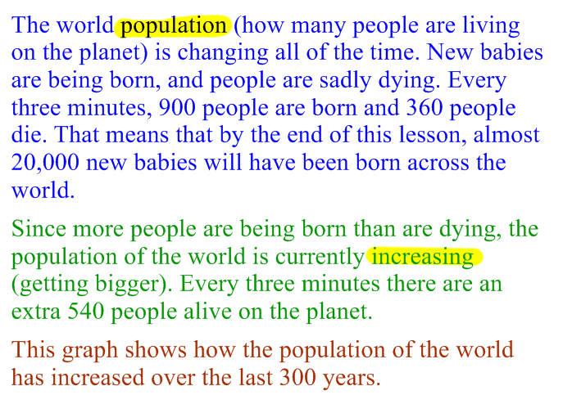
Are there more births or deaths every three minutes?

Slide 6
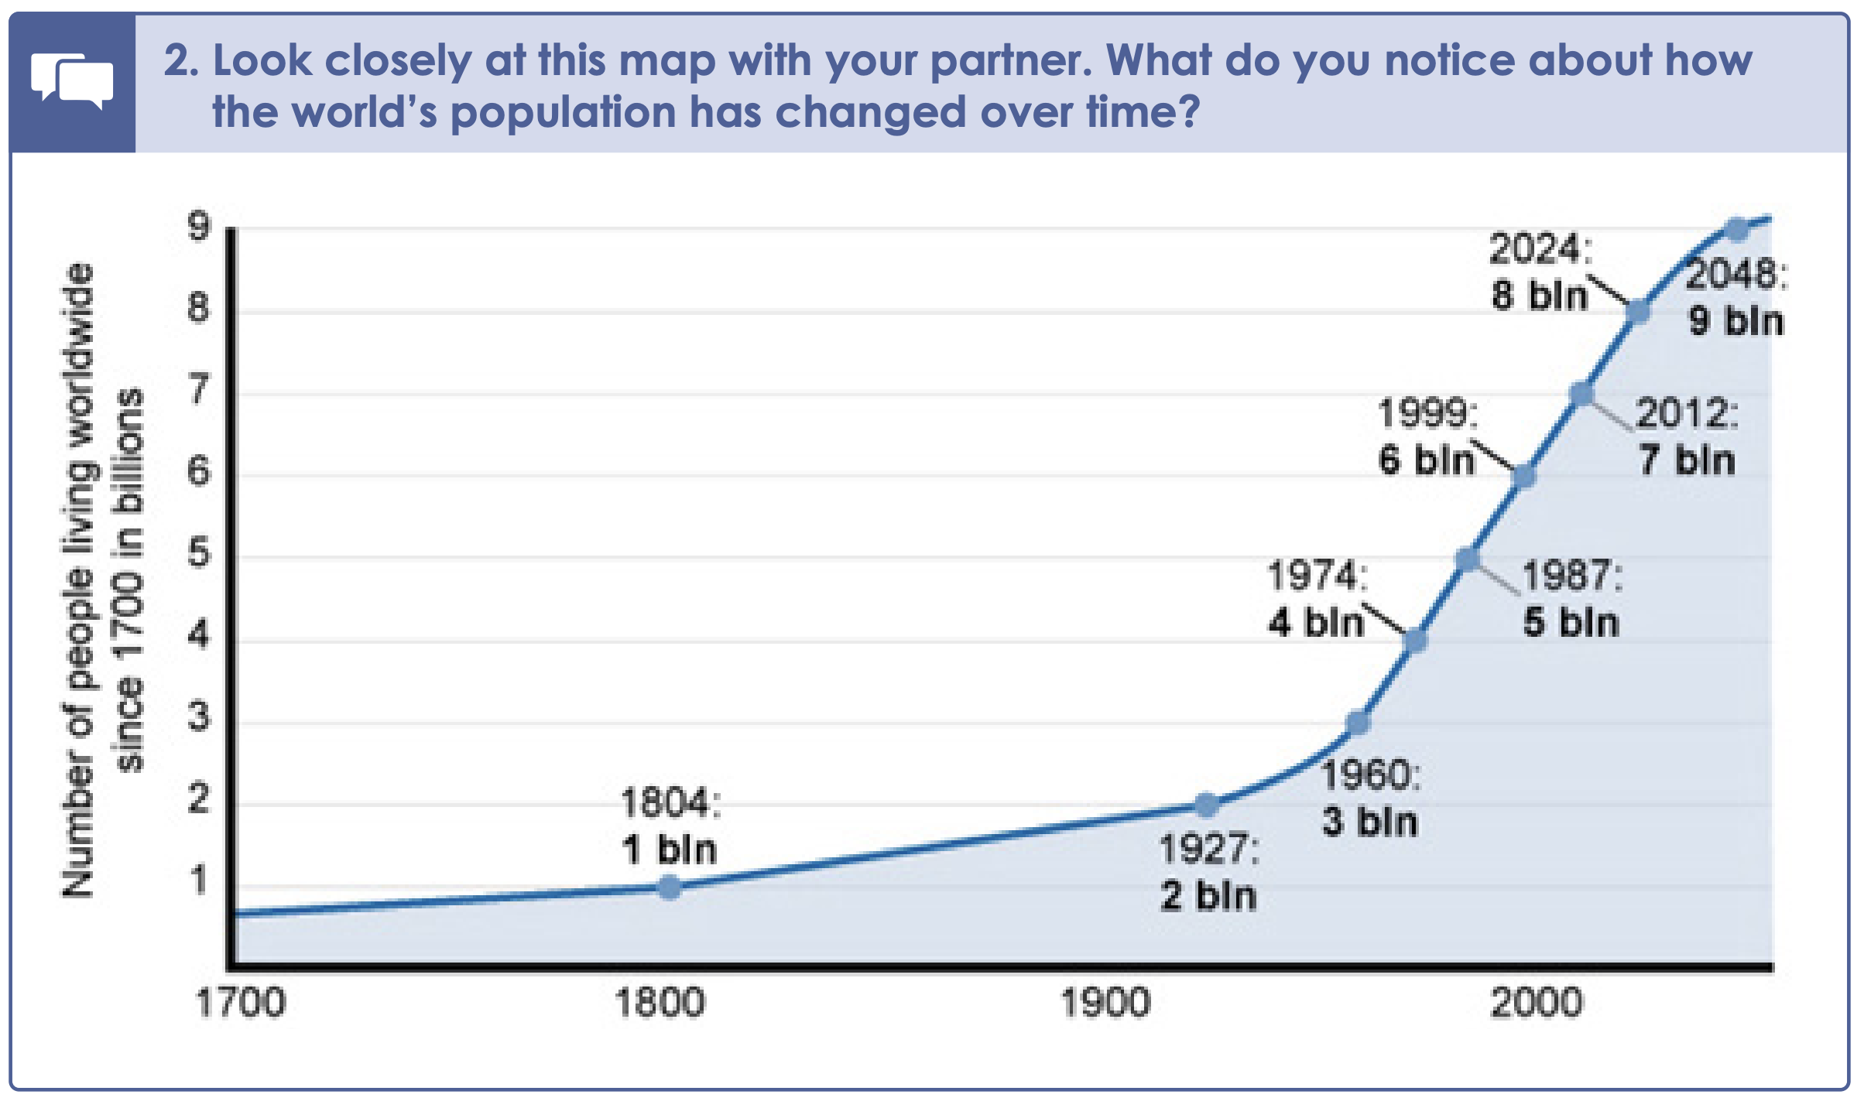

Slide 7
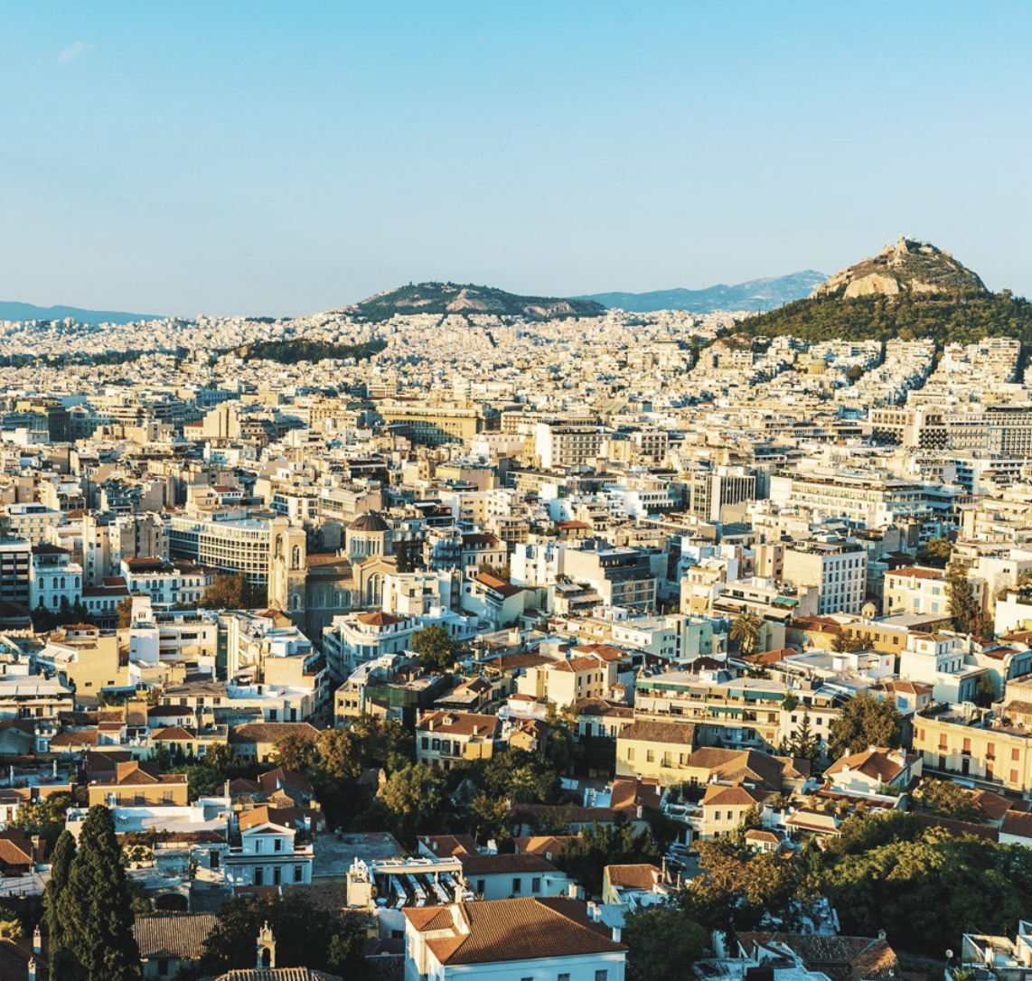
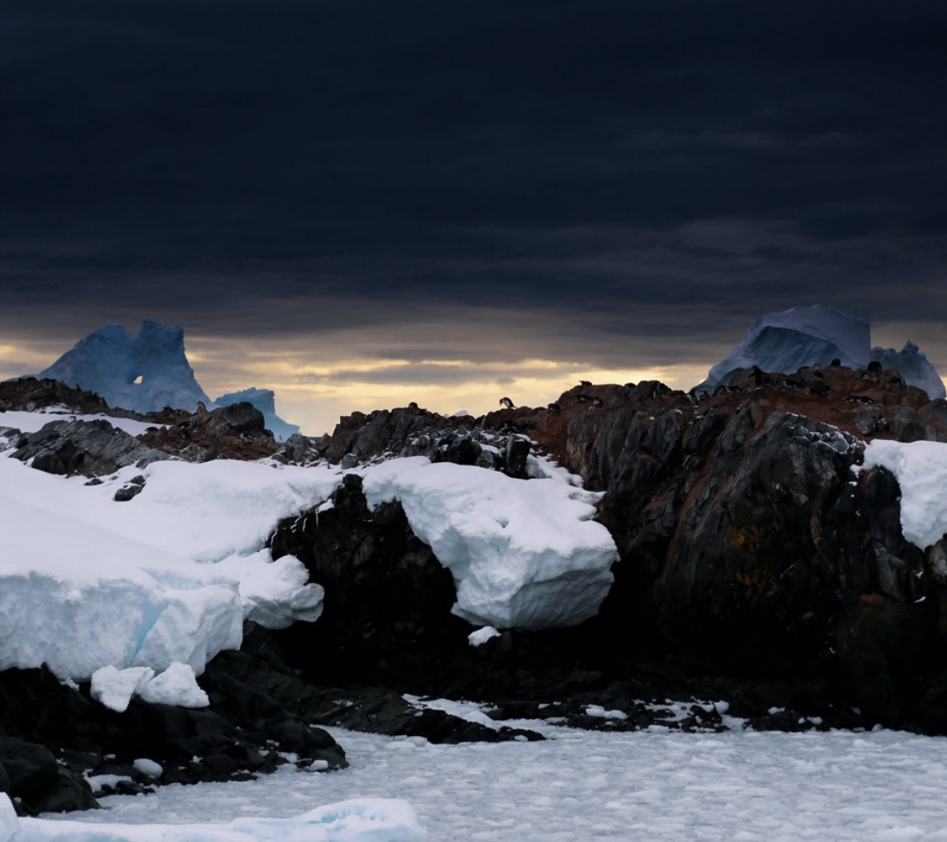
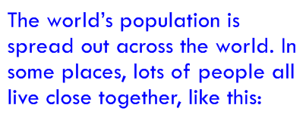
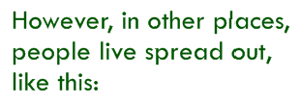
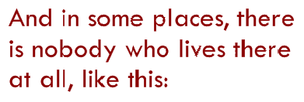

Slide 8
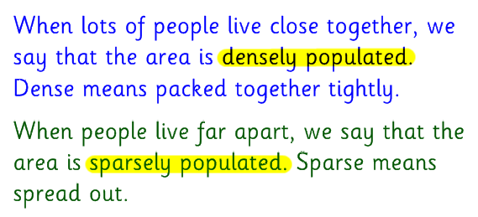
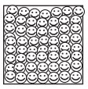
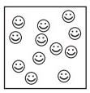
dense
sparse

Slide 9
Some places are more densely populated because …

Slide 10
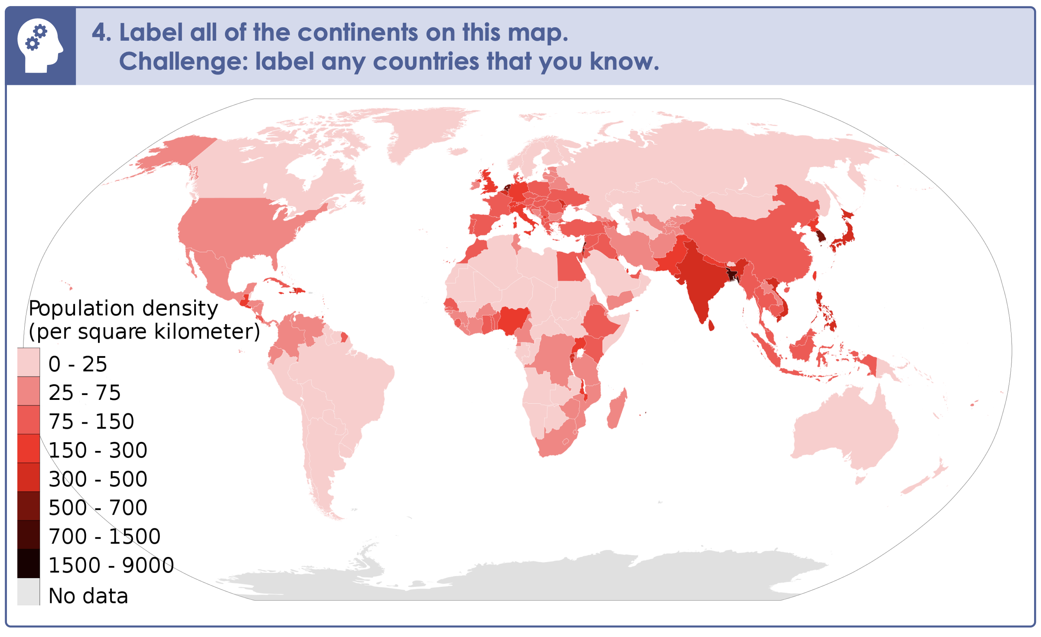

Slide 11
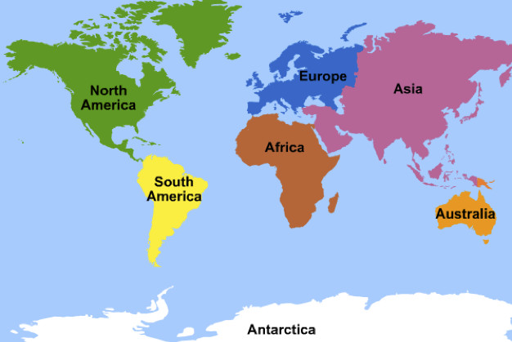

Slide 13
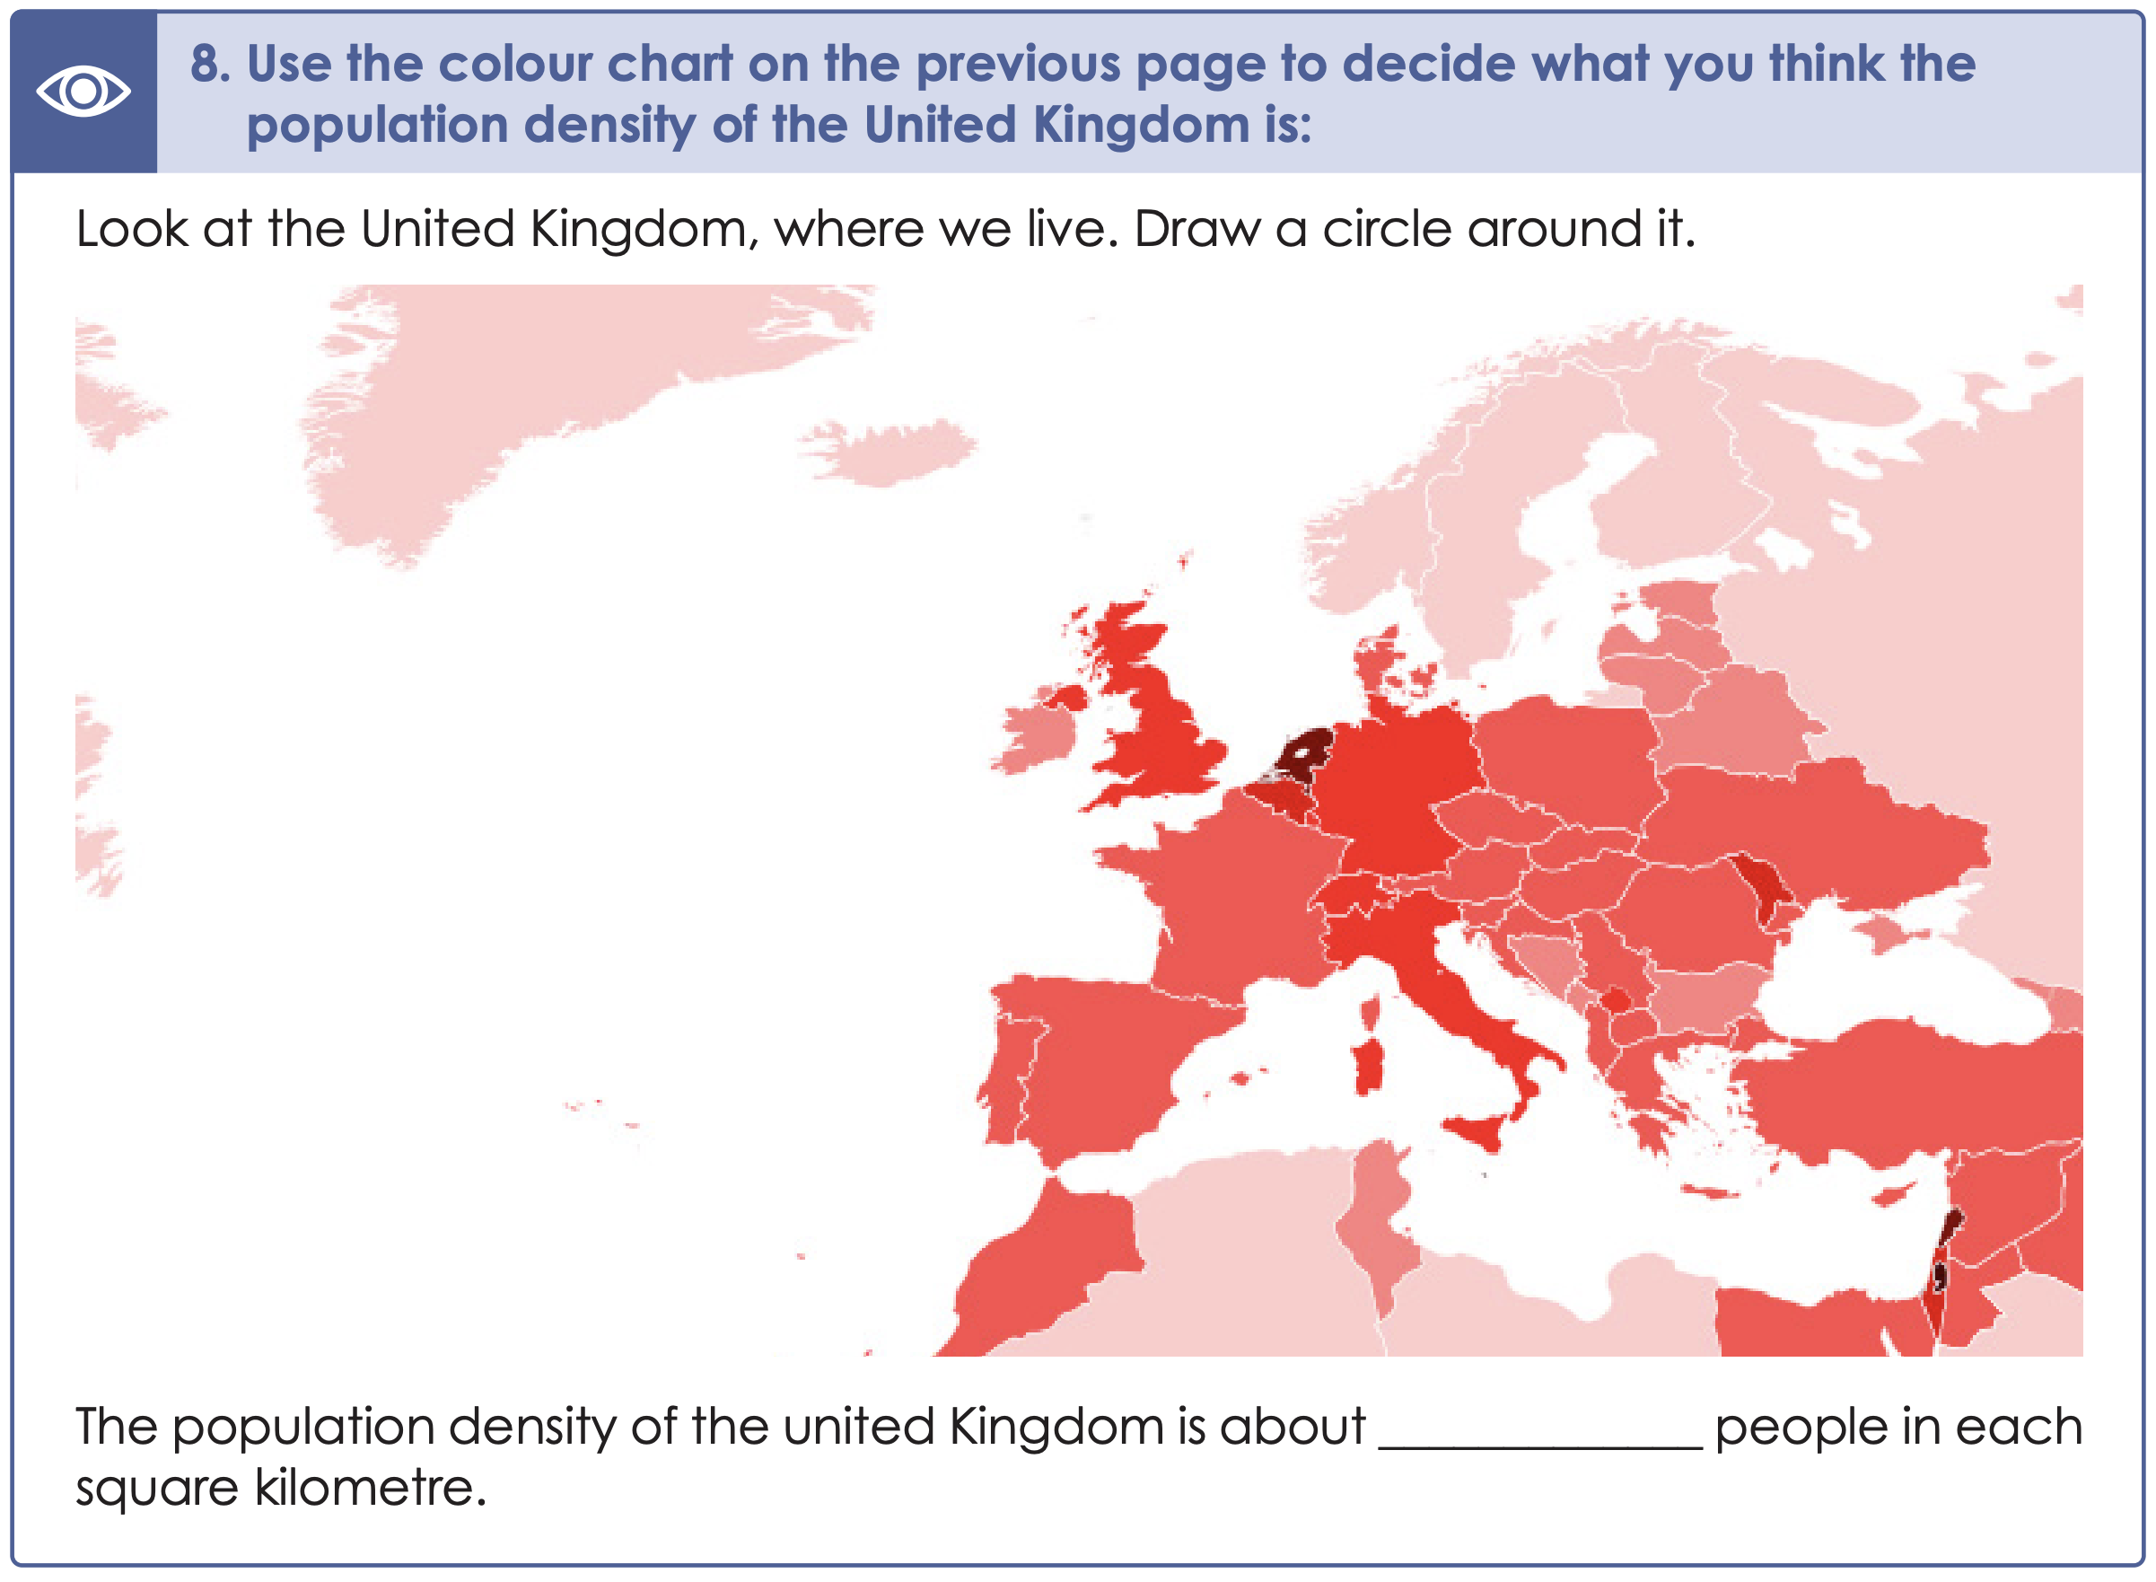

Slide 14
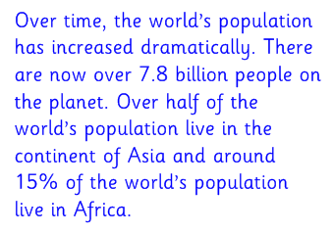
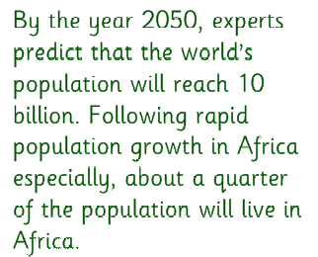

Slide 15
VILLAGES, TOWNS & CITIES
YEAR THREE
AUTUMN 2
Complete your learning review

