Slide 1
First turn the volume on!
2.
1.

Slide 2
To start the PowerPoint follow these steps…
1.
2.

Slide 3
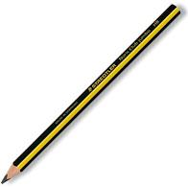
Are you organised?

Slide 4
25.9.20

Slide 5
Maths Drill
1. Write 20 in words
2. 23 + 7 =
7 + 3 + 5 =
3. 17 – 3 =
38 – 6 =
4. Represent these numbers with tens and ones:
12
35

Slide 6
Maths Drill - answers
1. Write 20 in words
twenty
2. 23 + 7 = 30
7 + 3 + 5 = 15
3. 17 – 3 = 14
38 – 6 = 32
4. Represent these numbers with tens and ones:
12
35

Slide 7
Number of the day...
20
1 less
1 more
partition
Add 4
Subtract 10
Challenge:
Complete this number sentence.
___ + ___ + ____ = 20

Slide 8
Number of the day - answers
20
1 less
1 more
partition
Add 7
Subtract 10
Challenge:
Complete this number sentence.
+ 9 + 1 = 20
+ 8 + 1 = 20
+ 7 + 1 = 20
19
21
10
13 + 6 + 1 = 20
20
27
12
8

Slide 9
Word of the day...
fewer

Slide 10
Greater Than and Less Than.

Slide 11
Recap...
Mr Greedy Crocodile
Likes to eat big amounts
Of ANYTHING!

Slide 12
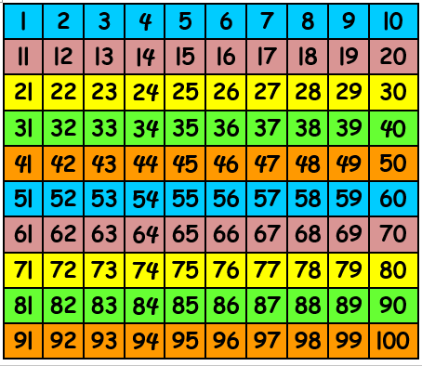
Two digit numbers
Which one will he eat?

Slide 13
Two digit numbers - answers
Which one will he eat?

Slide 14
Two digit numbers
Which one will he eat?

Slide 15
Two digit numbers - answers
Which one will he eat?

Slide 16
Two digit numbers
Which one will he eat?

Slide 17
Two digit numbers - answers
Which one will he eat?

Slide 18
Two digit numbers
52
41
Which one will he eat?

Slide 19
Two digit numbers - answers
52
41
Which one will he eat?

Slide 20
Two digit numbers
91
38
Which one will he eat?

Slide 21
Two digit numbers - answers
91
38
Which one will he eat?

Slide 22
Two digit numbers
33
67
Which one will he eat?

Slide 23
Two digit numbers - answers
33
67
Which one will he eat?

Slide 24
Let’s Learn:
1
<
3
2
=
2
3
>
1
1 is less than 3.
2 is equal to 2.
3 is greater than 1.

Slide 25
Two digit numbers
33
67

Slide 26
Two digit numbers
24
13

Slide 27
Two digit numbers - answers
24
13

Slide 28
Two digit numbers
36
25

Slide 29
Two digit numbers - answers
36
25
25 is less than 36

Slide 30
Two digit numbers
71
73

Slide 31
Two digit numbers - answers
71
73
73 is greater than 71

Slide 32
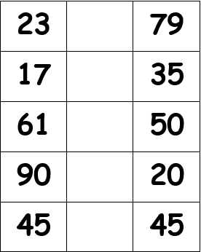
Task:

Slide 33
Task: answers

Slide 34
asalim@peelpark.bradford.sch.uk yfarooq-shafique@peelpark.bradford.sch.uk dfox@peelpark.bradford.sch.uk

