Slide 1
First turn the volume on!
2.
1.

Slide 2
To start the PowerPoint follow these steps…
1.
2.

Slide 3
Phonics
Group 3

Slide 4
My turn….
Your turn….

Slide 5
ea
My turn….
Your turn….

Slide 6
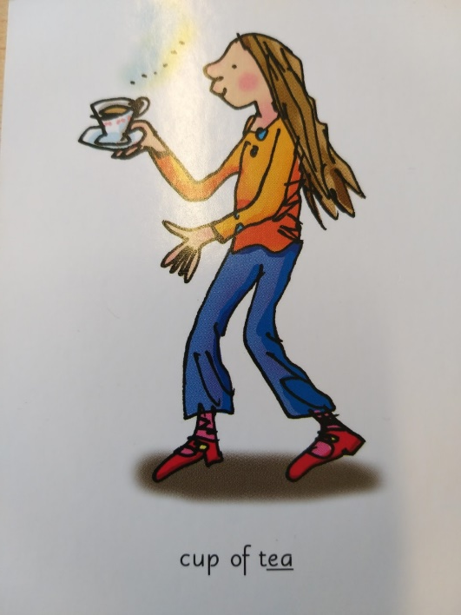
Cup of tea
My turn….
Your turn….

Slide 7
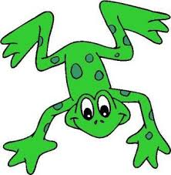
Fred talk

Slide 8
clean
Your turn….

Slide 9
dream
Your turn….

Slide 10
seat
Your turn….

Slide 11
scream
Your turn….

Slide 12
Spellings
Fred fingers

Slide 13
Spellings
Fred fingers

Slide 14
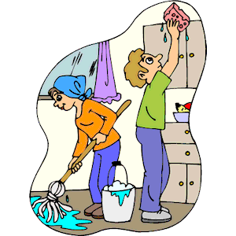

Slide 15
clean

Slide 16
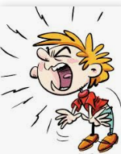

Slide 17
scream

Slide 18
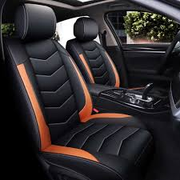

Slide 20
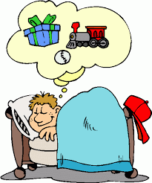

Slide 21
dream

Slide 22
dream seat clean scream

Slide 23
oi
My turn….
Your turn….

Slide 24
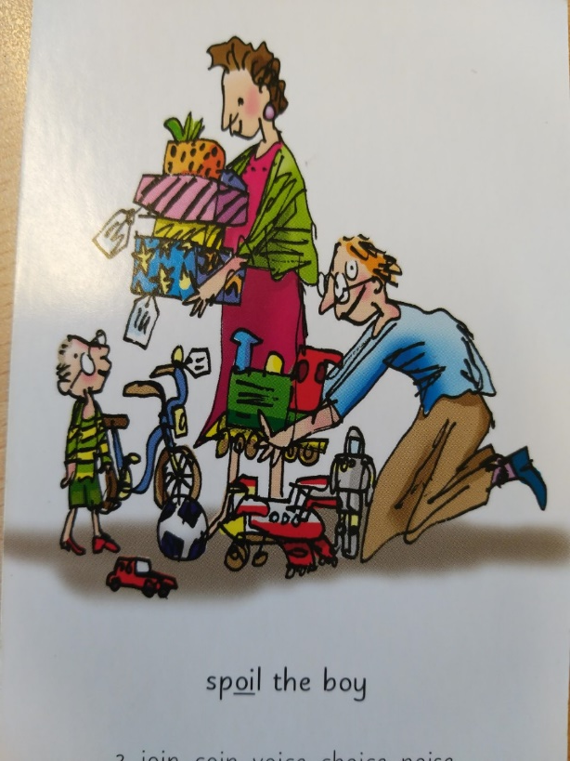
spoil the boy
My turn….
Your turn….

Slide 25
Fred talk

Slide 26
join
Your turn….

Slide 27
coin
Your turn….

Slide 28
choice
Your turn….

Slide 29
Spellings
Fred fingers

Slide 30
Spellings
Fred fingers

Slide 31
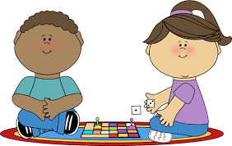

Slide 32
join

Slide 33
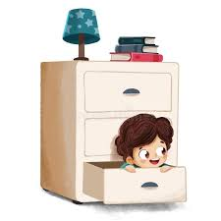

Slide 35
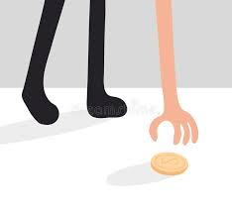

Slide 36
coin

Slide 37
choice coin join

Slide 38
a-e
My turn….
Your turn….

Slide 39
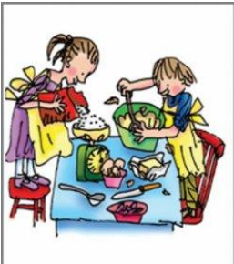
make a cake

Slide 40
Fred talk

Slide 41
make
Your turn….

Slide 42
shake
Your turn….

Slide 43
cake

Slide 44
same
Your turn….

Slide 45
Spellings
Fred fingers

Slide 46
Spellings
Fred fingers

Slide 47
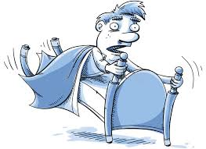

Slide 48
shake

Slide 50
cake

Slide 51
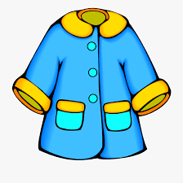

Slide 52
same

Slide 53
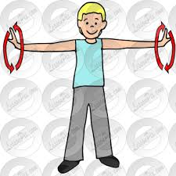

Slide 54
make

Slide 55
shake make same cake

