Slide 1
Guided Reading
Monday 28th September
Room 13 – Chapters 16 & 17

Slide 3
Whitby
Gary, Trot, Lisa and Felicity
Gary Bazzard
Dracula
The Crow’s Nest
Sal Haggerlythe
It opens outwards
The number 13 appears
Ellie-May Sunderland
Two spots of blood

Slide 4
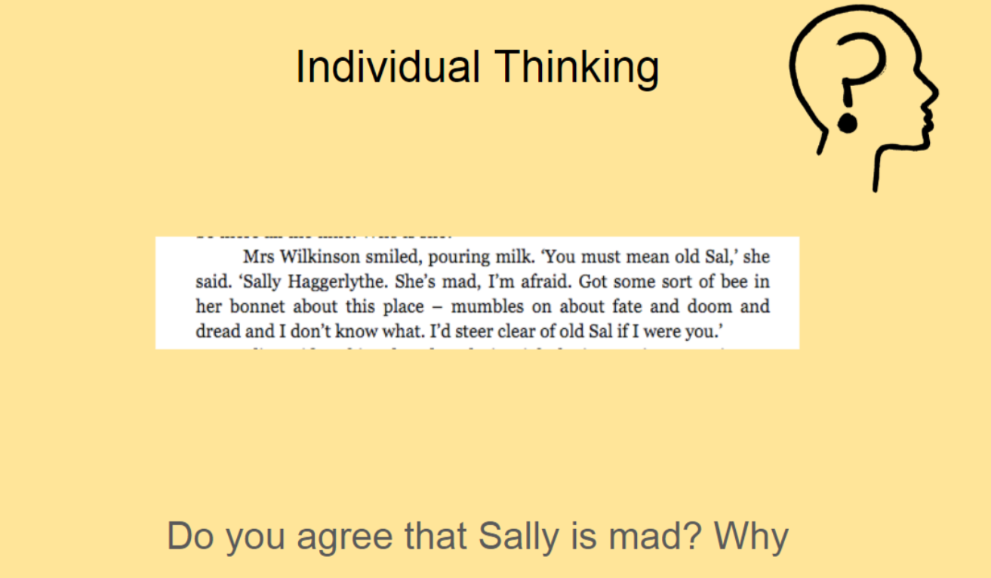

Slide 5
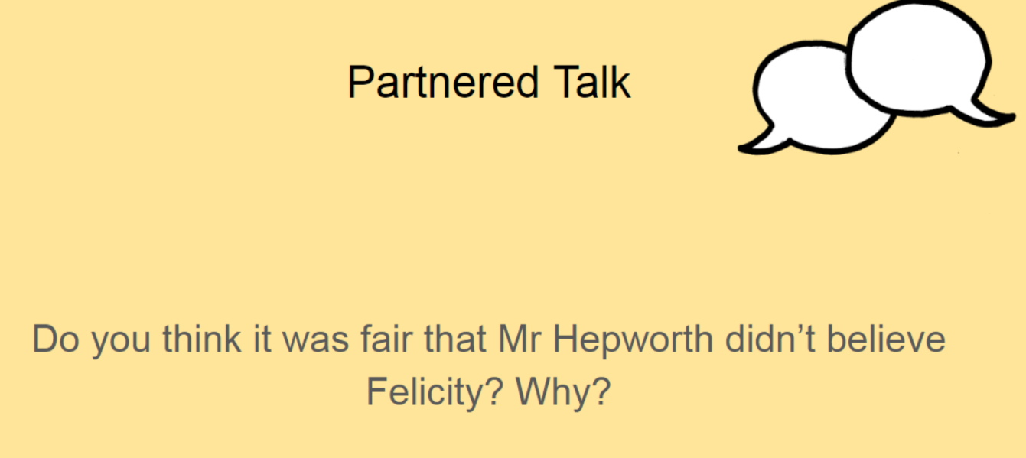

Slide 7
