Slide 1
27.11.20
Spelling test

Slide 2
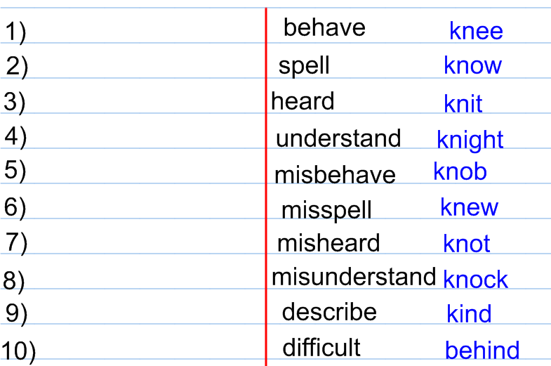
Answers
Group 1
Group 2

Slide 3
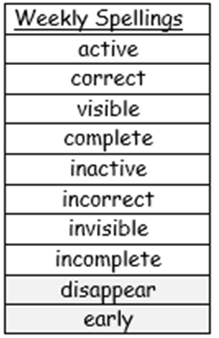
This week’s spelling rule is:
The prefix in-

Slide 4
Quick write
active

Slide 5
Quick write
correct

Slide 6
Quick write
visible

Slide 7
Quick write
complete

Slide 8
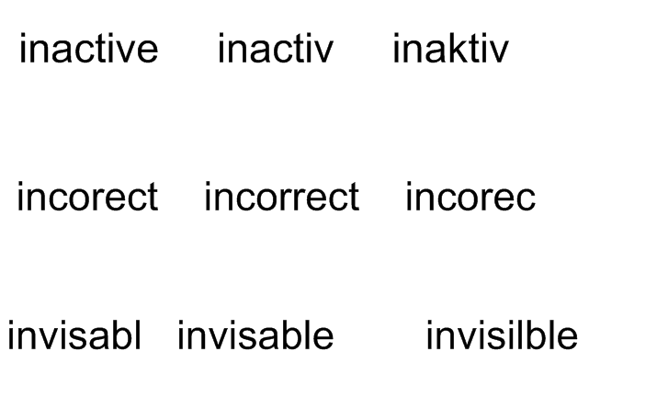
Which one is the correct spelling?
Copy the correct spellings.

Slide 9
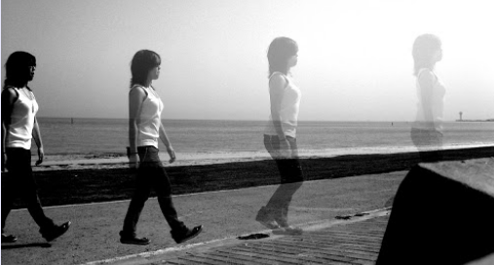
Practice writing the tricky word.
disappear

Slide 10
Practice writing the tricky word.
early

