Slide 1
Recap
What do these letters stand for?
RE

Slide 2
Recap
What do we learn in these lessons?

Slide 3
Recap
Which religion have we already looked at?
Can you write down one fact that you learnt from the last lesson?

Slide 4
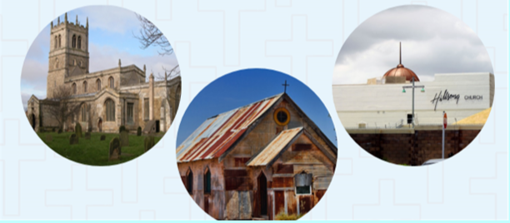
What do all these buildings have in common?
Who might visit them?
What might happen in them?

Slide 5
Acts of worship
Know where Christians worship
Important features of a church

Slide 6
Where do Christians worship?

Slide 7
Christianity

Slide 8
Inside a church
What might you find in a church?

Slide 9
Inside a church...
https://www.youtube.com/watch?v=KxLir3p9z8U

Slide 10
Activity
Important features of a church...

Slide 11
Church
Important features of a church...

Slide 12
Church
Outside a church...

Slide 13
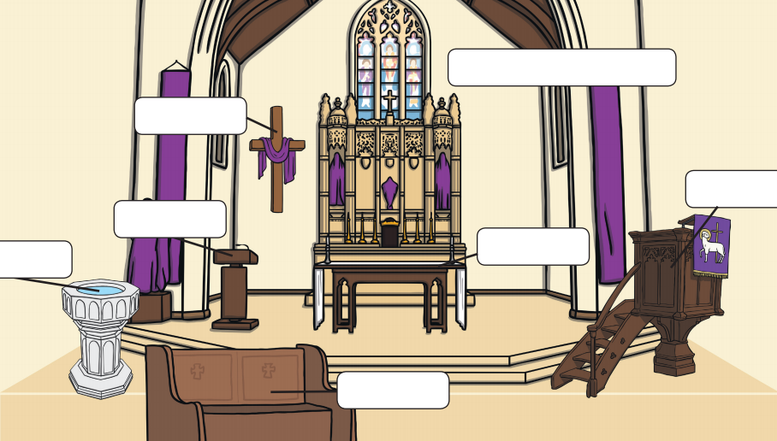
Activity
Word bank
Take a picture of your work and email it to nwatts@peelpark.bradford.sch.uk
2
1
3
7
4
6
5

Slide 14
Activity
In full sentences write at least three features of a church.
Extra challenge
writers tool kit
capital letters
full stops
conjunctions- and, because
Features of a church
Take a picture of your work and email it to nwatts@peelpark.bradford.sch.uk

