Slide 1
Guided Reading
Wednesday 30th September

Slide 2
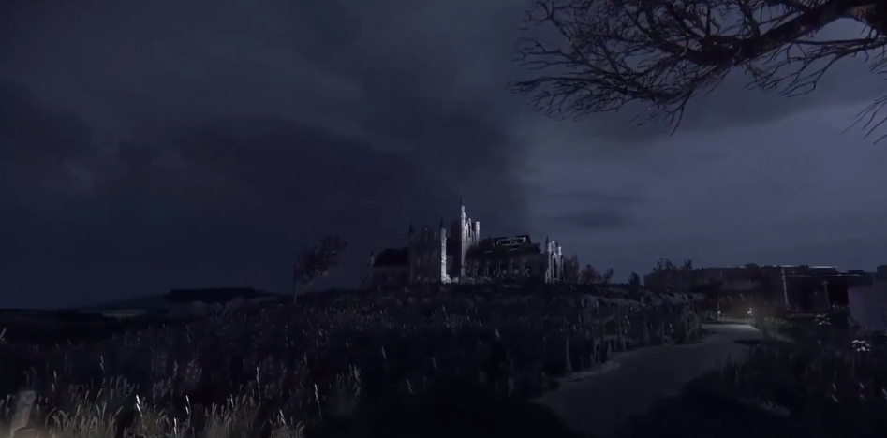
https://www.literacyshed.com/draculas-whitby.html

Slide 3
https://www.literacyshed.com/draculas-whitby.html
V – Write three words to describe the mood of this video
I – Why do you think this is set at night with a full moon? Explain your answer.
S – Explain what happens in this video in 20 words or less
I – What do you think the statue was pointing at?
E – How do you think the music chosen adds to the mood of the clip?
R – What was in the crypt beneath the abbey?
R – What was strange about the reflection in the water in the crypt?
P – What do you think the objects on the altar are going to be used for?
I – Who might have lit the candles inside the ruined abbey?

Slide 4
Extra Challenge:
Write a newspaper report describing the discovery of the previously unknown crypt. (Whitby Abbey doesn't actually have one)
Write the story as a diary or journal which abruptly ends and is completed in a different hand, perhaps the hand of Dracula himself. Include a prologue describing how and when the diary was found.
Write the narrative through the eyes of Dracula himself, perhaps he is aggrieved at the people visiting 'his' abbey

Slide 5
ckimberley@peelpark.bradford.sch.uk

