Slide 1
Spelling
Monday 9th November

Slide 2
Spelling Test
1.
2.
3.
4.
5.
6.
7.
8.
9.
10.
Make sure you are on full screen mode.
Write the numbers 1-10 in your red book.
When you are ready click on to hear the spelling test.

Slide 3
Spelling Test
1.
2.
3.
4.
5.
6.
7.
8.
9.
10.
Make sure you are on full screen mode.
Write the numbers 1-10 in your red book.
When you are ready click on to hear the spelling test.

Slide 4
Answers
1. lyric
2. symbol
3. syrup
4. typical
5. nourish
6. rough
7. tough
8. flourish
9. centre
10. circle

Slide 5
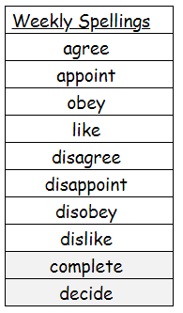

Slide 6
Spelling Test
1.
2.
3.
4.
5.
6.
7.
8.
9.
10.
Write the numbers 1-10 in your red book.
When you are ready click on to hear the spelling test.
Make sure you are on full screen mode.

Slide 7
Spelling Test
1.
2.
3.
4.
5.
6.
7.
8.
9.
10.

Slide 8
Answers
1. ice
2. mice
3. dice
4. nice
5. once
6. dance
7. prince
8. pence
9. most
10. both

Slide 9
