Slide 1
First turn the volume on!
2.
1.

Slide 2
To start the PowerPoint follow these steps…
1.
2.

Slide 3
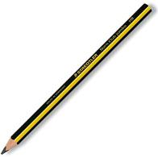
Are you organised?

Slide 4
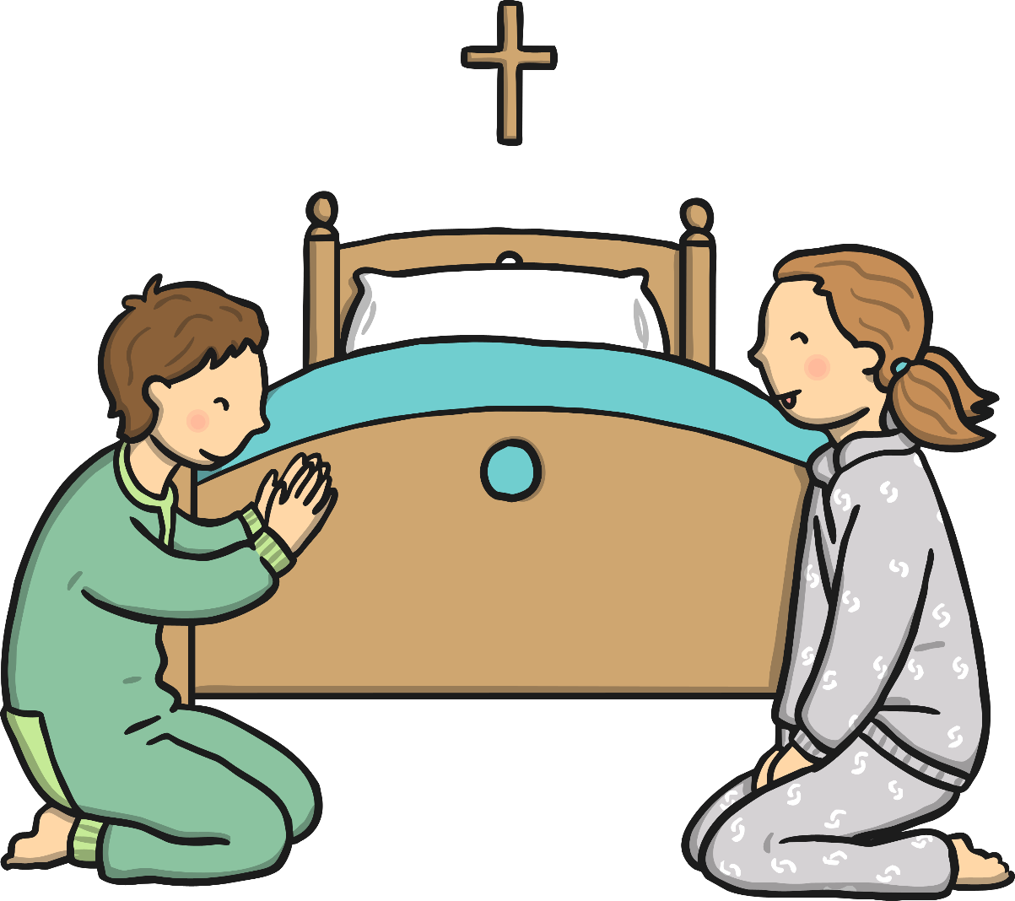
Christian Beliefs

Slide 5
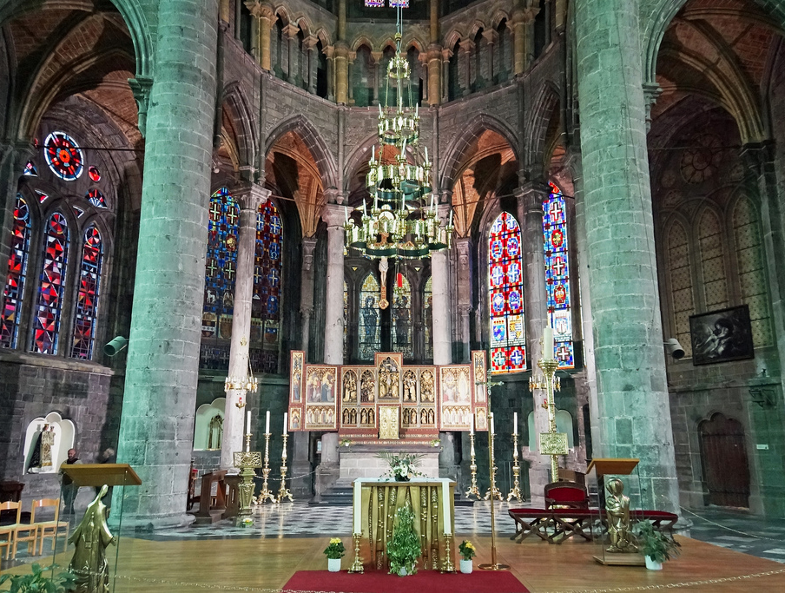
Learning Objective
To find out about Christian beliefs.
Photos courtesy of archer10 (Dennis) (@flickr.com) - granted under creative commons licence - attribution

Slide 6
Success Criteria
I can talk about Christian beliefs and the meaning behind them.
I understand it is important to respect the beliefs of others.

Slide 7
Starter Activity
What do Christians believe?

Slide 8
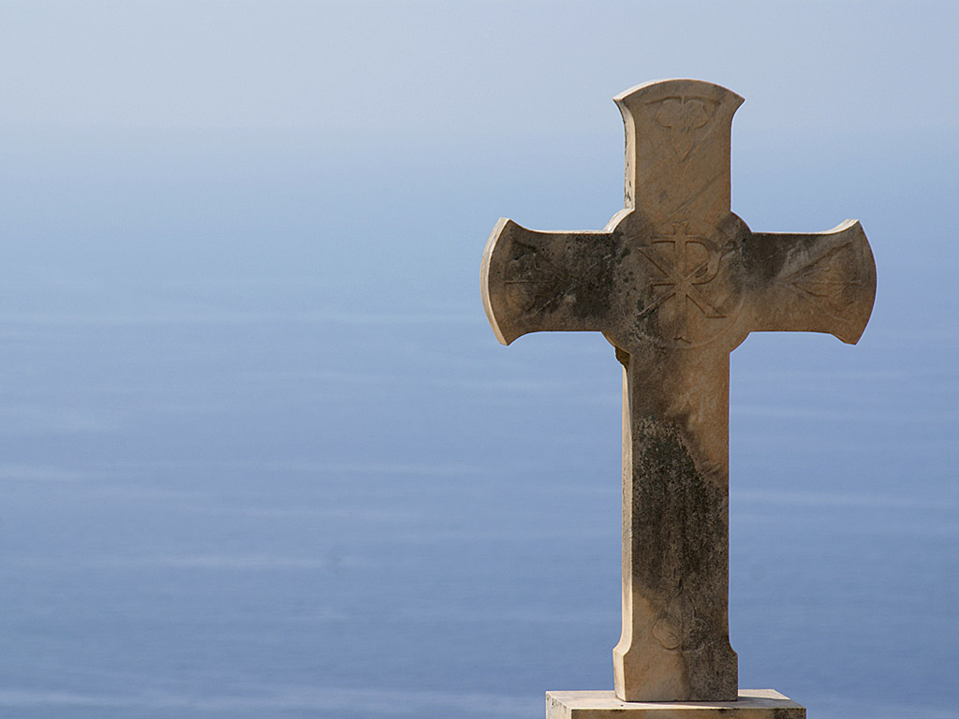
Christian Beliefs
God and Jesus
Christians believe in one God, they also call him the Father.
They believe that he sent his son, Jesus Christ, to show people a good way to live their lives.
Jesus’ most important messages from God were to love God and look after one another.
Photos courtesy of Ifreefotouk (@flickr.com) - granted under creative commons licence - attribution

Slide 9
Christian Beliefs
Christians believe that God created the world.
God said ‘‘Let there be light!’’ and there was light. God separated light and dark and called the light ‘‘day’’ and the darkness ‘‘night’’. On the second day God made the earth and sky. On day three, God created the land and seas, along with plant and trees. On the fourth day, God created the sun, moon and stars then on the fifth day, the birds and sea creatures. On the sixth day, God made animals and Adam and Eve. On the final day, God rested.

Slide 10
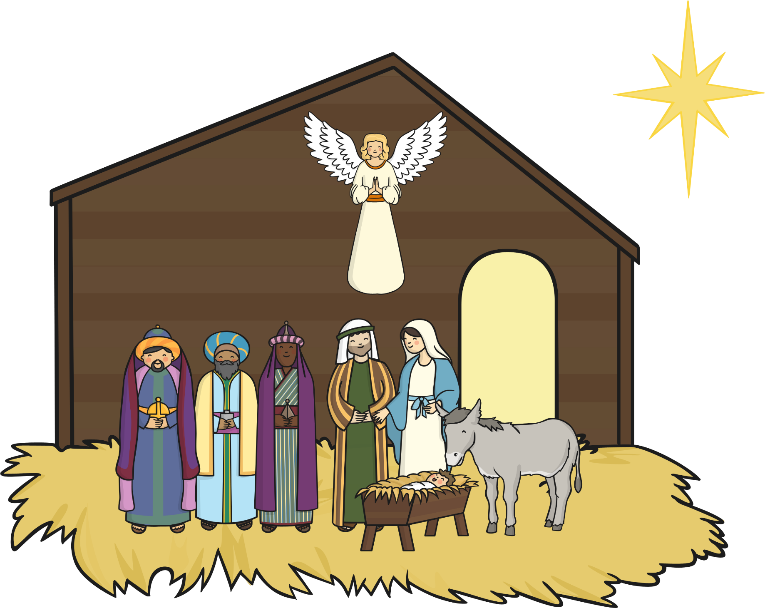
Christian Beliefs
Christmas
Christmas is a very special time of year for Christians because it remembers the time when Jesus was born.
At this time of year, many Christians visit church to sing carols and give thanks for the baby Jesus. People also give and receive gifts to remind them of the gift of the baby Jesus.
Families and friends get together to celebrate Christmas Day which is on the 25th December every year.

Slide 11
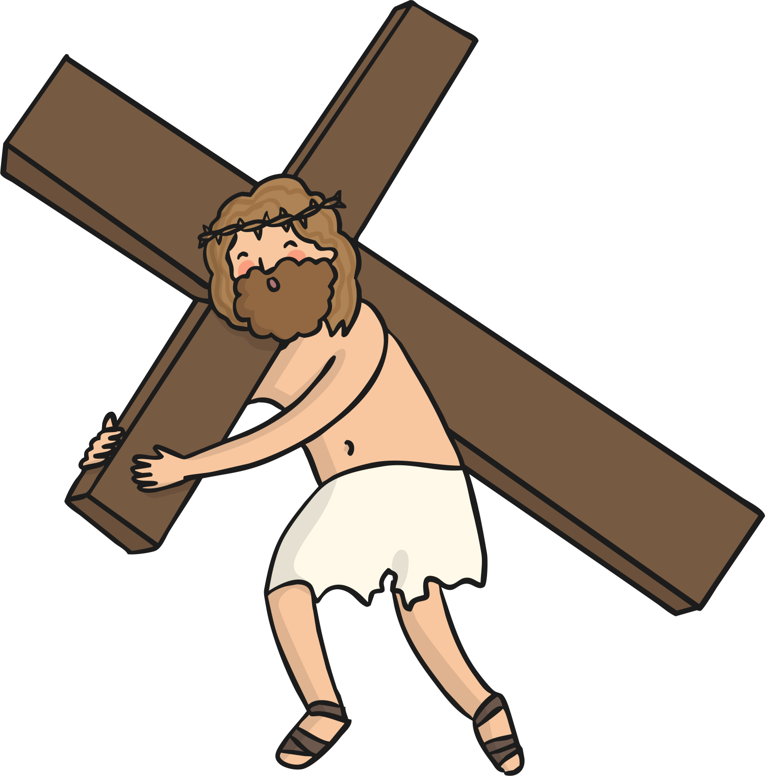
Christian Beliefs
Easter
Easter is the most important time of year for Christians because it remembers and celebrates when Jesus came back to life three days after he died on the cross.
The week before Easter is called Holy Week.
Many Christians celebrate Easter by visiting church and giving, receiving and eating Easter eggs, which signify new life.

Slide 12
Christian Beliefs
Prayer
Christians believe that praying is a way of speaking with God. People can pray to give thanks, ask for help or to ask for forgiveness.
Christians pray together, on their own in church or at home.
Some people like to focus on a cross or candle to help them think about God.

Slide 13
Our Father, who art in heaven, Hallowed be thy Name. Thy Kingdom come. Thy will be done, On Earth as it is in heaven. Give us this day our daily bread. And forgive us our trespasses, As we forgive them that trespass against us. And lead us not into temptation, But deliver us from evil. For thine is the kingdom,
The power, and the glory,
For ever and ever.
Amen.
The Lord’s
Prayer
The Lord’s Prayer is a very special prayer to Christians. Read it and think about what the words might mean.

Slide 14
Christian Beliefs
Following God’s rules
These are God’s rules set out in the Bible, the Christian holy book.
Christians believe that following these rules will help them to lead a good and happy life.
Love God more than all others.
Don’t make anything more important than God.
Always use God’s name with love respect.
Rest on a Sunday.
Love and respect your parents.
Never hurt others.
Be faithful to your husband or wife.
Don’t steal.
Always tell the truth.
Be happy with what you have.

Slide 15
Christian Beliefs
God and Jesus are important to Christians because
The Creation Story shows
Easter is important because
Christmas in important because
Prayer is important because

Slide 16
THE END

