Slide 1
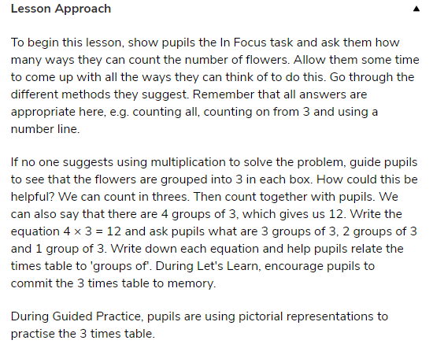

Slide 2
Maths Drill
How will you work out the answers to the questions?
What method will you use?
2x10=
2x2=
2x6=
2x9=
2x8=
2x3=
7. 2x4=
8. 2x5=
9. 2x7=
10. 2x1=

Slide 3
Number of the Day
100 less | Three digit number | 100 more
 | 252
 | 678
 | 111

Slide 4
Multiplying by 3
To be able to understand and learn the 3 times table
Make equal groups of 3
Draw pictures to represent grouping
Counting
Number-lines
Base ten

Slide 5
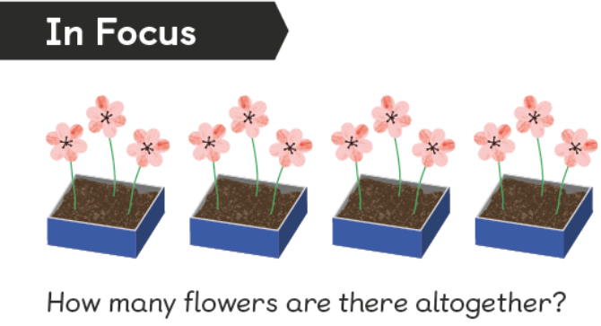
In focus
What can we do to find the answer?

Slide 6
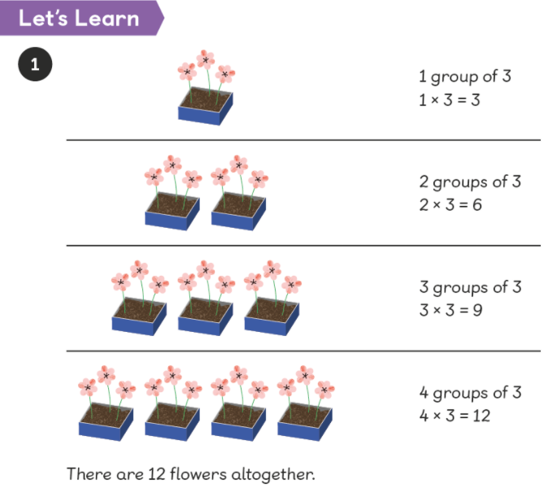
Let’s Learn
Count each flower to get your answer.
Lets do it together.

Slide 7
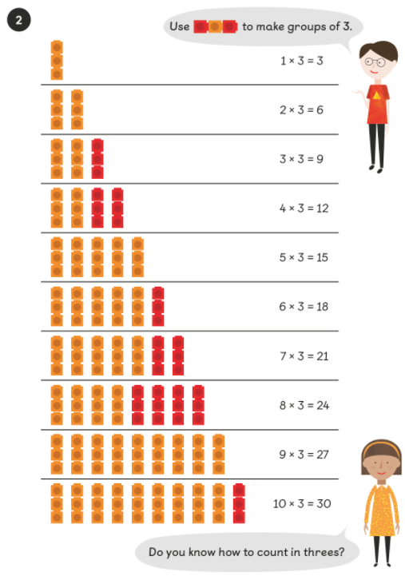
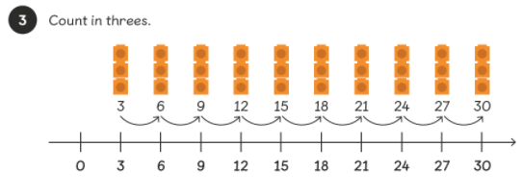
Let’s Learn
You can count the cubes on the screen or use the equipment to help you with knowing your 3x tables.

Slide 8
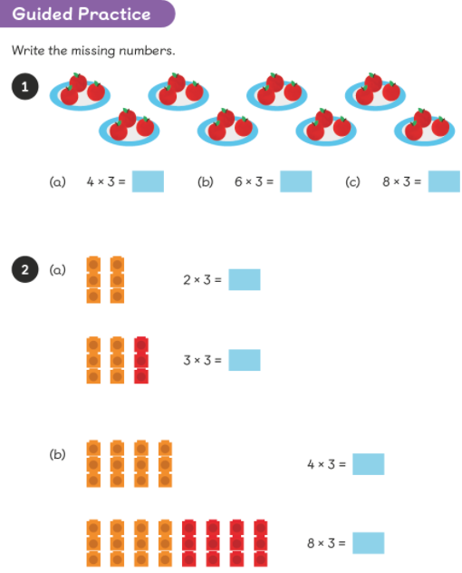
Guided Practice
Use the pictures to help you answer the questions.

Slide 9
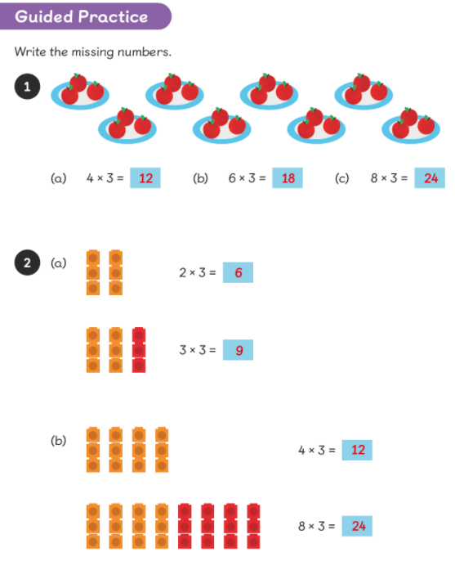
Guided Practice Answers:

Slide 10
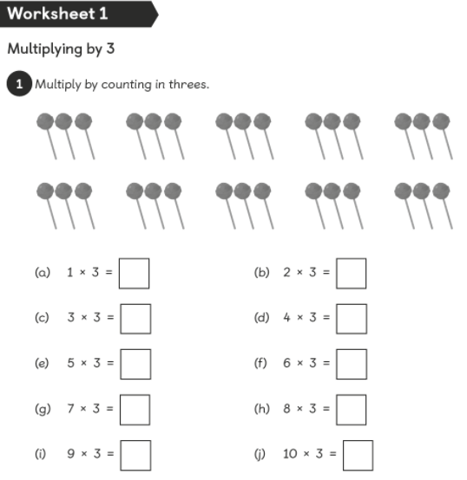
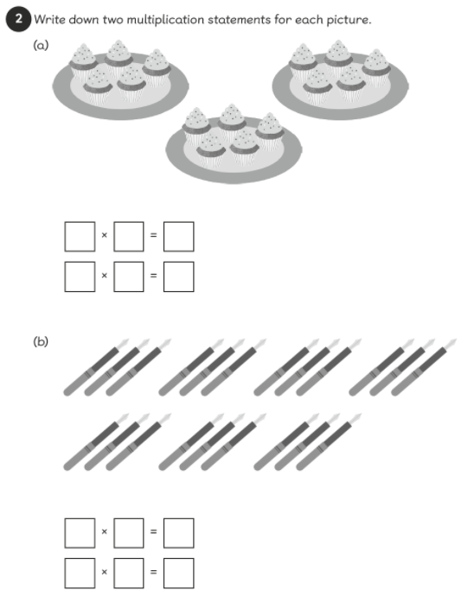
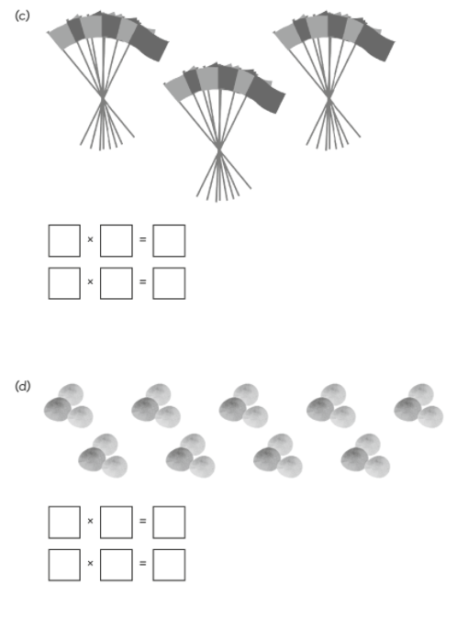
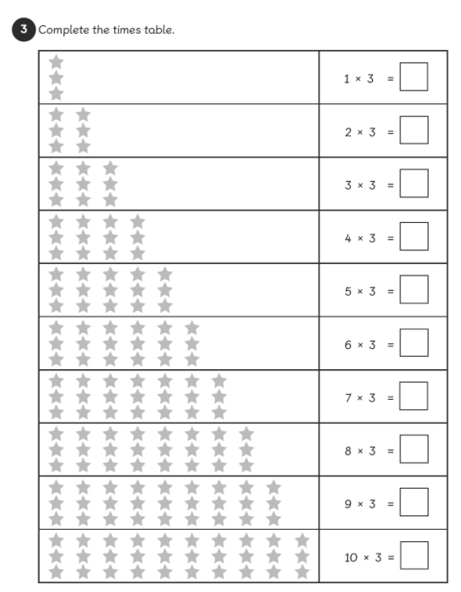
Page 77-80
Complete the pages that I have uploaded onto Seesaw.

Slide 11
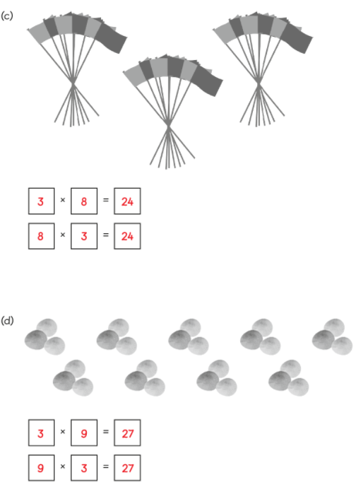
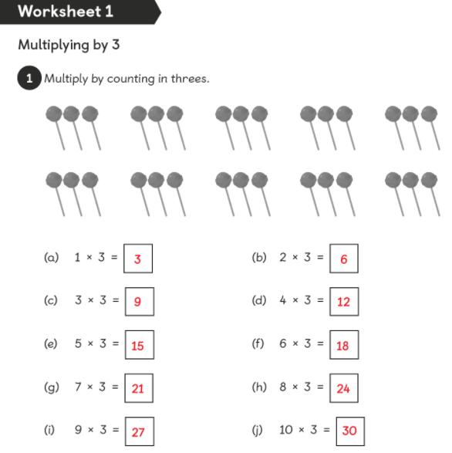
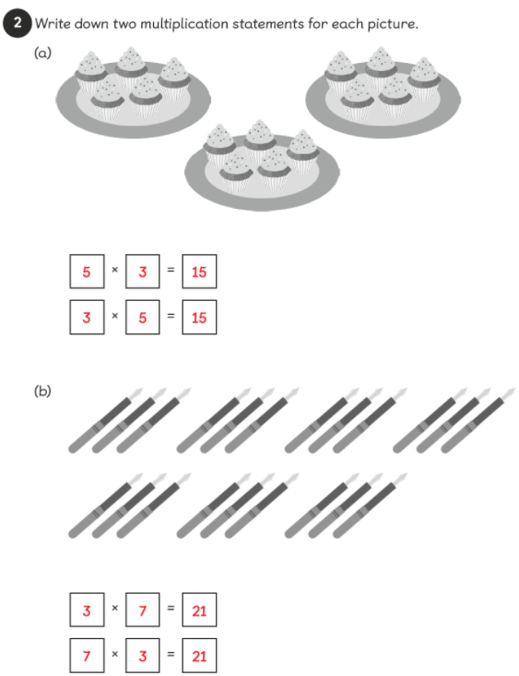
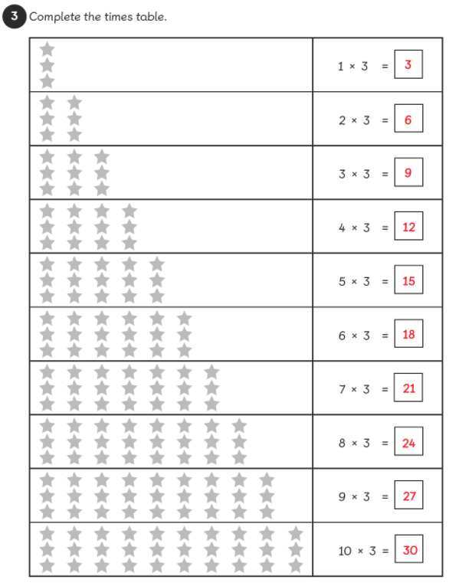
Answers

Slide 12
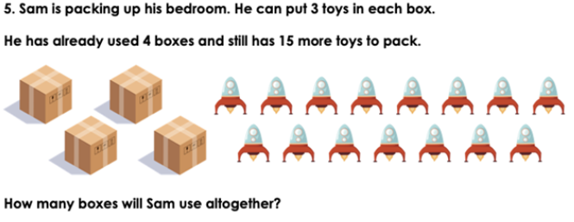
Extension

Slide 13
Extension
Answers
Sam will end up using 9 boxes altogether.

