Slide 1
Maths
13/11/20

Slide 2
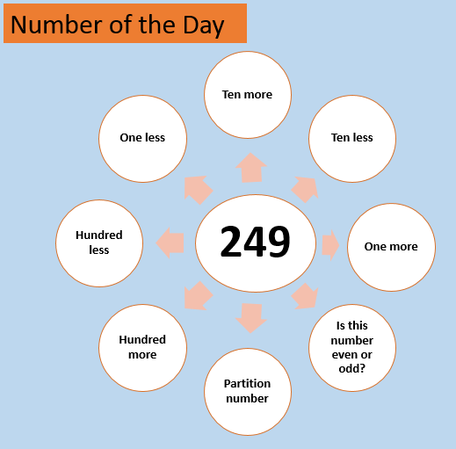

Slide 3
259
248
239
149
250
349
odd
200+40+9

Slide 4
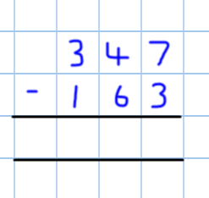
What do these two numbers mean?
The top number (347) is the amount you are starting with.
Imagine having 347 apples.
The bottom number (163) is the amount you are taking away.
Imagine throwing away 163 apples.

Slide 5
When solving each column, I take the smaller digit away from the bigger digit each time.
When solving each column, I take the bottom digit away from the top digit each time.

Slide 6
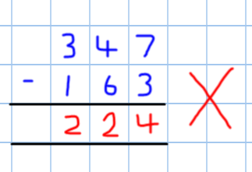
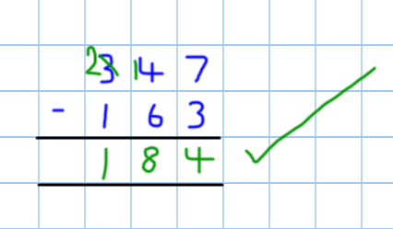
When solving each column, I take the smaller digit away from the bigger digit each time.
When solving each column, I take the bottom digit away from the top digit each time.

Slide 7
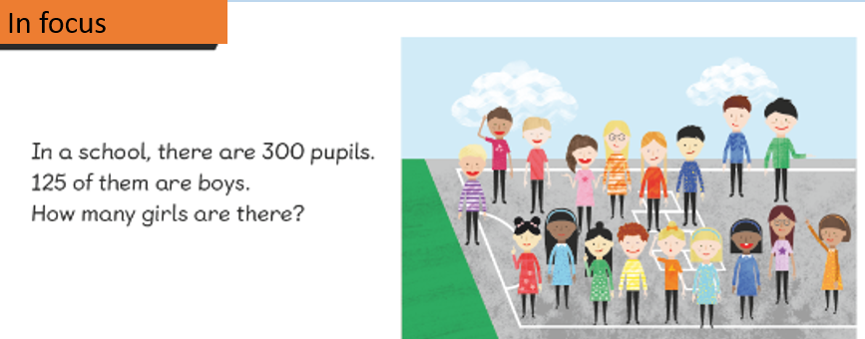
300 – 125 =

Slide 11
Break up a hundred into 9 tens and 10 ones.

Slide 12
Break up a hundred into 9 tens and 10 ones.

Slide 13
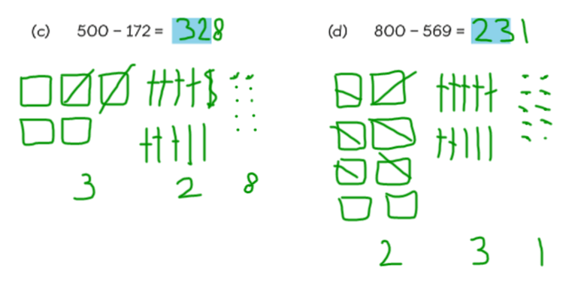
Break up a hundred into 9 tens and 10 ones.

Slide 14
