Slide 1
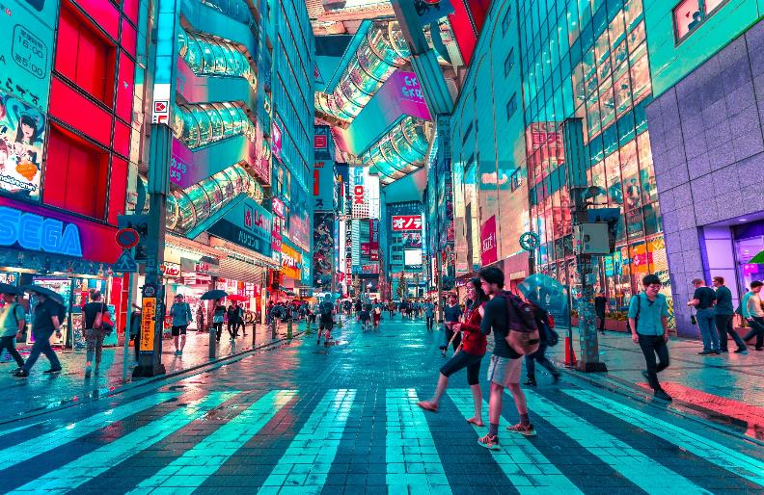
VILLAGES, TOWNS & CITIES
YEAR THREE
AUTUMN 2

Slide 2
LESSON FIVE WHAT MAKES UP A CITY?

Slide 4
The community never permanently settles in one location.
8,000,000,000 or eight billion.
A human who gets food by hunting animals and collecting fruit, nuts and plants.

Slide 7
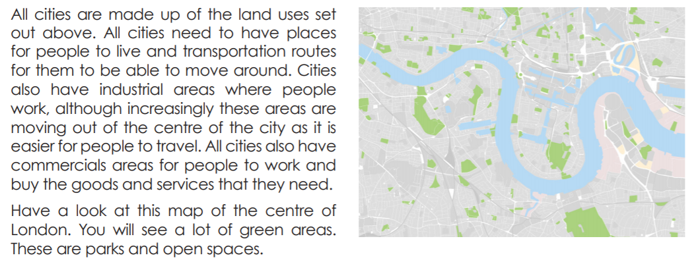
Underline the key information within this text and we will discuss the questions as a class.

Slide 8
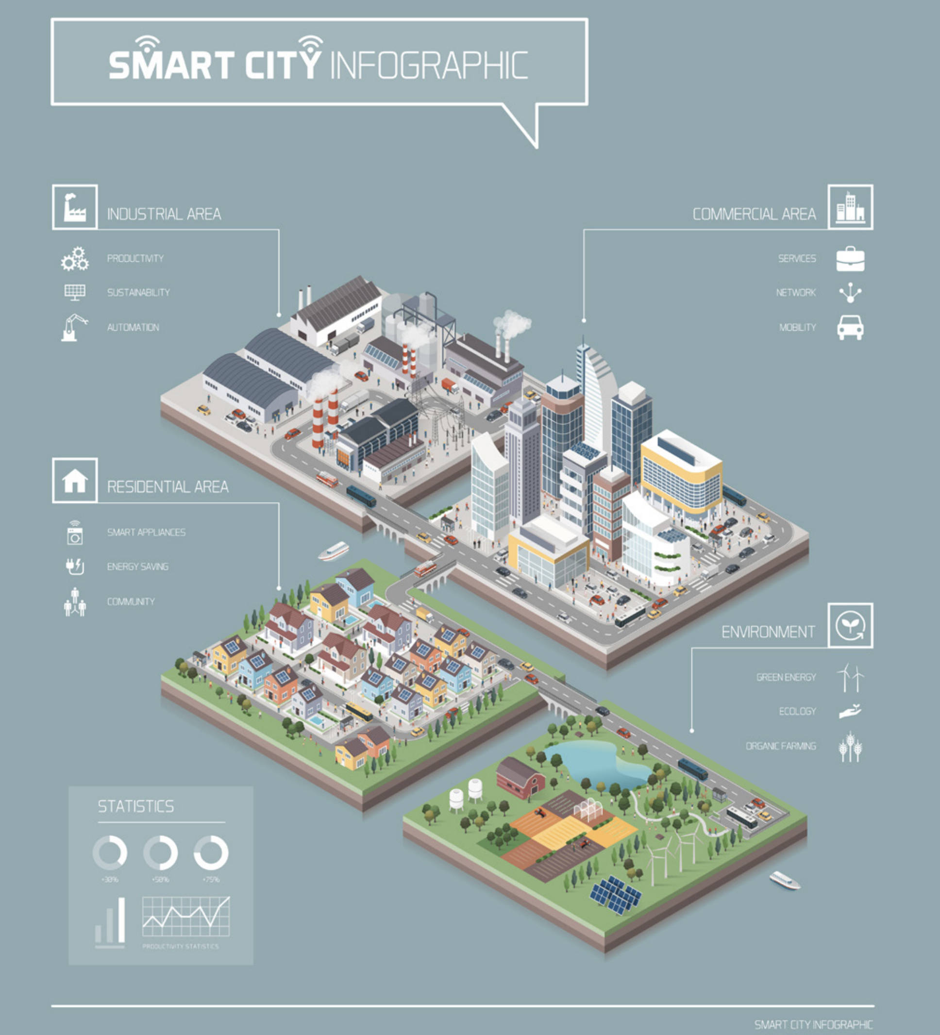
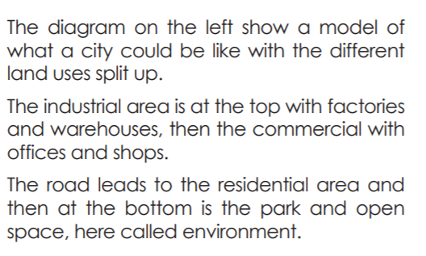
5. What is one advantage and one disadvantage of separating the land use?
(hint: pollution, transportation and travel)

Slide 9
