Slide 1
Y6 English- Poetry
Monday 5th October 2020

Slide 2

Y6 English- Poetry
Editing a storm poem
-Text analysis of a WAGOLL poem
Edit your storm poem to improve it.
Produce a ‘published’ version of your storm poem.

Slide 3
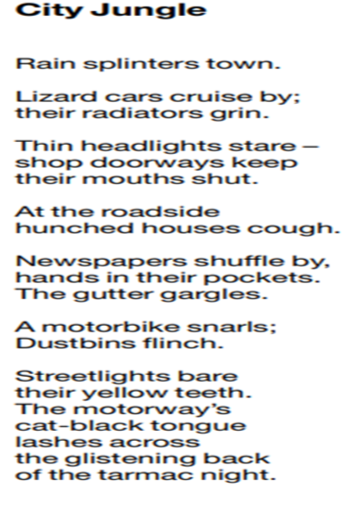
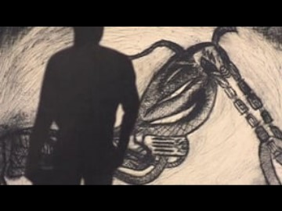
Y6 English- Poetry
Read this poem and watch the animation below

Slide 4
Y6 English- Poetry
This poem is full of ‘toolkit features’ that help to make it so descriptive can you spot examples of each of the following:
Powerful verbs
Powerful adjectives
Alliteration
Onomatopoeia
Personification
Click on the next slide for the answers

Slide 5
Y6 English- Poetry
Powerful verbs: splinters, cruise, grin, stare, cough, shuffle, gargles, snarls, flinch, bare, lashes,
Powerful adjectives: hunched, yellow, cat-black, glistening,
Alliteration: cars cruise, hunched houses, gutter gargles,
Onomatopoeia: cough, gargles, snarls,
Personification: all of it!
Did you spot them all?

Slide 6
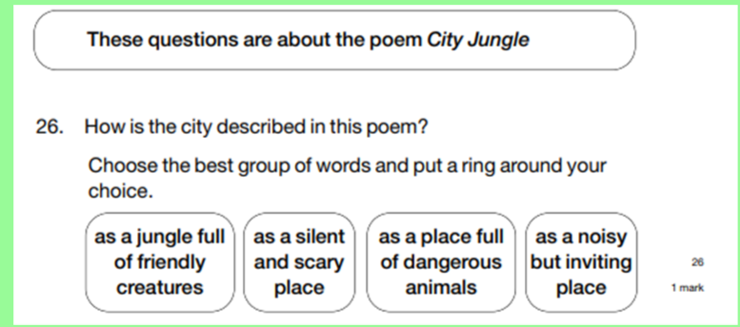
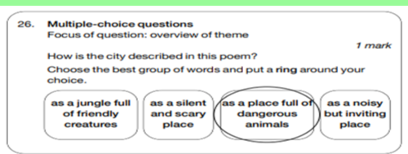
Y6 English- Poetry
Once you have written your answer, click to reveal the mark scheme.
Have a look at these SAT style reading questions :

Slide 7
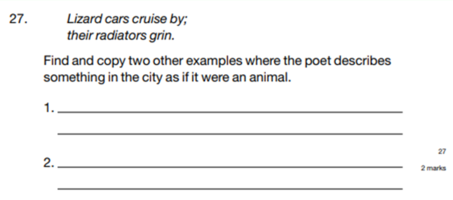
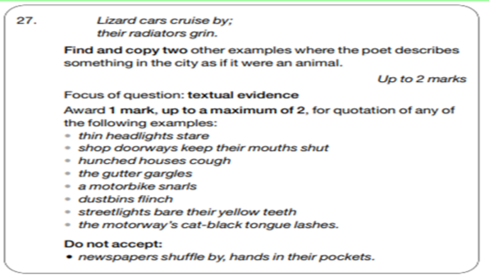
Y6 English- Poetry
Once you have written your answer, click to reveal the mark scheme.

Slide 8
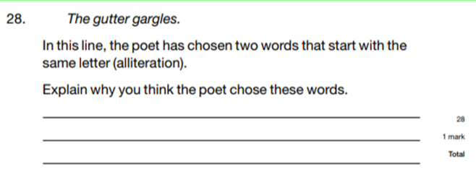
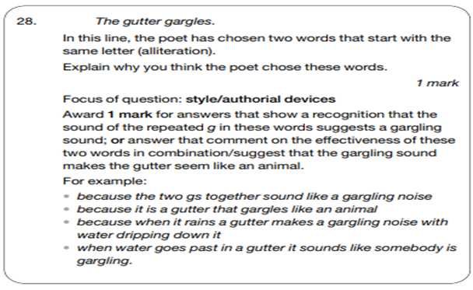
Y6 English- Poetry
Once you have written your answer, click to reveal the mark scheme.

Slide 9
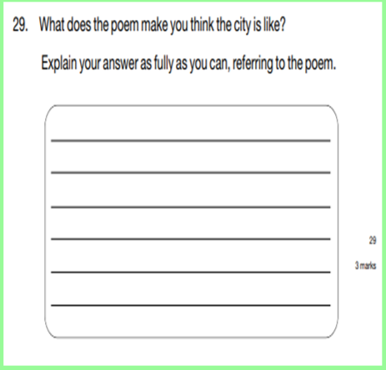
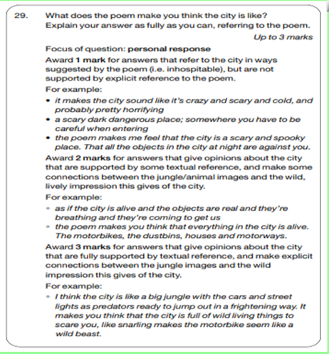
Y6 English- Poetry
Once you have written your answer, click to reveal the mark scheme.

Slide 10

Y6 English- Poetry
Edit to correct:
-Check each line makes sense.
-Check the verses make sense
- Have you stayed in the same tense?
- Check for obvious spelling and grammar errors.
Now we need to edit your storm poem.
Edit to improve:
- Look back at your brainstormed ideas (maybe even watch the clips again) to see if you can add more description.
Think back to when you edited your suspense story.

Slide 11


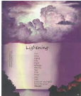
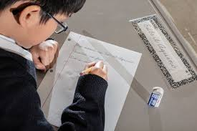
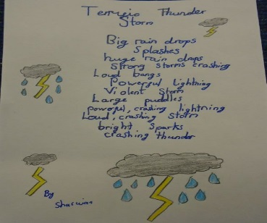

Y6 English- Poetry
Handwriting-
Use your neatest,
joined handwriting.
Illustrations-
Once finished, you could draw or print pictures and/or patterns around your poem to grab the reader’s attention.
Finally, copy up your edited storm poem.
Use a new page in your book.
Set the poem out neatly.
Practice performing your poem as we’d love to read some aloud in class.

