Slide 1
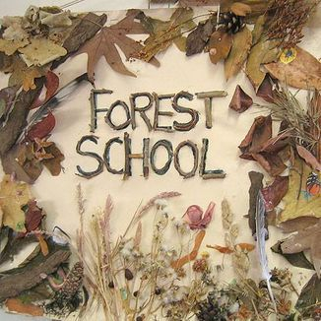


Slide 2
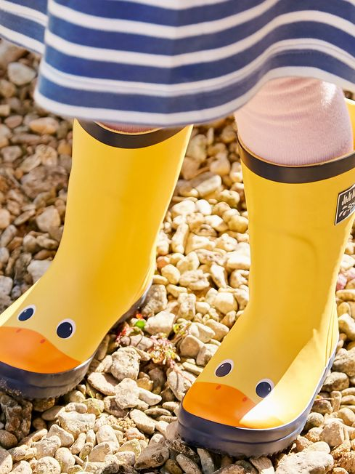
Reception Beech
Spring 1 2025

Slide 3
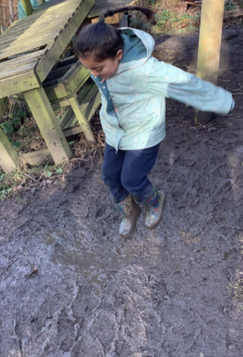
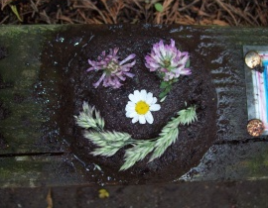
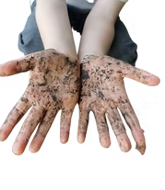
Mud Play
Sense of self: Mud play can help children develop a sense of self and belonging in the world around them.

Slide 4
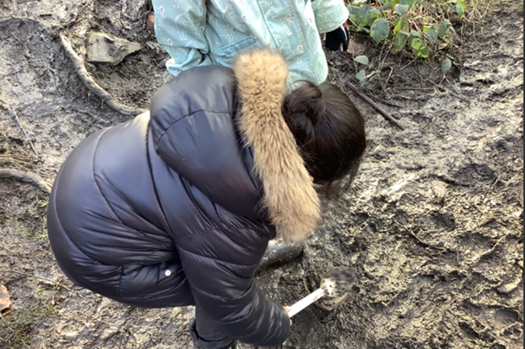
Creativity and imagination: Children can use mud to create sculptures, mud pies, and more.
Physical skills: Mud play can help children develop fine and gross motor skills, hand-eye coordination, and awareness of their senses.
Social and emotional skills: Mud play can help children learn to take turns, share, and follow directions

Slide 5
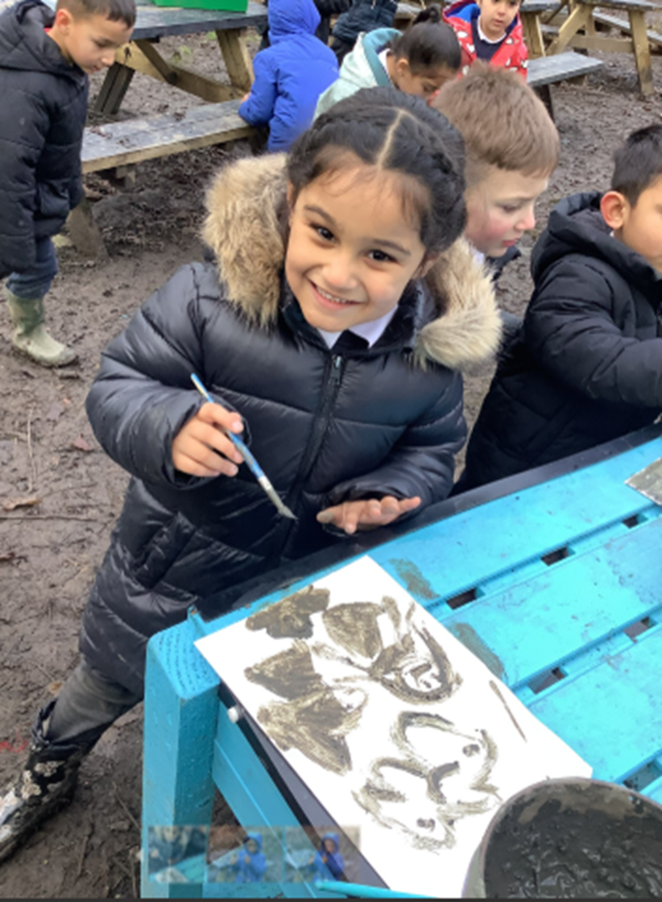
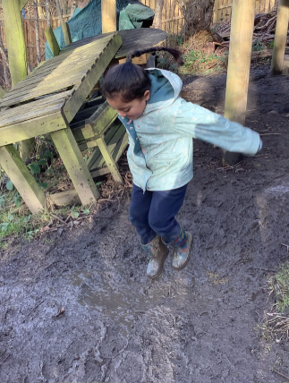
Immune system: Playing in mud can help children develop a healthy immune system by exposing them to healthy bacteria and other microbes.
Well-being: Mud play can have a positive effect on children's mood and well-being.

Slide 6
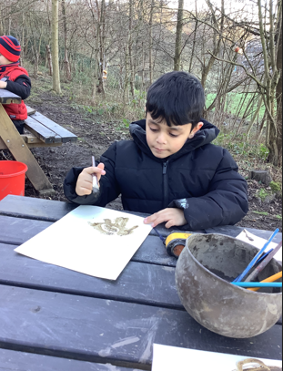
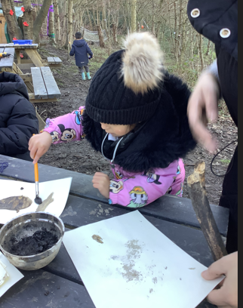

Slide 7
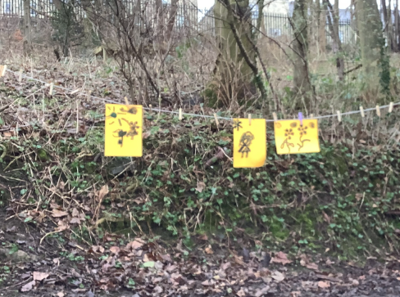
Resilience and self-confidence: Mud play gives children the opportunity to lead themselves and experiment without rules, which can help build resilience and self-confidence.
Connection with nature: Mud play can help children develop a lifelong connection with the natural world.
Brain activity: Mud play can stimulate the brain by activating all of the senses.

Slide 8
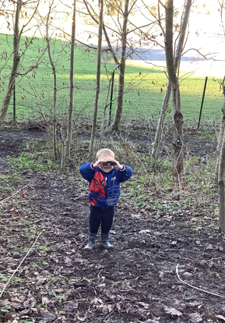








I spy with my little eye……..
birds
Sticks
Leaves
NATURE
friends
Sunshine
…….FUN

Slide 9
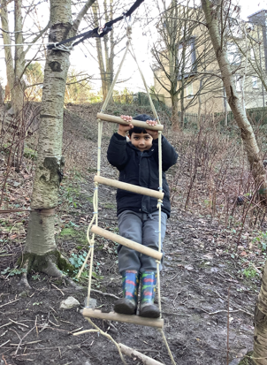
Climbing equipment allows children to
manage and assess risk
Children learn when they are doing something that is too dangerous
Climbing allows children to challenge themselves and push beyond their comfort zones
Climbing improves hand, foot, and body coordination
It helps children develop fine and gross motor skills
It helps children understand where their body is in space

Slide 10
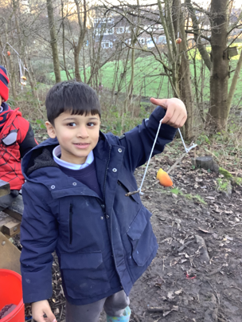
Today we made animal feeders.
We have a variety of
different wildlife in the Forest.
We made these feeders
to help the wildlife on the cold
winter days.

Slide 11
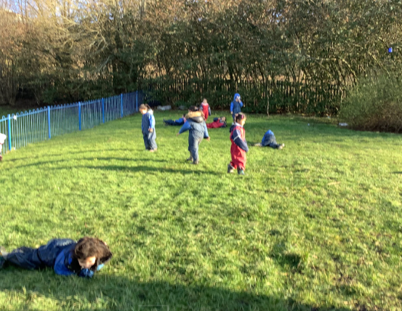
Hill Rolling
Balance and Coordination:
Rolling down a hill challenges
Children’s vestibular system, improving
their ability to maintain balance and
Co-odination their movements.
Spatial Awareness:
Rolling down a hill helps children
Develops an understanding of
Bodies in space and their
relationship to the environment.
Gross Motor Skills: Rolling is a fun and engaging way for children to practice large muscle movements.

Slide 12
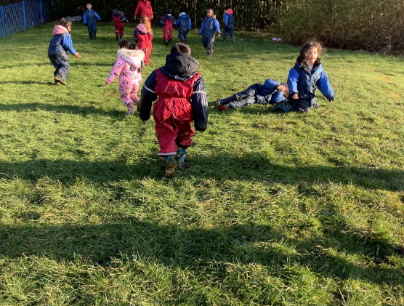
Problem-Solving:
Children may need to adapt their
rolling technique depending on the
slope of the hill, which can promote
problem-solving skills.
Sensory processing
Children can explore different
textures and sensations
as they roll down the hill,
such as grass, dirt and sand.

Slide 13
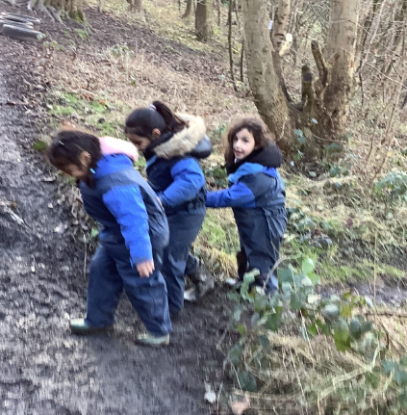
Teamwork
Building Confidence
Respect and Trust
Empathy and Cooperation
Social Skills
Sense of Belonging

Slide 14
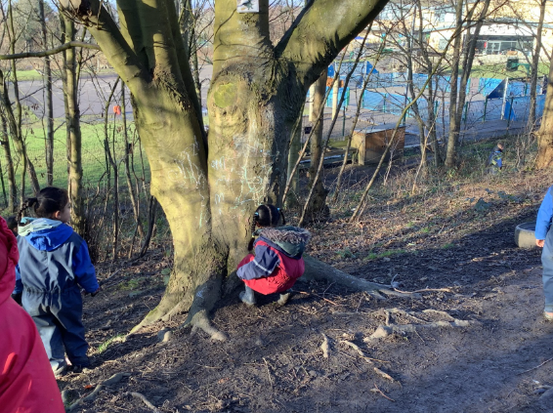
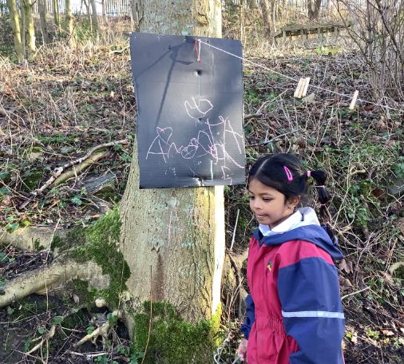
Independent Learners

Slide 15
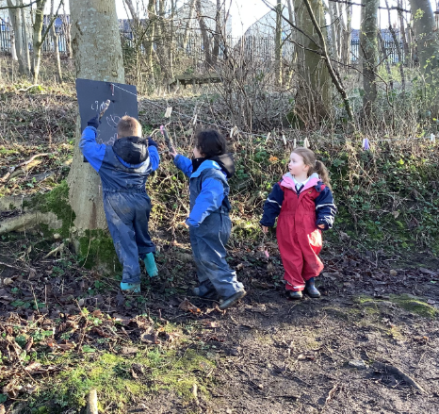

Thank you Beech Class
You have been amazing.
From
Mrs Loker.

Slide 22
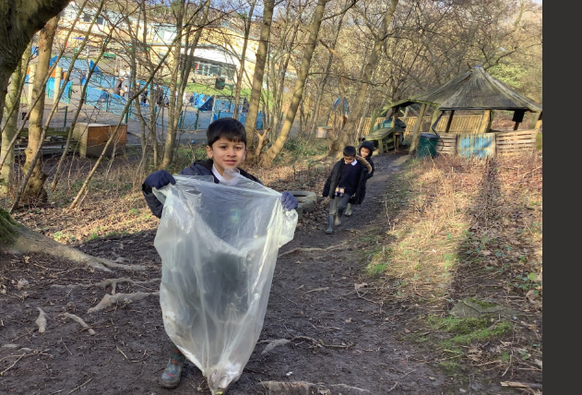

Slide 23
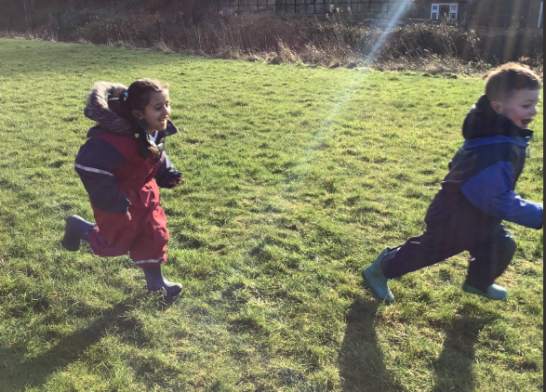

Slide 24
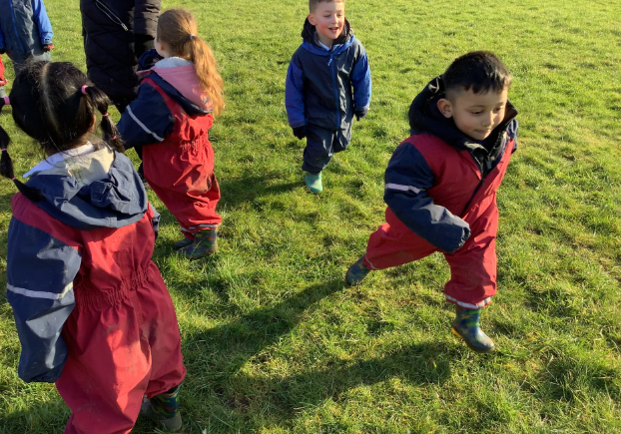
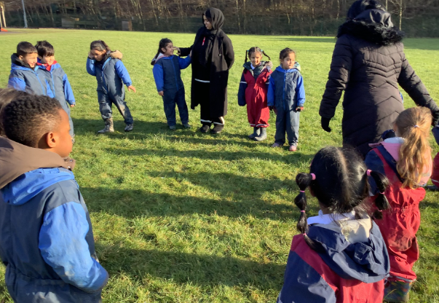

Slide 25
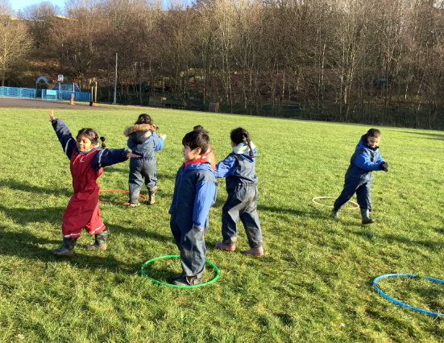
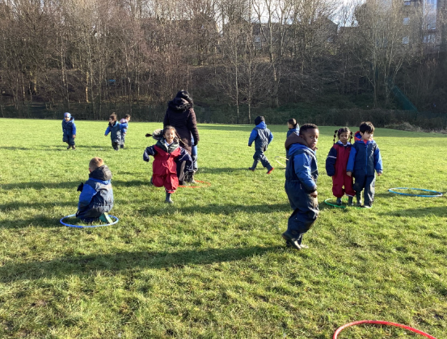

Slide 26
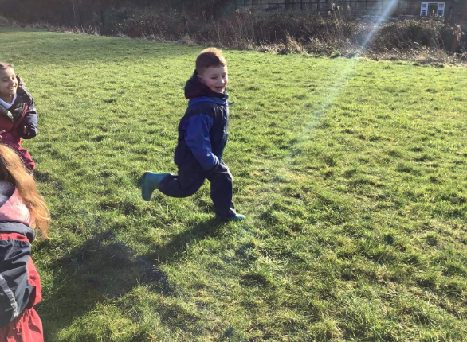

Slide 27
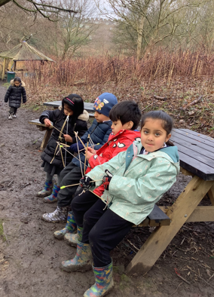
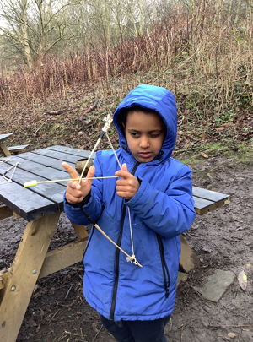

Slide 28
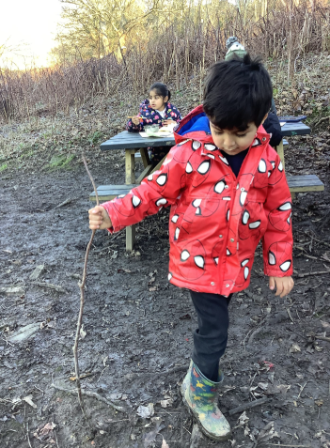

Slide 29
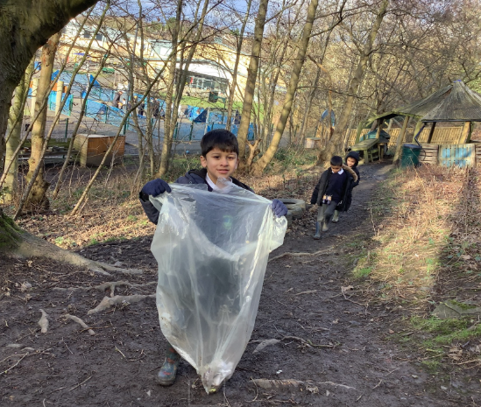

Slide 30
