Slide 1
LESSON THREE What are chemical changes and how can we identify them?

Slide 2
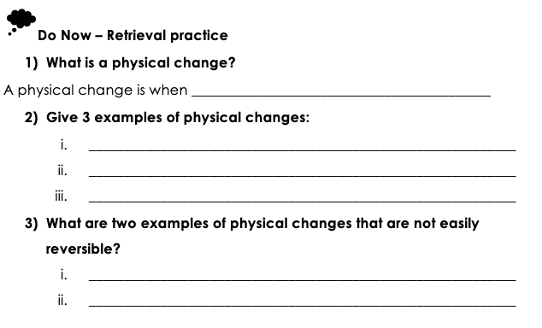

Slide 3
a substance goes through a change
Change of shape
Change of state
Dissolving or mixing of substances
When a substance is dissolved
A physical change

Slide 5
Hot liquid hot gas hot solid
Cold gas cold solid cold liquid

Slide 6
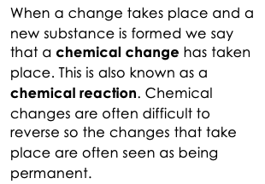
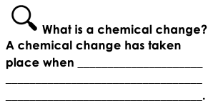

Slide 7
a new substance is formed

Slide 8
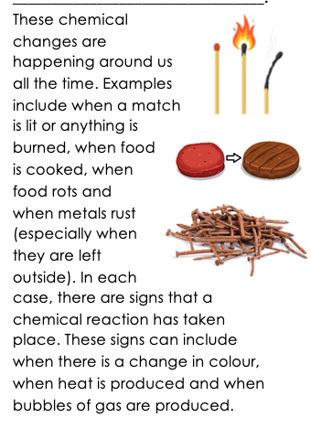
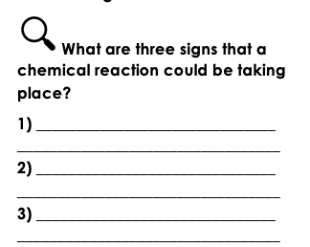

Slide 9
A change in colour
When heat is produced
When bubbles of gas are produced

Slide 10
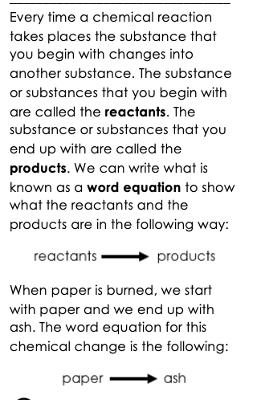

Slide 11
Reactants
Products

Slide 12
https://www.bbc.co.uk/bitesize/clips/z9wkjxs
Notes:
https://www.bbc.co.uk/bitesize/clips/z9wkjxs

Slide 13
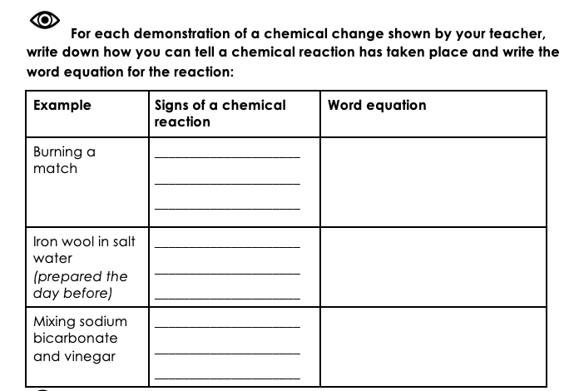
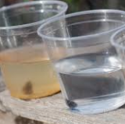

Slide 14
Heat
Change in colour wood – charcoal
Change in colour iron – rust
Bubbles of gas are produced
sodium bicarbonate & vinegar - solution

Slide 15
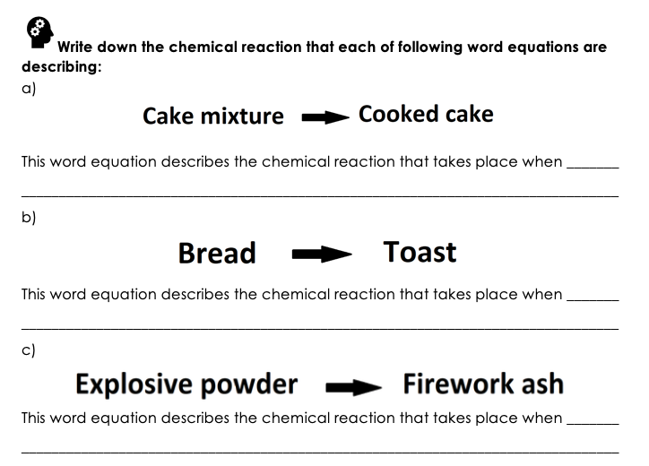

Slide 16
Cake mixture is heated
Bread is heated
A firework is lit

