Slide 1
Tuesday - Maths

Slide 2
Maths Drill
125 + 15 =
345 + 35 =
786 + 27 =
345 - 35 =
247 - 178 =
500 – 142 =

Slide 3
Maths Drill
125 + 15 =
345 + 35 =
786 + 27 =
345 - 35 =
247 - 178 =
500 – 142 =
310
69
358
140
380
813

Slide 4
Multiplying by 8 and Commutative Law
Use arrays to find the answer.
Use a number line to find the answer.
Use repeated addition.
Count on in 8s.
Recall 8 times table facts.

Slide 5
In focus

Slide 6
Let’s Learn
So, 4 x 8 = 8 x 4
These times table facts are commutative.
Are all times table facts commutative?

Slide 7
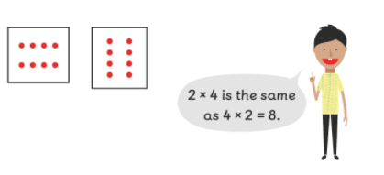
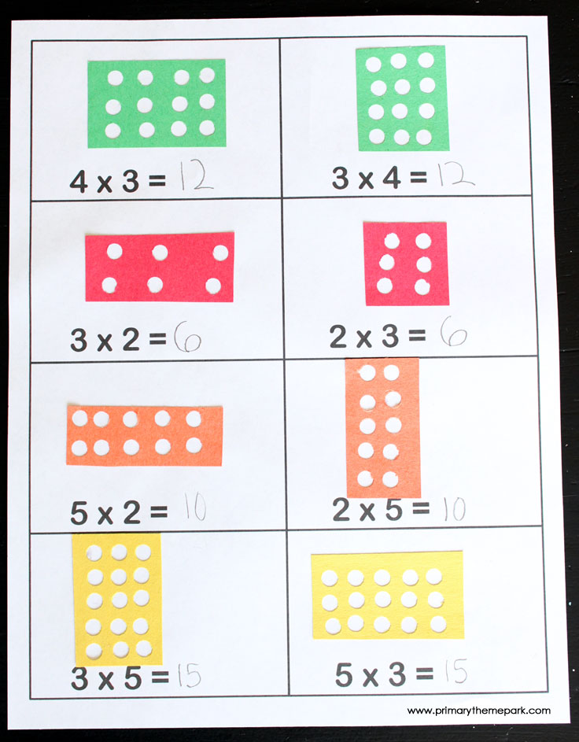
Look, all times table facts are commutative.
So if:
6 x 8 = 48
8 x 6 = __
9 x 4 = 36
4 x 9 = __
48
36

Slide 8
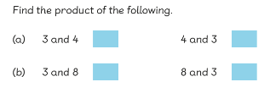
Guided Practice

Slide 9
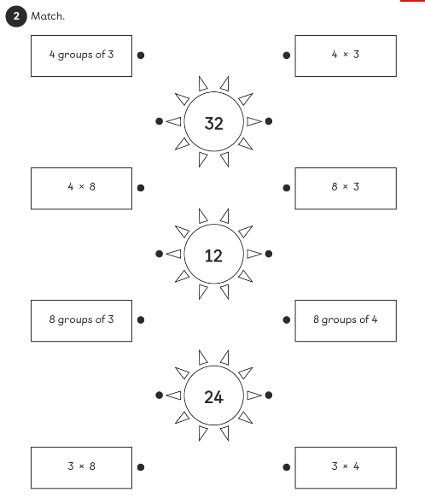
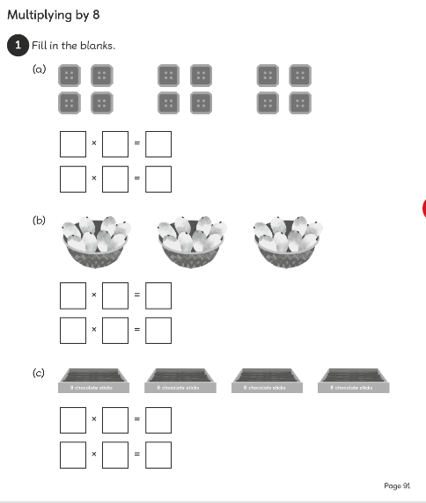
Page 91 - 92

Slide 10
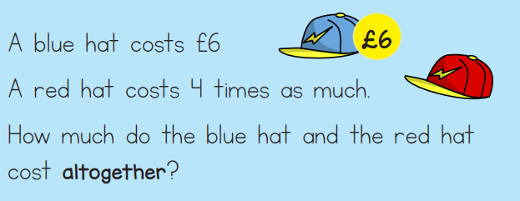
Extension
8
£8
£8
8 x 5 =
8 + 8 + 8 =
8 x 6 – 8 =
8 X 4 + 8 =

