Slide 1
Recap
What do these letters stand for?
RE

Slide 2
Recap
What do we learn in these lessons?

Slide 3
This term we will explore how believers in the Christian, Muslim and Hindu faith show what they believe.
This lesson we will be exploring Christianity.

Slide 4
Teach
What do Christians wear
What symbols are
Some symbols belong to religions

Slide 5
Christianity
What is a symbol?

Slide 6
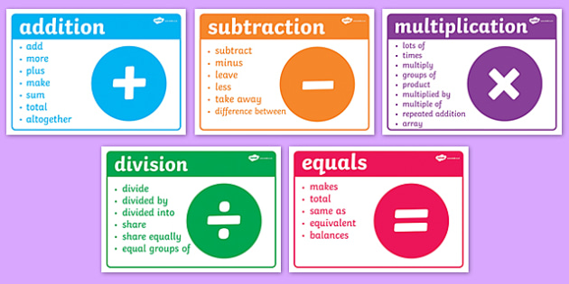
1.
2.
Symbol

Slide 7
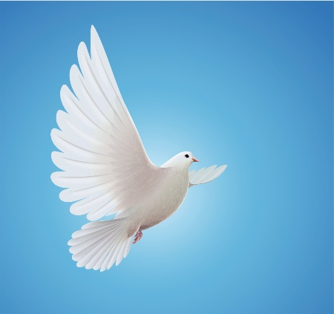
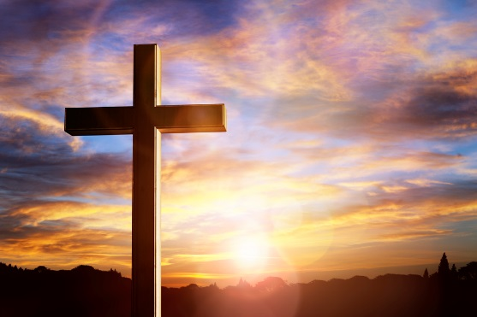
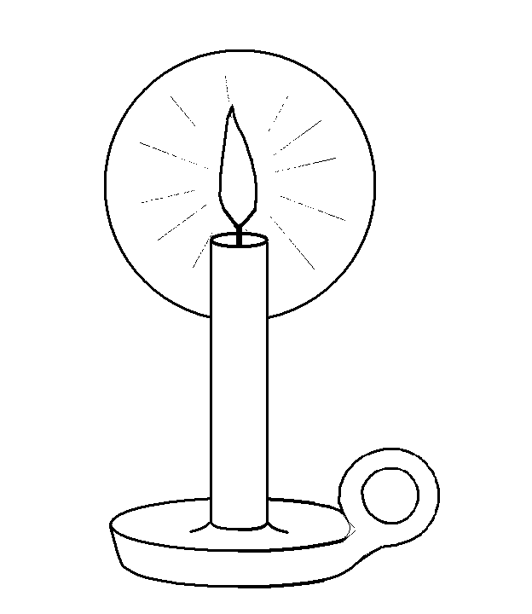
Symbol

Slide 8
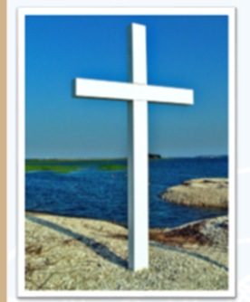
Christianity
Important symbols for Christians….
The fish was a secret sign used by people who weren’t allowed
To be Christians. This symbol secretly showed that a person
Believed in and followed Jesus.
The cross stands for Jesus’ death
Because he died on the cross.

Slide 9
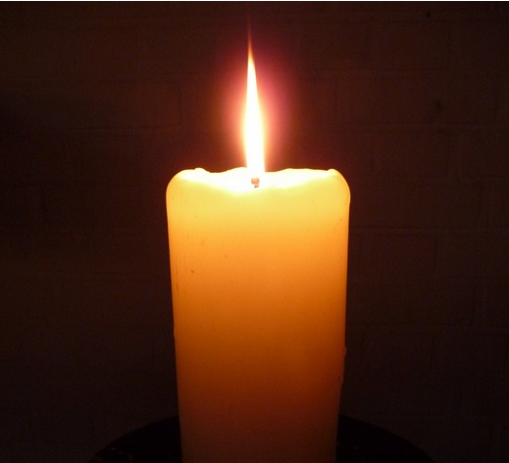
Christianity
Important symbols for Christians….
The dove represents the presence of God in
the form of the Holy Spirit.
The dove is also a sign of peace.
The candle flame is another symbol
as Jesus is known as the light of
the world to Christians and is also
seen as a symbol of hope in sad times.

Slide 10
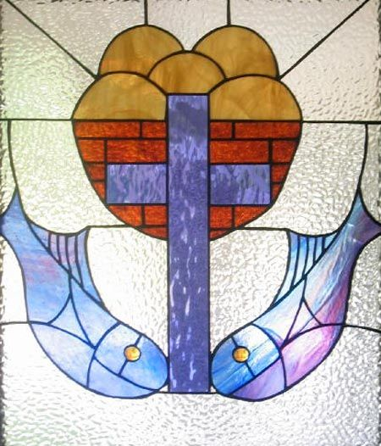
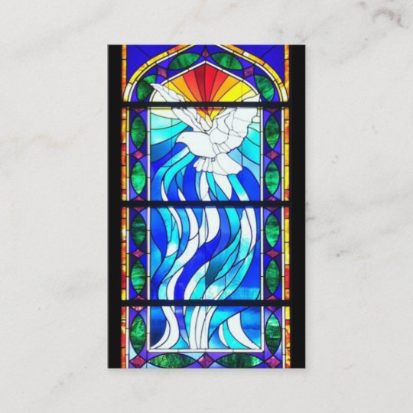
Christianity
Important symbols for Christians…
Within stained glass windows there are many symbols.
What can you see?

Slide 11
Activity
Can you send me a photo of your picture to nwatts@peelpark.bradford.sch.uk

Slide 12
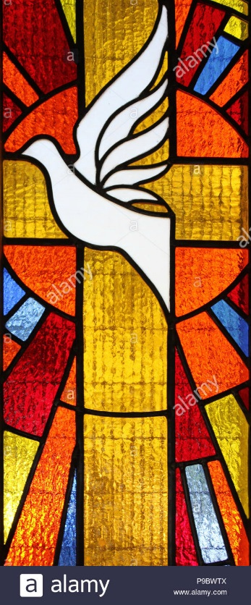
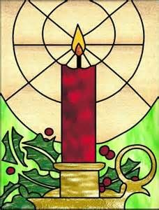
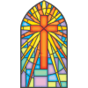
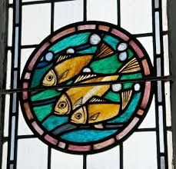
Examples

