Slide 1
First turn the volume on!
2.
1.

Slide 2
To start the PowerPoint follow these steps…
1.
2.

Slide 3
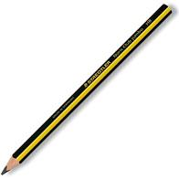
Are you organised?

Slide 4
24.9.20

Slide 5
Maths Drill
What is the missing number? How do you know?
21
20
1

Slide 6
Maths Drill
What is the missing number?
48
40
8

Slide 7
Maths Drill
What is the missing number?
52
50
2

Slide 8
Maths Drill
What is the missing number?
64
50
14

Slide 9
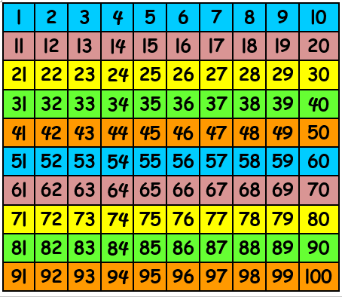
Counting

Slide 10
Number of the Day.
12
Half
double
partition
Add 7
Subtract 2
Challenge
How many ways can you complete this number sentence?
___ + ____ = 12

Slide 11
Number of the Day - answers.
12
Half
double
partition
Add 7
Subtract 2
6
Challenge
How many ways can you complete this number sentence?
1 + 11 = 12
2 + 10 = 12
3 + 9 = 12
4 + 8 = 12
10
24
12
19
5 + 7 = 12
5
7

Slide 12
Word of the day
greater

Slide 13
Greater Than and Less Than.

Slide 14
Greater Than and Less Than.

Slide 15
Which plate will he eat?

Slide 16
Which plate will he eat?

Slide 17
Which plate will he eat?

Slide 18
Which plate will he eat?

Slide 19
Which plate will he eat?

Slide 20
Which plate will he eat?

Slide 21
Which plate will he eat?

Slide 22
Which plate will he eat?

Slide 23
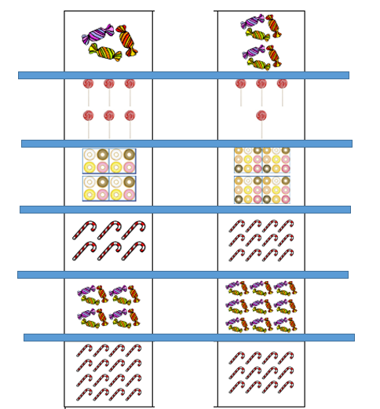
Task: Which side has the greater amount?
1.
2.
3.
Greater
1.
4.
5.
6.

Slide 24
Task: answers
1.6
2.6
3.24
4.12
5.27
6. 16
1.
2.
3.
4.
5.
6.

Slide 25
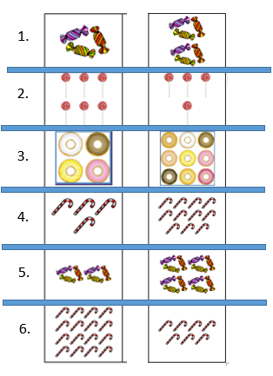
Task: Which side has less?
Less
1.

Slide 26
Answers
Task: Which side has less?
3
4
4
5
6
7

