Slide 1
Monday 23rd November 2020
Editing your Hot Task
English

Slide 4
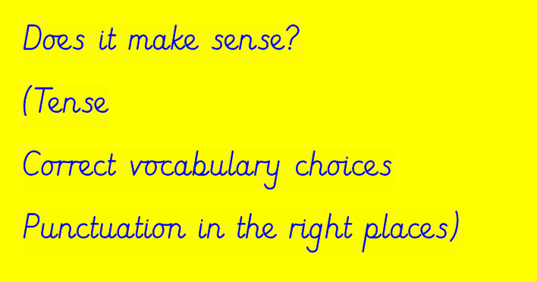

Slide 5
