Slide 1
Raw and Synthetic Materials
YEAR THREE
AUTUMN 2

Slide 2
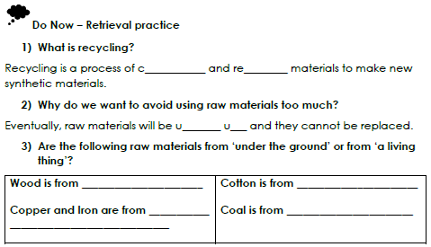

Slide 3
LESSON SIX What does it mean to live sustainably?

Slide 4
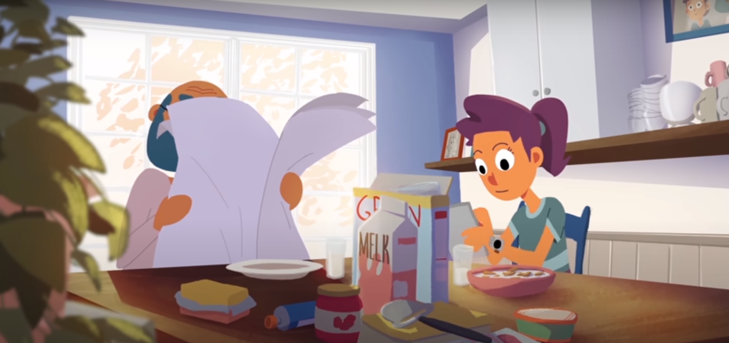
Notes:
https://www.youtube.com/watch?v=RMx3bcTlxqY

Slide 5
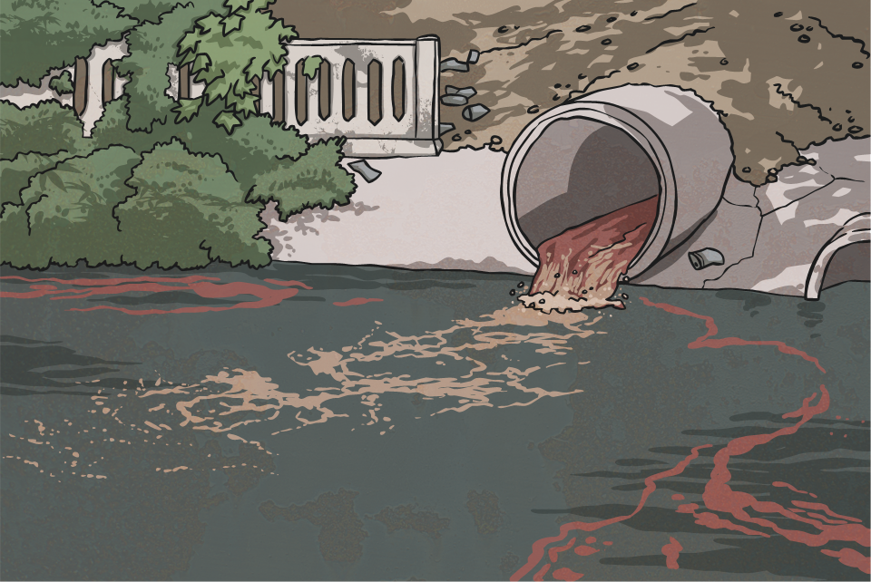

Slide 7
Continue reading about living sustainably

Slide 9
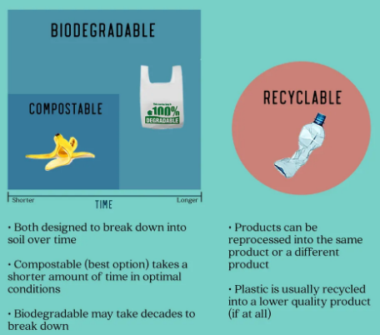
Continue reading about living sustainably

Slide 12
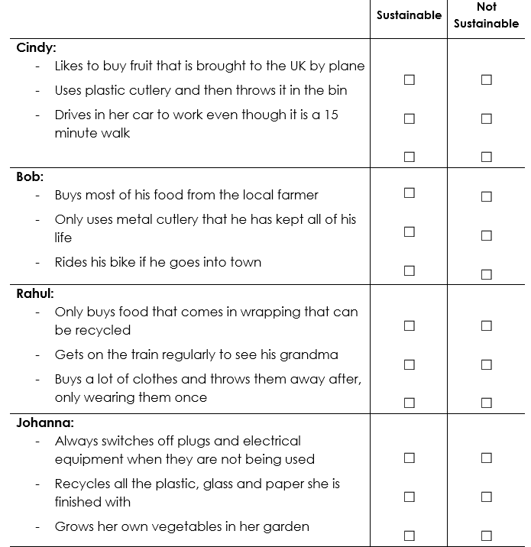

Slide 13
Who is more sustainable? Explain your answer.

Slide 15
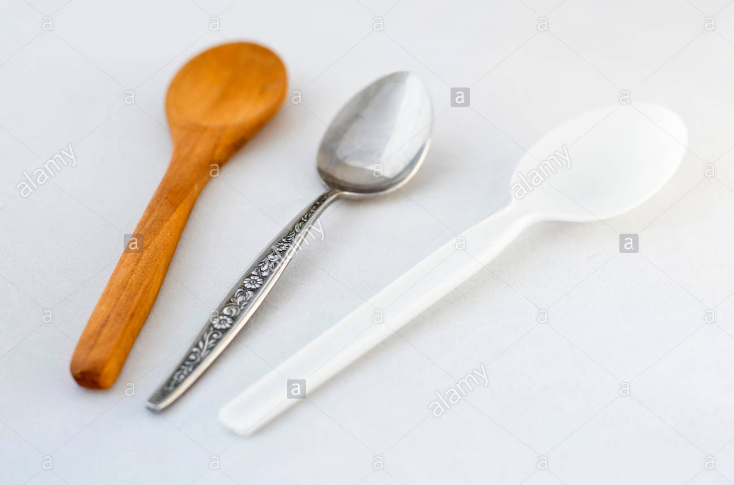
Wooden spoon
Metal spoon
Plastic spoon
Notes:
This is an opportunity for a form of debate where students are able to decide which they think is best and why.
It is perhaps best to draw the conclusion that it depends on circumstance – cutlery used at home is best to be metal for durability but disposable cutlery should be wood based if thrown away or plastic if it disposed of

Slide 16
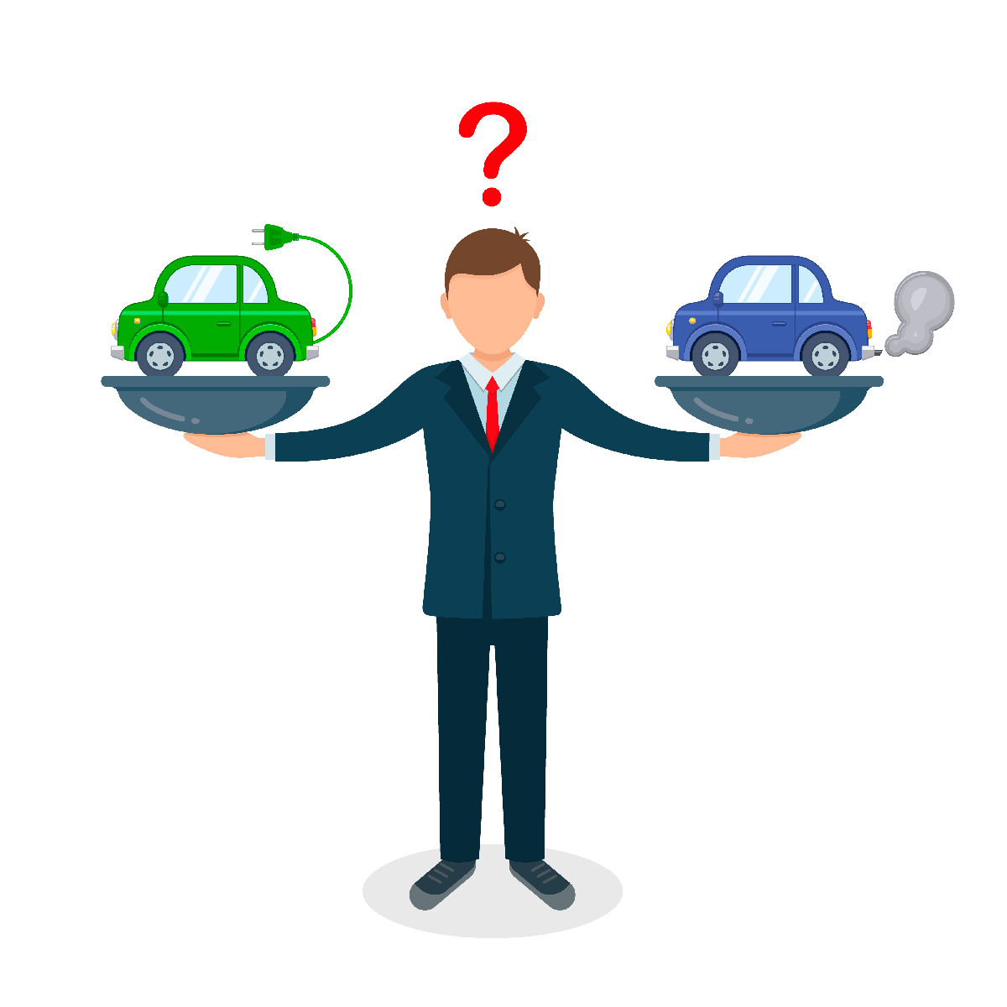
Notes:
Make the point that sometimes people have to drive and they don’t have a choice (i.e. if they need to pick people up or live in the countryside) but that it uses less fuel per person to take the train or a bus.
Also, using electricity from wind power or solar energy would be ok because it does not use up raw materials to do that

