Slide 1
Maths
Tuesday 10th November

Slide 2
Maths Drill
10 less than 460
100 less than 734
1 more than 349
10 more than 283
462 + 30 =
196 – 50 =
Partition 372
400 + 30 + 21 =

Slide 3
Maths Drill
10 less than 460 450
100 less than 734 634
1 more than 349 350
10 more than 283 293
462 + 30 = 492
196 – 50 = 146
Partition 372 300 + 70 + 2
400 + 30 + 21 = 451

Slide 4
Subtract Using Renaming
Reduce the tens
Increase the ones
Subtract ones, tens then hundreds

Slide 5
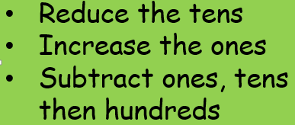
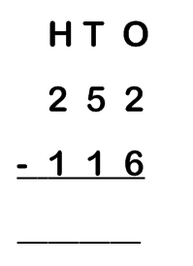
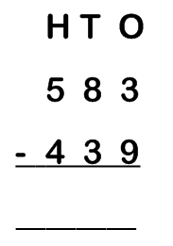

Slide 6
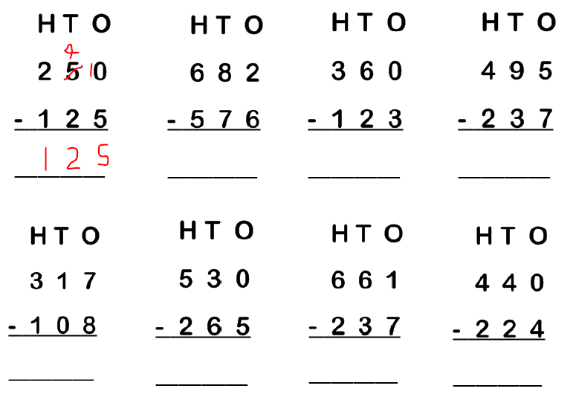

Slide 7
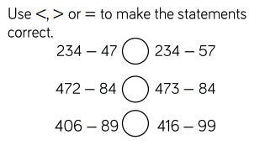
Challenge
Explain in a sentence how you reached each answer.

