Slide 1
Maths
Tuesday 29th September
Place Value Review

Slide 2
Terror Tables
Terror Tables.exe
x 6

Slide 3
80 x 6
12 x 6 =
0.6 x 2
600 x 5
24 divided by 6
7 x 6
60 divided by 6

Slide 4
420
80 x 6
12 x 6 =
72
0.6 x 2
1.2
600 x 5
3000
24 divided by 6
4
7 x 6
42
60 divided by 6
10

Slide 5
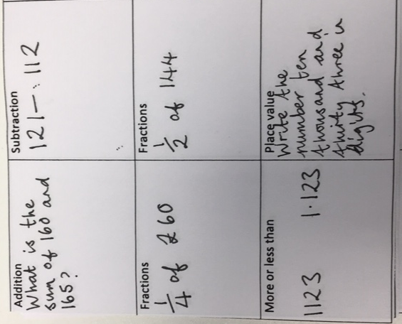

Slide 6
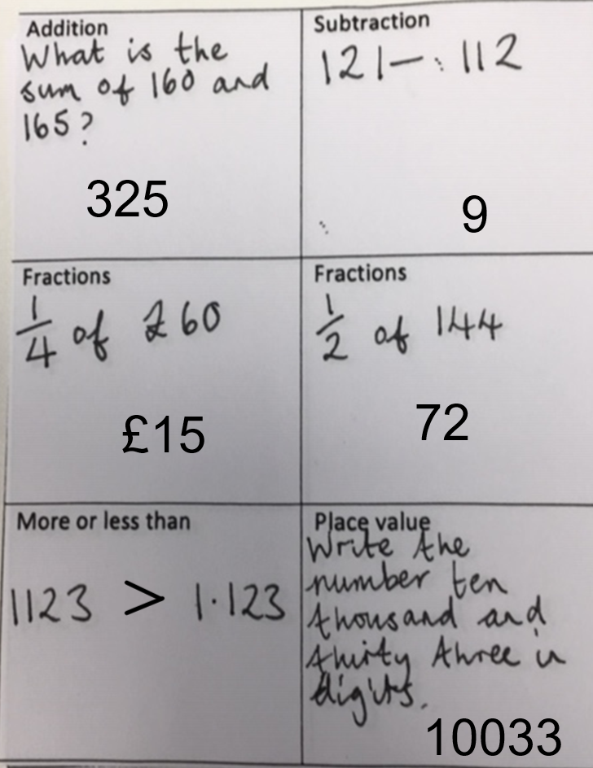

Slide 7
Place value review

Slide 8
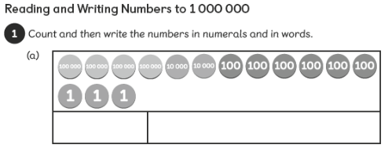
Place Value is...
Comparing numbers
Numbers in numerals and words
Number Patterns
Value of digits in a number
Rounding Numbers
7

Slide 9
Place Value is...
Numbers in numerals and words
Comparing numbers
603
Four hundred and twenty thousand six hundred and three
Number Patterns
Value of digits in a number
7
321000
6
800 000
Rounding Numbers

Slide 10
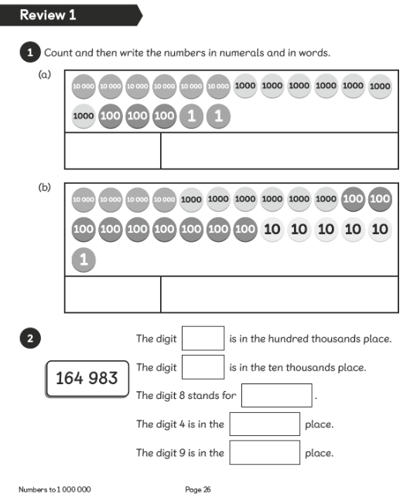
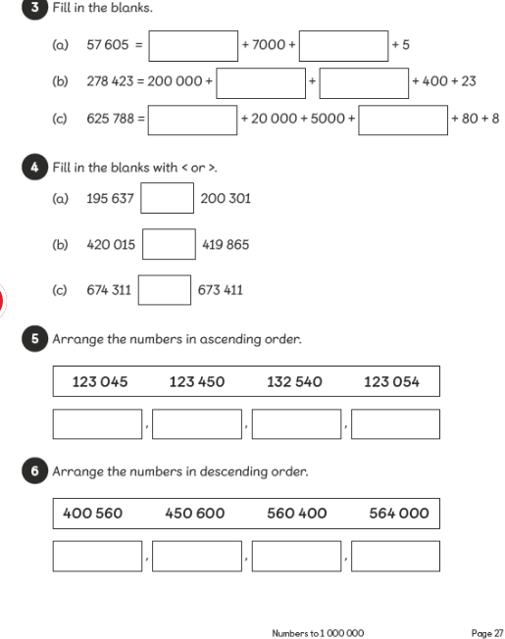

Slide 11
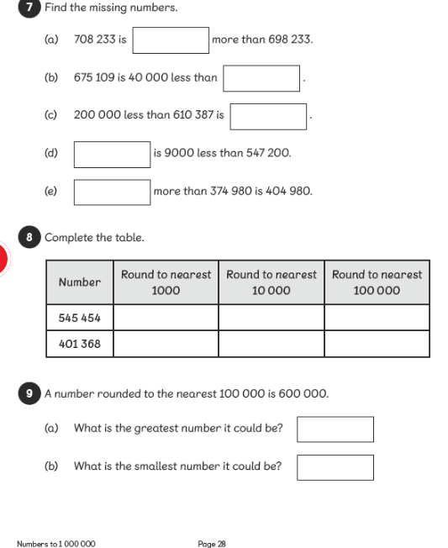

Slide 12
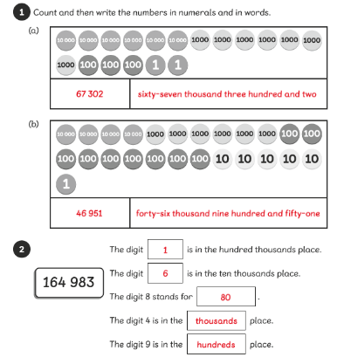
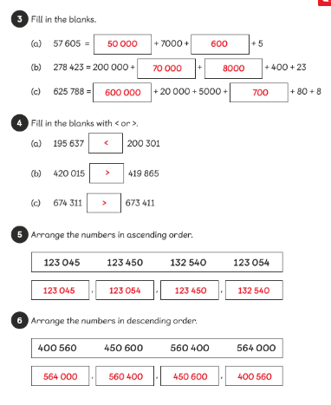

Slide 13
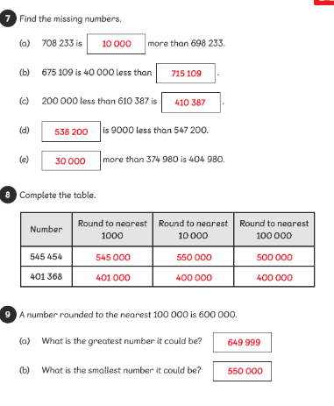

Slide 15
Attachments
Terror Tables.exe

