Slide 1


M1i: Can use negative numbers in context and calculate intervals across zero
Commissioned by The PiXL Club Ltd.
July 2018
This resource is strictly for the use of member schools for as long as they remain members of The PiXL Club. It may not be copied, sold nor transferred to a third party or used by the school after membership ceases. Until such time it may be freely used within the member school.
All opinions and contributions are those of the authors. The contents of this resource are not connected with nor endorsed by any other company, organisation or institution.
PiXL Club Ltd endeavour to trace and contact copyright owners. If there are any inadvertent omissions or errors in the acknowledgements or usage, this is unintended and PiXL will remedy these on written notification.
© Copyright The PiXL Club Limited, 2018

Slide 2
Vocabulary: using negative numbers
positive
negative
increase
decrease
difference
Teacher’s Note:
See ‘Vocabulary Shorts’ resource below for ideas and games to develop and embed vocabulary.
Vocabulary Shorts
Notes:
To locate Vocabulary Shorts resource click on:
Currency
Whole School Materials
English
Writing
PiXL Vocabulary
Vocabulary Shorts PP

Slide 3
Can use negative numbers in context and calculate intervals across zero
Remember:
Positive numbers are numbers which are greater than zero.
Negative numbers are numbers which are smaller than zero.

Slide 4

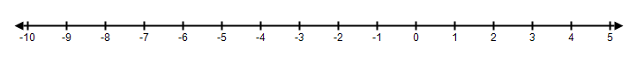
Can use negative numbers in context and calculate intervals across zero
Using a number line
This number line shows the numbers from -10 to 5.
Remember, on a horizontal line the numbers get smaller as we move to the left.
We can see on the number line that -9 is smaller than -6.

Slide 5
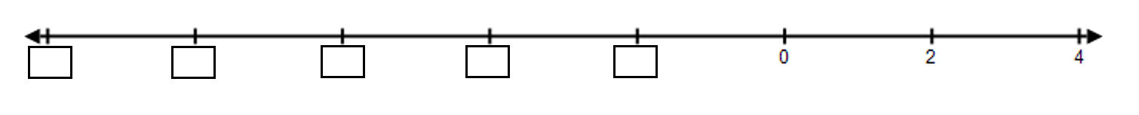
Can use negative numbers in context and calculate intervals across zero
Missing Values
What are the missing values in the following number line?
We can see from the positive numbers that the number line goes up in 2s.
Therefore, the number to the left of 0 must be -2, the next one -4, then -6 etc.
Therefore, the number line will look like this:

Slide 6
Can use negative numbers in context and calculate intervals across zero
Using number lines to add and subtract
We can use number lines to help us add and subtract with negative numbers.
Let’s look at some examples…

Slide 7
Can use negative numbers in context and calculate intervals across zero
Using number lines to add and subtract
Using the number line below, work out the difference between -5 and -2
To find the difference between -5 and -2, we need to count how many steps there are from -5 to -2 (shown by the blue arrows).
We can see that we have gone up 3 steps.
Therefore: The difference between -5 and -2 is 3.
+1
+1
+1

Slide 8

Can use negative numbers in context and calculate intervals across zero
Your turn
Using the number line below, work out the difference between:-
-8 and -1
-6 and 1
-5 and 0

Slide 9

Reasoning
Seb says -8 is bigger than -4. Explain where he has gone wrong.

Slide 10
Can use negative numbers in context and calculate intervals across zero
Finding missing numbers in sequences
Find the missing number in the sequence:
5 | 1 | ? | -7 | 11
To answer this question, we first need to find the difference between
1 and -7. Let’s use a number line to help us….
The difference between 1 and -7 is 8. But we’re not finished yet…
Notes:
Count the steps together using the number line.

Slide 11
Can use negative numbers in context and calculate intervals across zero
But we have gone from 1 to -7 in two steps. Therefore the step size must be 4. We also know the numbers are getting smaller.
5 | 1 | ? | -7 | 11
-3
Therefore to find the missing number, we need to work out 1 – 4. Let’s use a number line to help :
We can see from the number line that if we are at 1 and subtract 4, we get -3. Therefore the missing number in the sequence is -3.

Slide 12
Can use negative numbers in context and calculate intervals across zero
Your turn
Find the missing number in each sequence:
-8 | ? | -2 | 1 | 4
-4 | ? | -10 | -13 | -16

Slide 13
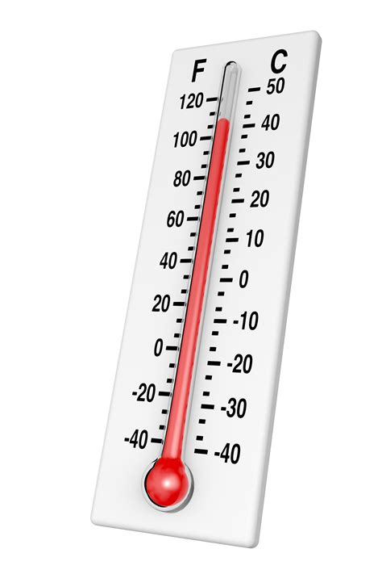
Can use negative numbers in context and calculate intervals across zero
Vertical number lines
It is important to remember that number lines are not always horizontal. You will sometimes see vertical number lines, especially when we are talking about temperatures. Think of them looking like thermometers.
Let’s look at some examples…

Slide 14
Can use negative numbers in context and calculate intervals across zero
Vertical number lines
+5
Start at +5
+4
During the day the temperature reached 5ºC but at night the temperature dropped to -4ºC. By how much did the temperature drop?
+3
+2
+ 1
0
Count how many steps there are from +5 to -4.
– 1
– 2
– 3
Finish at -4
Using this vertical number line, we can see that if the temperature dropped from 5˚C to -4˚C, it dropped by 9˚C.
– 4
– 5

Slide 15
Can use negative numbers in context and calculate intervals across zero
+5
Your turn
+4
+3
Finish at +2
The temperature in Leeds is -3ºC. In London it is 5ºC warmer. What is the temperature in London?
+2
+1
0
– 1
Count up 5 steps.
– 2
Start at -3
– 3
– 4
Starting at -3, and counting up 5 steps, we can see that the temperature in London will be 2ºC.
– 5

Slide 16
Can use negative numbers in context and calculate intervals across zero
Your turn
+50
+40
An underwater vehicle is below sea level at -40m. It is lifted onto the deck of a boat which is above sea level at +10m. How far does it go up? Use the number line to help.
+30
+20
+10
0
We can see on the number line that from -40 to 10 is 5 steps. Be careful: these are steps of 10, not steps of 1 as in the previous question!
– 10
– 20
– 30
– 40
Therefore, the underwater vehicle went up 50m.
– 50

Slide 17
Problem Solving
I measured the temperature outside in the morning. By evening the temperature had fallen by 5 degrees and was below freezing point. What could both of the temperatures have been?

Slide 18

Can use negative numbers in context and calculate intervals across zero
Your turn: adding negative numbers
The temperature is -12ºC. It rises by 7 degrees.
What is the temperature now? Use a number line to help!
If the temperature rises by 7 degrees, it means it is getting warmer so we must add 7 to -12.
-12 + 7 = -5
Therefore, the temperature is -5ºC.
Notes:
Note: for support with adding and subtracting negative numbers, you may wish to use a vertical or horizontal number line or a thermometer.

Slide 19
Can use negative numbers in context and calculate intervals across zero
Your turn: subtracting negative numbers
The temperature is -7ºC. It falls by 8 degrees. What is the temperature now? Use a number line to help you!
If the temperature falls by 8 degrees, it means it is getting colder so we must subtract 8 from -7. The new temperature will therefore need to be lower than -7ºC.
-7 – 8 = -15
Therefore, the temperature is -15ºC.
Notes:
Note: for support with adding and subtracting negative numbers, you may wish to use a vertical or horizontal number line or a thermometer.

Slide 20
Can use negative numbers in context and calculate intervals across zero
Your turn: calculating the difference between negative numbers
The lowest recorded temperature in Antarctica was -89ºC. The average temperature in Antarctica is -57ºC. What is the difference between these two temperatures?
This problem is a bit trickier! Discuss how you would approach this problem.
Notes:
Note: for support with adding and subtracting negative numbers, you may wish to use a vertical or horizontal number line or a thermometer.
Guide pupils towards the fact that the difference between -89 and -57 will be the same as the difference between 89 and 57.

Slide 21
Can use negative numbers in context and calculate intervals across zero
What ideas did you come up with?
The lowest recorded temperature in Antarctica was -89ºC. The average temperature in Antarctica is -57ºC. What is the difference between these two temperatures?
If you look at -89 and -57 on a number line, you can see that the difference between the two numbers is exactly the same as the difference between 89 and 57. We can easily work out the difference between 89 and 57…
89 – 57 = 32
Therefore, the difference between -89ºC and -57ºC is 32ºC.
Notes:
Note: for support with adding and subtracting negative numbers, you may wish to use a vertical or horizontal number line or a thermometer.

Slide 22
Can use negative numbers in context and calculate intervals across zero
Your turn: calculating the difference between negative numbers
At the end of the month Jim’s bank balance was £52. Alex’s was -£108. Who had the most money? How much more?
This problem is tricky again! Discuss how you would approach this problem.
Notes:
Note: for support with adding and subtracting negative numbers, you may wish to use a vertical or horizontal number line or a thermometer.

Slide 23
Can use negative numbers in context and calculate intervals across zero
What ideas did you come up with?
At the end of the month Jim’s bank balance was £52. Alex’s was -£108. Who had the most money? How much more?
To get from -108 to 0, we add on 108. To get from 0 to 52, we add on 52. Therefore in total we have added on 108 + 52 = 160
Jim has the most money as Alex is overdrawn.
The difference between -£108 and £52 is £160.
Notes:
Note: for support on adding and subtracting negative numbers, you may wish to use a vertical or horizontal number line or a thermometer.

Slide 24
Reasoning
The answer is -12 degrees. Make up some calculations that will give this answer.

Slide 25
Reasoning
Amy says the difference between -5 and -19 is 24. Is she correct? How do you know?

