Slide 1
Friday Maths

Slide 2
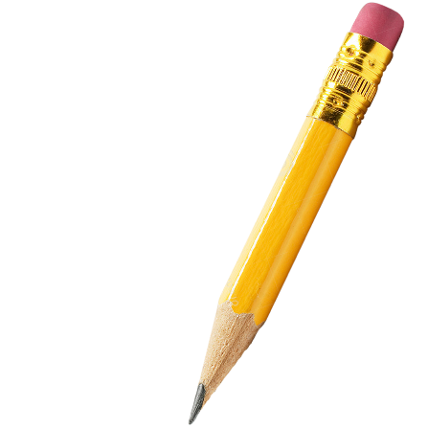
Maths Drill
3 x 3 =
4 x 4 =
5 x 3 =
221 + 321 =
50 + 72 =
100 – 25 =
Challenge:
40 children need 2 pencils each.
There are 10 pencils in one box.
Write down the correct number of boxes of pencils that would be needed.
4 10 2 8

Slide 3
Maths Drill
Challenge:
40 children need 2 pencils each.
There are 10 pencils in one box.
Write down the correct number of boxes of pencils that would be needed.
4 10 2 8
3 x 3 = 9
4 x 4 = 16
5 x 3 = 15
221 + 321 = 542
50 + 72 = 122
100 – 25 = 75
Pencils needed: 40 x 2 = 80
Boxes needed: 80 ÷ 10 = 8
8 boxes are needed.

Slide 4
Multiplying by 4
Add or subtract 4 to find the answers to new times table facts.
Count in 4s to answer times table questions.
Match questions with correct answers.

Slide 5
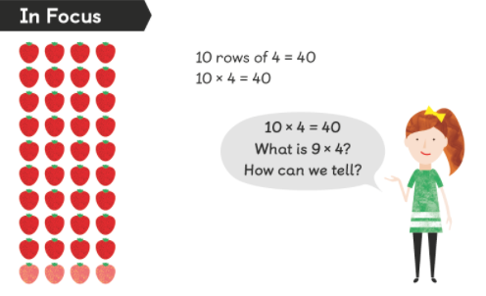
In focus
How have the strawberries been arranged?

Slide 6
4
36

Slide 7
Let’s Learn
4
28

Slide 8
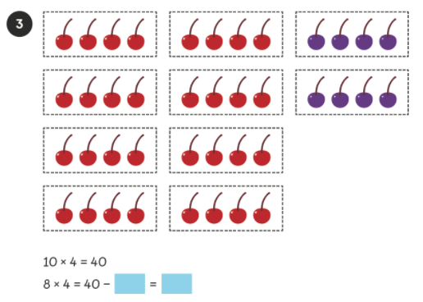
Let’s Learn
8
32

Slide 9
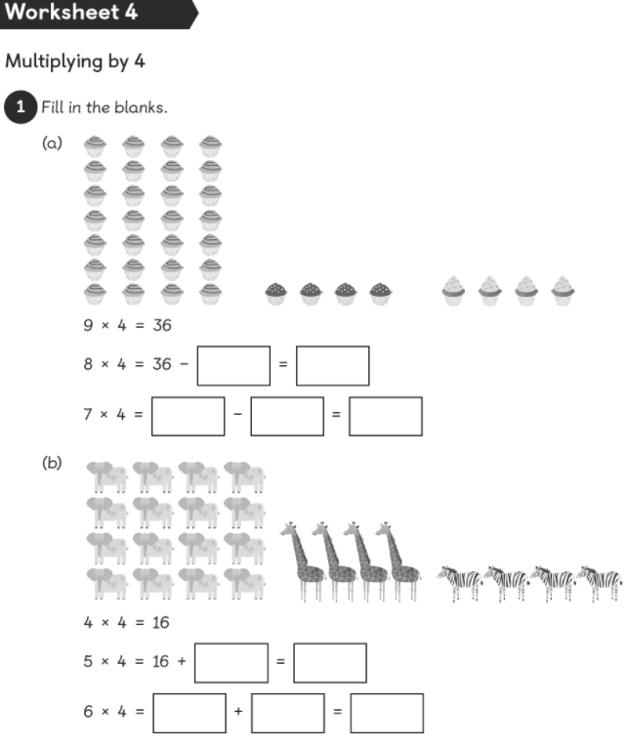
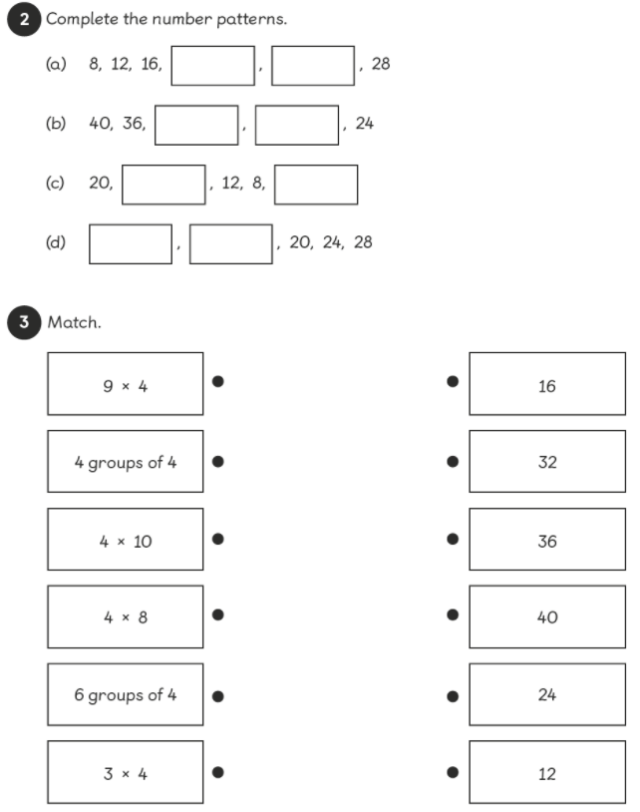

Slide 10
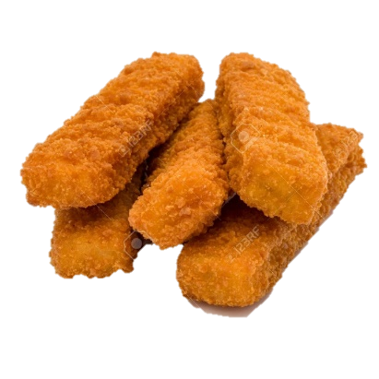
Extension
1. Ben wants to buy 4 lollies for each of his twelve friends.
How many lollies will he need to buy? ____________
2. Tom has 4 friends over for tea. They have 3 fish fingers each.
How many fish fingers does Tom’s mum have to buy for his friends? ___________

